Slide 1
Impact of prostate cancer in a UK African Caribbean population
Professor Frank Chinegwundoh MBE
Consultant Urological Surgeon, London, UK
For the Barcelona health disparities symposium, 10-11 April 2019

Slide 2
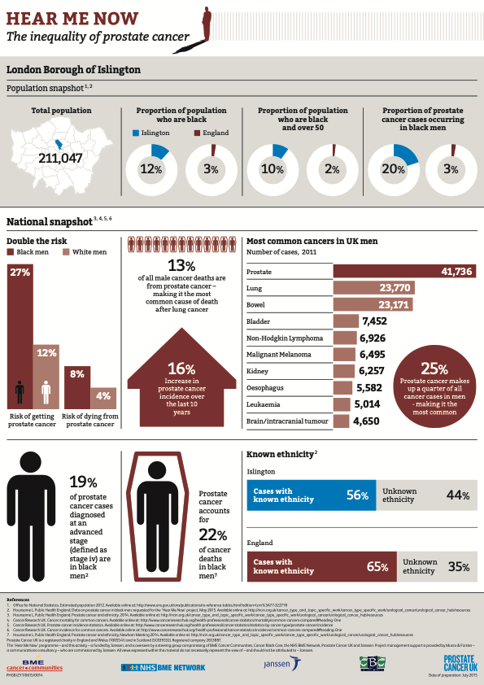

Slide 3
Qualitative research
Barriers and facilitators to healthy lifestyle and acceptability of a dietary and physical activity intervention among African Caribbean prostate cancer survivors in the UK: a qualitative study
Vanessa Er1, J Athene Lane1,2, Richard M Martin1,2,3, Raj Persad4,
Frank Chinegwundoh5,6, Victoria Njoku5, Eileen Sutton1
  BMJ Open October 24, 2017

Slide 4
Black men in UK
x 2 risk ca prostate x2 risk dying
Low awareness
Misconceptions as to diagnosis
Few tested
  Lack of information
  Mistrust
  Threats to masculinity
  Fear of cancer
  Fear of Rx side effect
  Natural treatments

Slide 5
Evidence base
Link fatness with advanced prostate cancer
Physical activity…… less progression
                Less mortality
                Improves side effects of treatment
Suboptimal diets & lifestyle
Many obese
5 a day fruit & vegetables 15-30%
> 50% survivors are inactive

Slide 6
The study
Black men in depth interviews age 52-80
If thought healthy eating pre diagnosis – no need to change
Would eat more tomatoes
Would reduce dairy
  Doctor messaging important
Would exercise. Brisk walk 30 minutes daily

Slide 7
‘social networks and support were important for men in coping with prostate cancer …….. Dietary ……lifestyle changes’
Role of partner/wife
Social support to stay active – group exercises
  Limited by incontinence
  Loss of income
Fears about strenuous exercise
Weight reduction for body image dieting

Slide 8
Life after prostate cancer: A systematic literature review and thematic synthesis of the post‐treatment experiences of Black African and Black Caribbean men
O. Bamidele MSC, BSC ,H. McGarvey PhD, BSC (HONS), PGCTHE, RNT, RN , B.M. Lagan PhD, MSC, BSC, RNT, RGN, RM , N. Ali PhD, MSC, BSC (HONS)
F. Chinegwundoh MBE MBBS, MS, MML (Med Law), FRCS(Eng.), FRCS(Ed), FRCS(Urol), FEBU K. Parahoo PhD, BA, RMN
E. McCaughan PhD, BSC, PGDHE, PGCUT, DIP, ONCOLOGY NURSING, RGN
European J of Cancer Care 2017
Support from wives, peers, church

