Slide 1
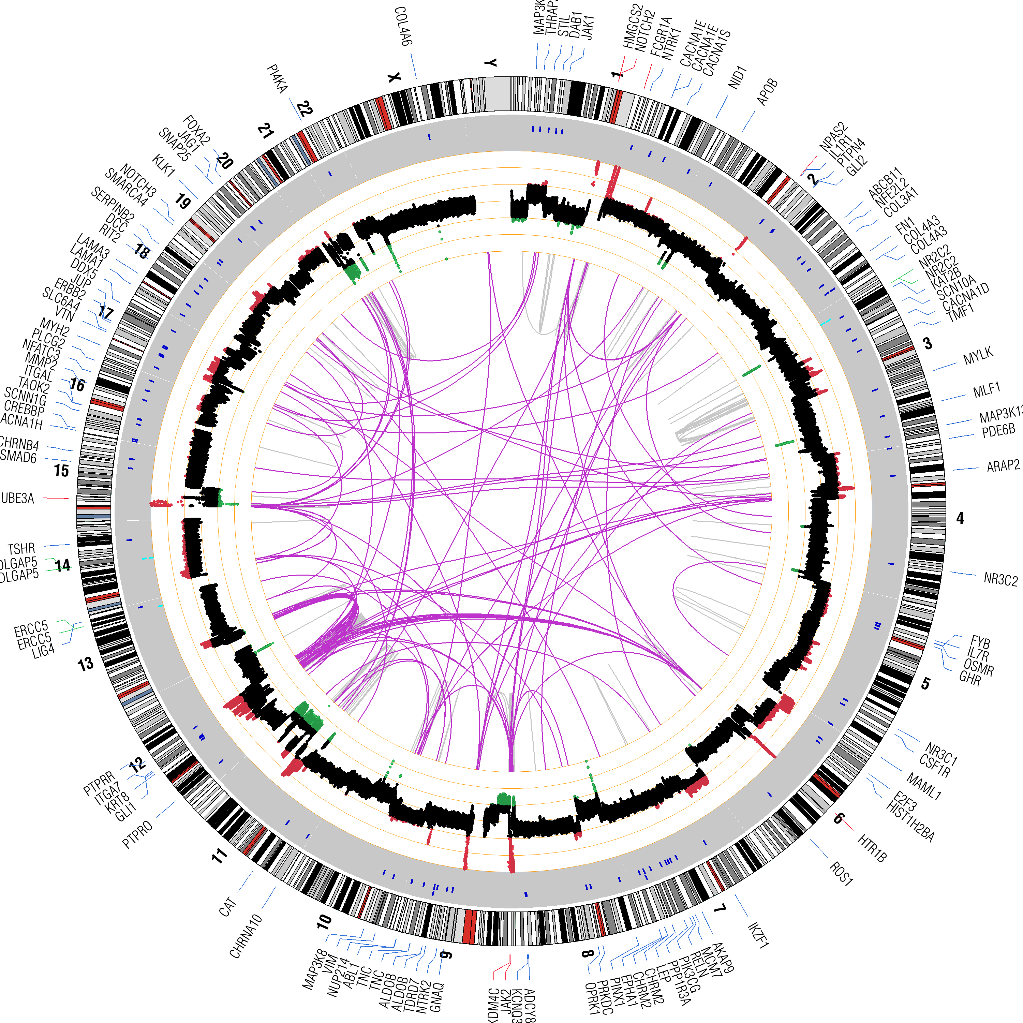
Towards Understanding the Impact of Diversity in Cancer Genome Science
John D. Carpten, Ph.D.
Founding Chair, Department of Translational Genomics
Director, USC Institute for Translational Genomics
USC Translational Genomics

Slide 2
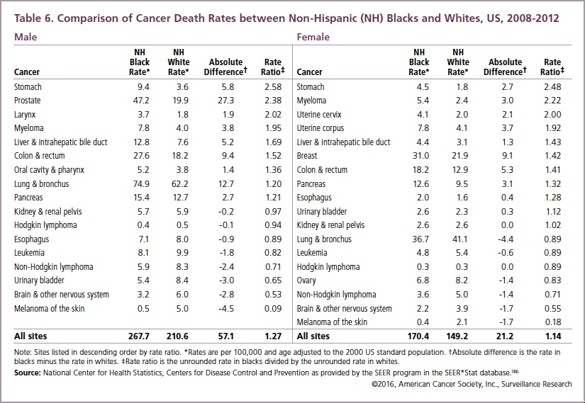
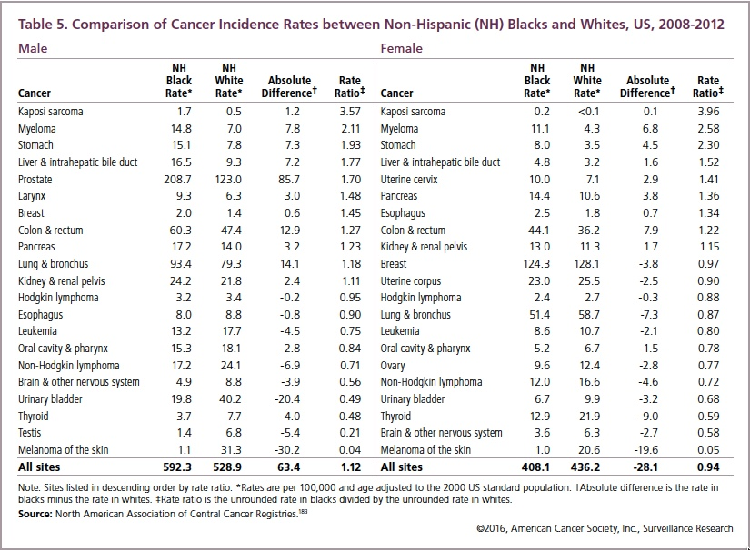
Cancer Statistics and Cancer Disparities
www.cancer.org
USC Translational Genomics

Slide 3
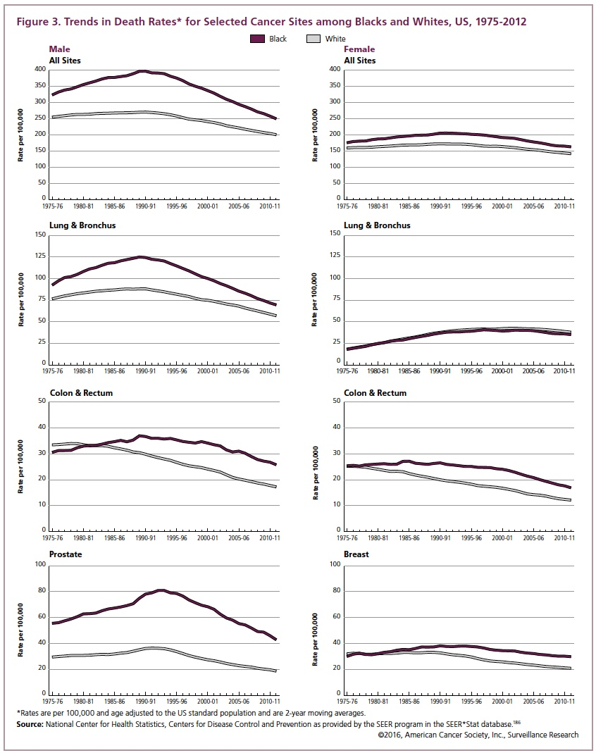
Cancer Statistics and Cancer Disparities
www.cancer.org
USC Translational Genomics

Slide 4


Race and Ancestry Represent Different but Related Factors
Race
(social)
Social/Societal
vs
Biological/Genetic
Tumor/Host
Biology
Ancestry
(genetic)
USC Translational Genomics

Slide 5
Ancestry or Race Can Influence Outcome – DLBCL
Diffuse large B-cell lymphoma (DLBCL) is the most commonly occurring subtype of lymphoma in
the United States.
In 2001, randomized, controlled clinical trials demonstrated that when rituximab (an anti-CD20 antibody immunotherapy) is added to standard CHOP chemotherapy improved complete response (CR) rates from 63% (CHOP alone) to 76% (p= 0.005), and 2-year OS improved from 57% to 70% (p = .007).
Likely no biological differences in disease etiology??
Parra et al. AJHG 1998; Parra et al. AJPA 2002; Kittles et al. unpublished

Slide 6
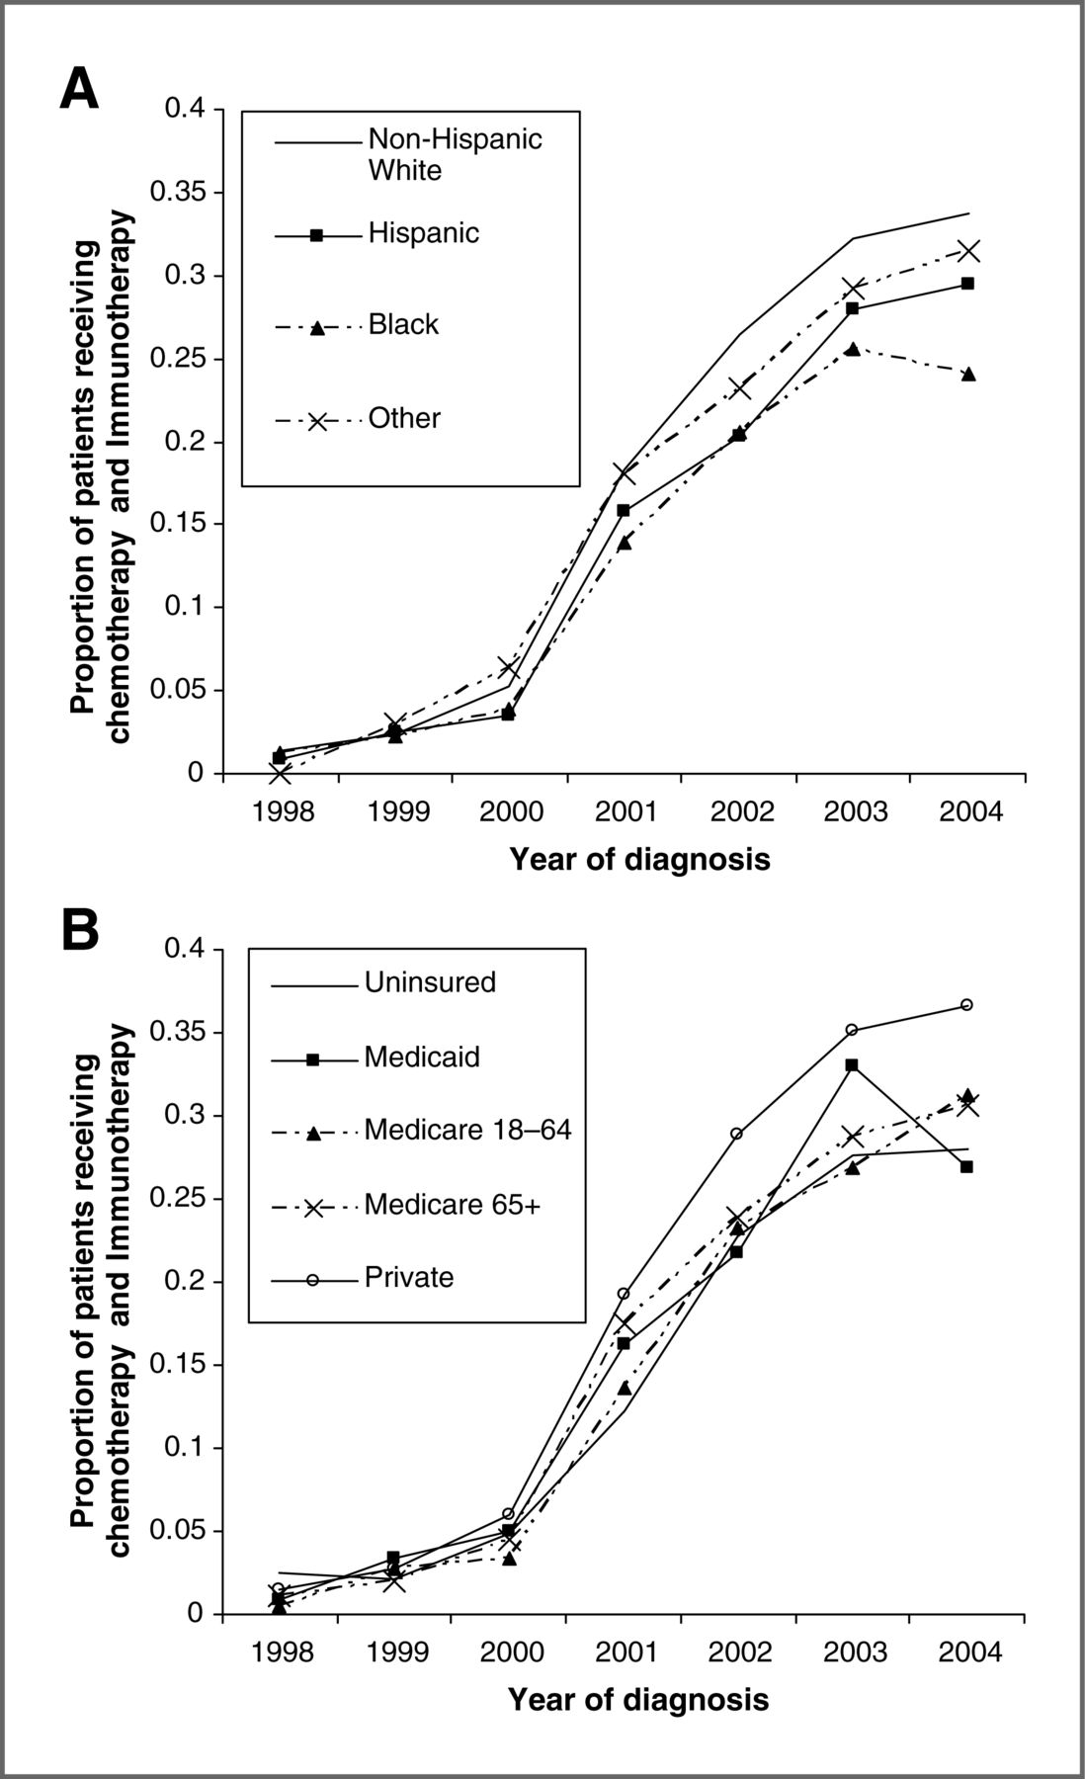
Ancestry or Race Can Influence Outcome – DLBCL
Study of clinical database from 2001-2004 showed a significant trend in increased disparity of receipt of rituximab.
Results indicated that disparities exist in the receipt of recommended chemotherapy and immunotherapy for diffuse large cell lymphoma. Blacks, uninsured and Medicaid-insured patients had lower odds of receiving Rituximab with their chemotherapy.
Even in light of effective and optimal treatment options, will we see equal access??
Receipt of chemotherapy and immunotherapy.
Flowers C R et al. Cancer Epidemiol Biomarkers Prev 2012;21:1520-1530

Slide 7
Precision Medicine – Access
Examined 1,362 from a national cohort of Medicare beneficiaries with incident stage I to III HER2-positive breast cancer.
Reported significant racial disparities in the receipt of trastuzumab for the treatment of Her2 positive breast cancers.
Among women with stage III disease, 74% of whites and 56% of blacks received trastuzumab.
After adjustment for tumor characteristics, poverty, and comorbidity, black women were 25% less likely to receive trastuzumab within 1 year of diagnosis than white women (risk ratio, 0.745; 95% CI, 0.60 to 0.93).
Journal of Clinical Oncology, 2016 Jun 10;34(17):2003-9.

Slide 8

Prostate Cancer
USC Translational Genomics

Slide 9
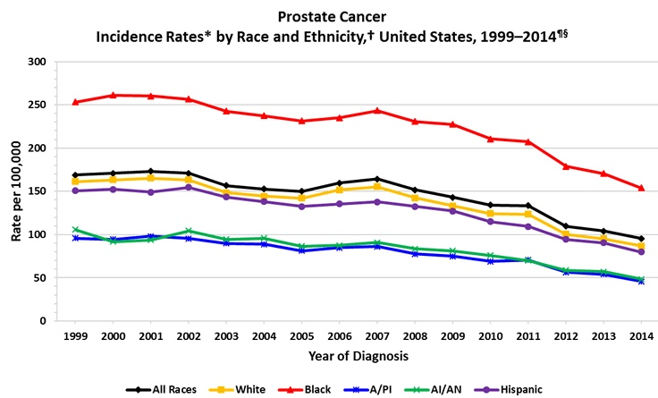
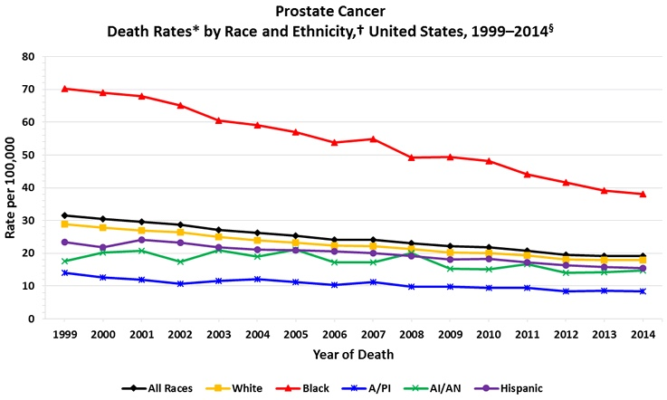
Genomic Studies of Prostate Cancer Disparities
The Cancer Genome Atlas Research Network
Prostate Cancer
https://www.cdc.gov/
USC Translational Genomics

Slide 10
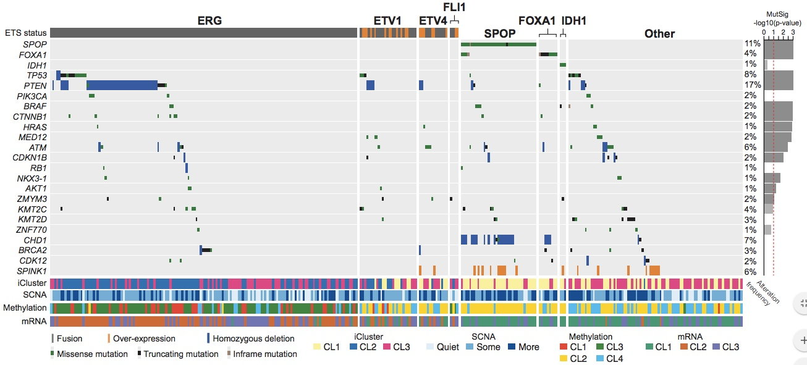
Genomic Studies of Prostate Cancer Disparities
The Molecular Taxonomy of Primary Prostate Cancer
The Cancer Genome Atlas Research Network
Comprehensive molecular analysis of 333 primary prostate carcinomas.
~25 were from African American men!
USC Translational Genomics

Slide 11


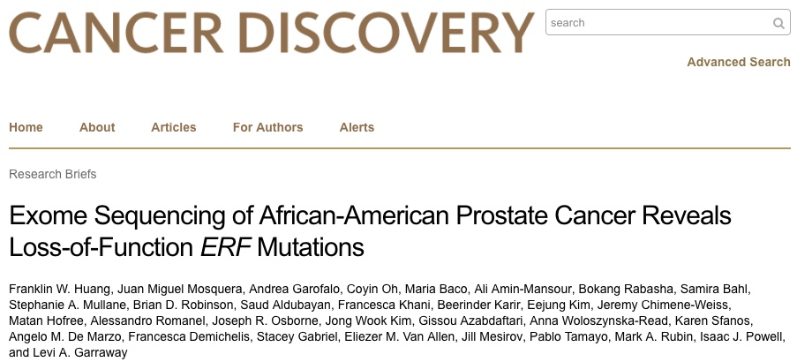
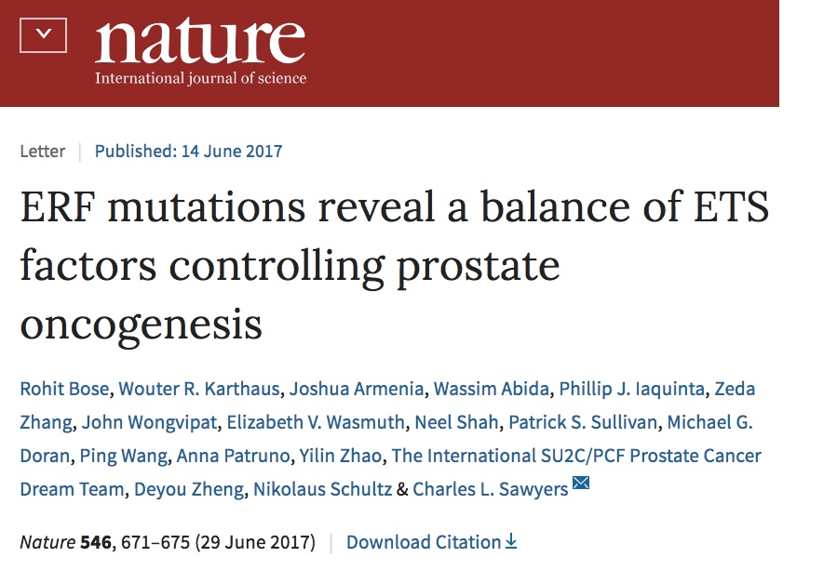
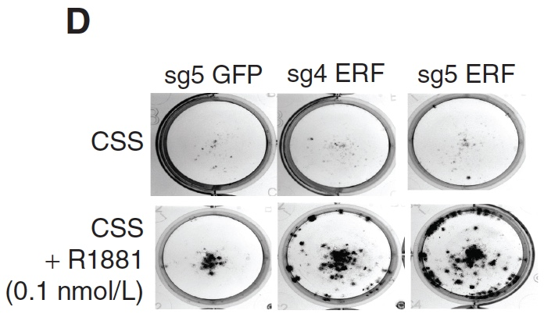
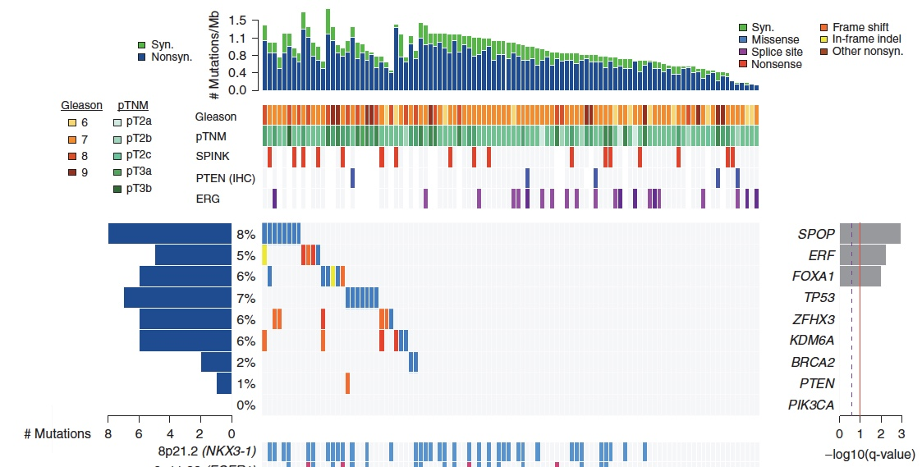
Genomic Studies of Prostate Cancer Disparities
CRISPR-Cas9 knockout of ERF increases clonogenic growth in an androgen-dependent manner in LNCAP cells
Huang et al., Cancer Discovery, 2017, 7(9):973-983.
USC Translational Genomics

Slide 12



Genomic Studies of Prostate Cancer Disparities
A number of commercial tests are now available to provide pretreatment information to help determine risk of aggressive disease or cancer related mortality.
Most tests are based upon gene expression signatures of primary tumors with clinical follow up data.
One issue is that many of the datasets used to define these signatures were from largely European descent cohorts.
Mounting evidence suggests that markers of aggressive prostate cancer in African Americans are unique to those for European descent men.
USC Translational Genomics

Slide 13


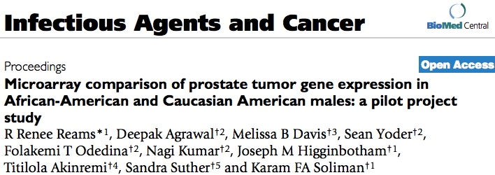
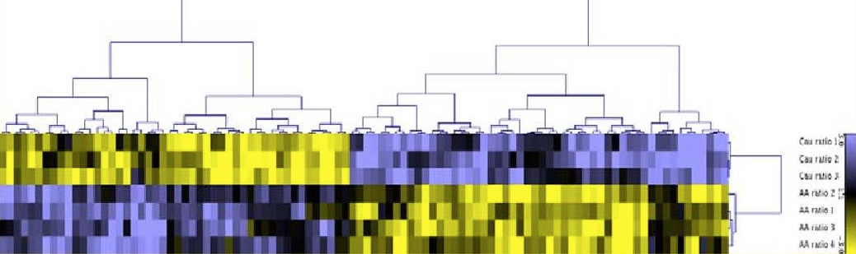
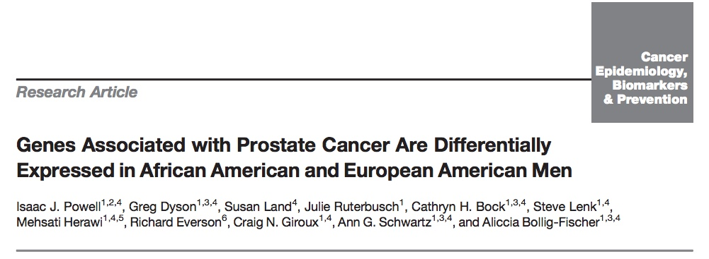

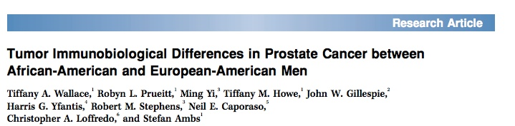
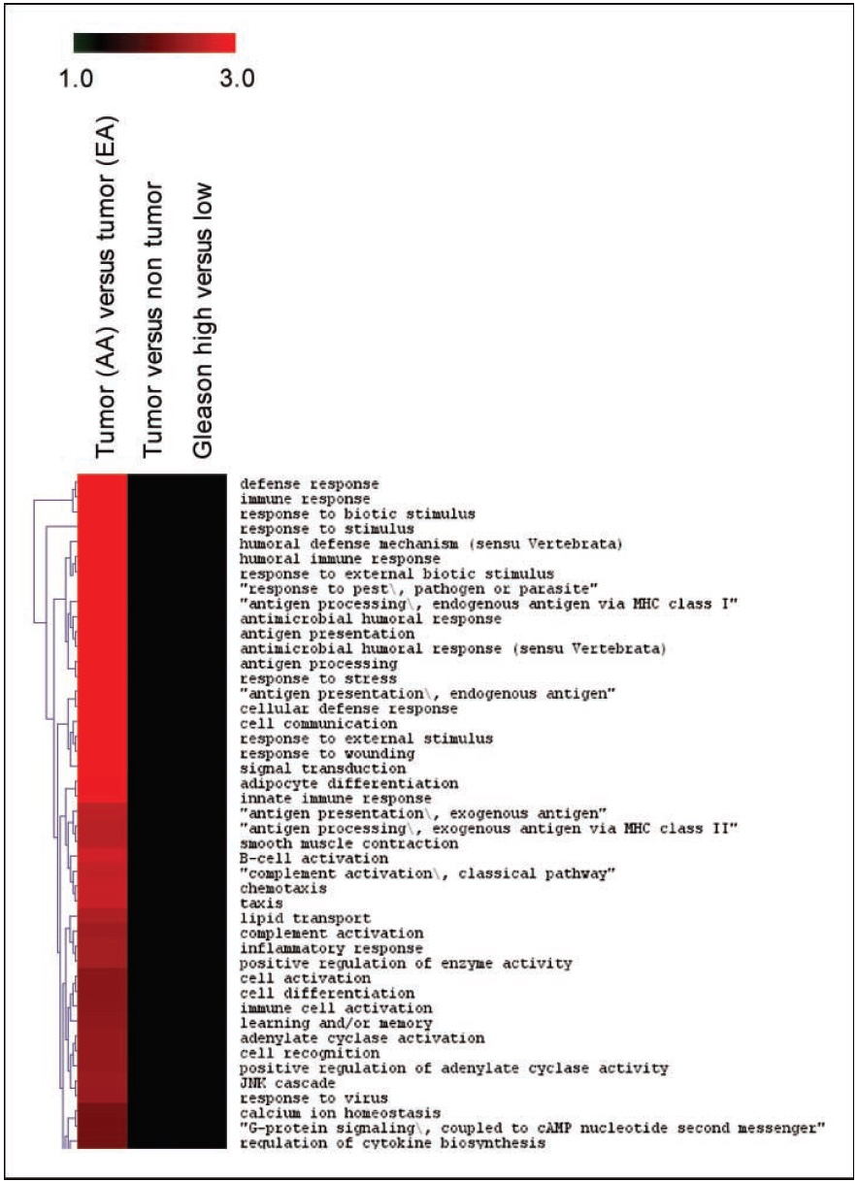
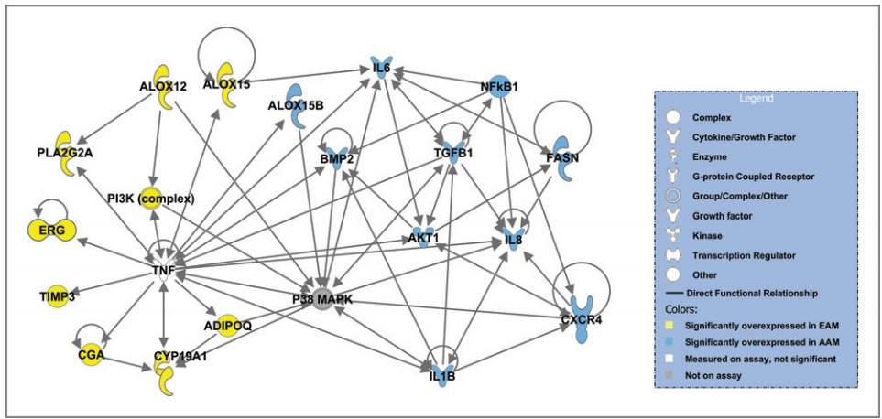
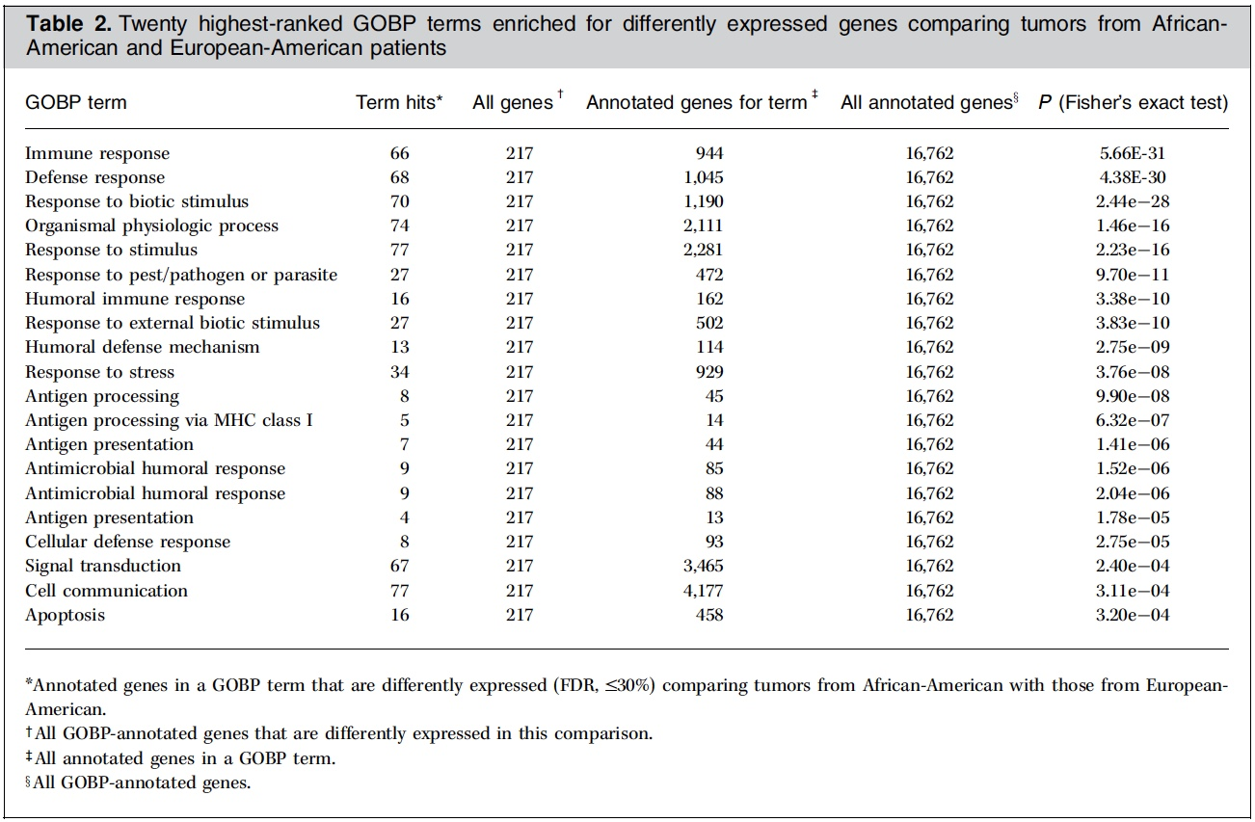
Genomic Studies of Prostate Cancer Disparities
Reams et al., Infect Agent Cancer. 2009;4 Suppl 1:S3.
Wallace et al., Cancer Research, 2008;68(3):927-36.
Powell et al., CEBP, 20013; 22(5): 891–897. .
USC Translational Genomics
Notes:
Gene expression studies comparing prostate tumors from AA men compared to EA men show signatures enriched for inflammatory gene pathways.

Slide 14
Genomic Studies of Prostate Cancer Disparities
Thus, there remains the question of generalizability of currently available gene expression clinical tests for men of African descent.
Will need to assess these tests in large cohorts of African Americans to determine their effectiveness and accuracy in this population of men?
Our hope is that these studies are moving forward quickly to assess this important question in prostate cancer diagnostics/prognostics.
USC Translational Genomics

Slide 15
Genomic Studies of Prostate Cancer Disparities
In the pivotal COU-AA-302 phase III trial randomizing prostate cancer patients to abiraterone/prednisone vs placebo/prednisone for patients with mCRPC, 2.6% (28/1088) patients were black.
Efstathiou et al., Cancer Research 2014;74:CT313-CT.
USC Translational Genomics
Notes:
Same extends to clinical trials where there is a critically low number of blacks in definitive trials for cancers that disproportionately affect this population.

Slide 16

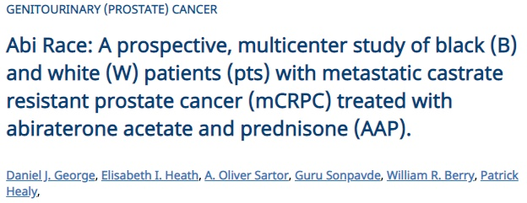
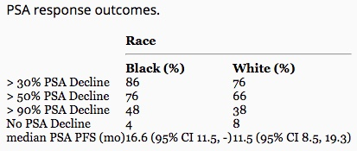
Genomic Studies of Prostate Cancer Disparities
USC Translational Genomics
Notes:
Several studies presented at ASCO 2018 revealed significant differences in outcomes in black versus white men on clinical studies, where black men did better on certain regimens.

Slide 17
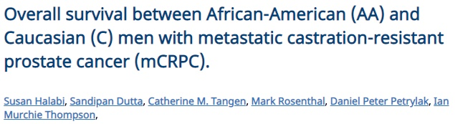
Genomic Studies of Prostate Cancer Disparities
Individual patient data from 8,871 mCRPC men randomized on nine phase III trials to docetaxel/prednisone (DP) or a DP containing regimen were combined.
7,528 (85%) were C, 500 (6%) were AA, 424 were Asian (5%) and 419 (4%) had race unspecified
In multivariable analysis adjusting for established risk factors, the pooled hazard ratio (HR) for AAs vs. Caucasians was 0.81 (95% CI = 0.72-0.92, p-value = 0.001) in all patients.
Observed a statistically significant increased OS in AA vs. C men with mCRPC who were eligible to be enrolled on these clinical trials.
USC Translational Genomics

Slide 18

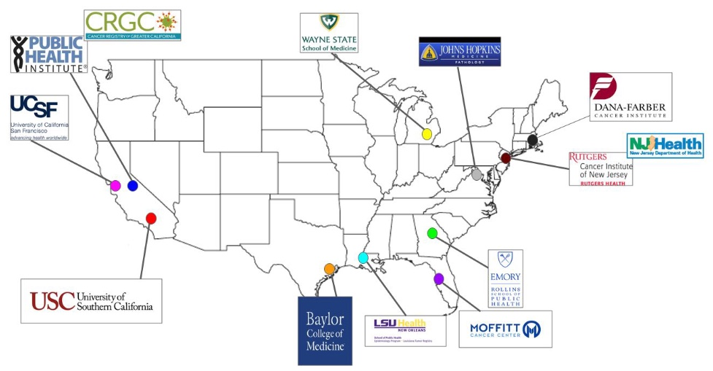
Genomic Studies of Prostate Cancer Disparities
A large, national, population-based cohort
study, RESPOND, (Research on Prostate Cancer in Men of African Ancestry: Defining the
Roles of Genetics, Immunity and Access to Care) of 10,000 AA men with incident PCa identified
through nine SEER and NPCR U.S. cancer registries from states that include 38% of all AA
PCa cases in the U.S.
USC Translational Genomics

Slide 19
Multiple Myeloma
USC Translational Genomics

Slide 20
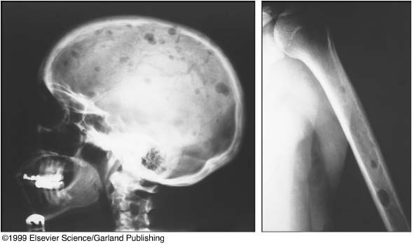
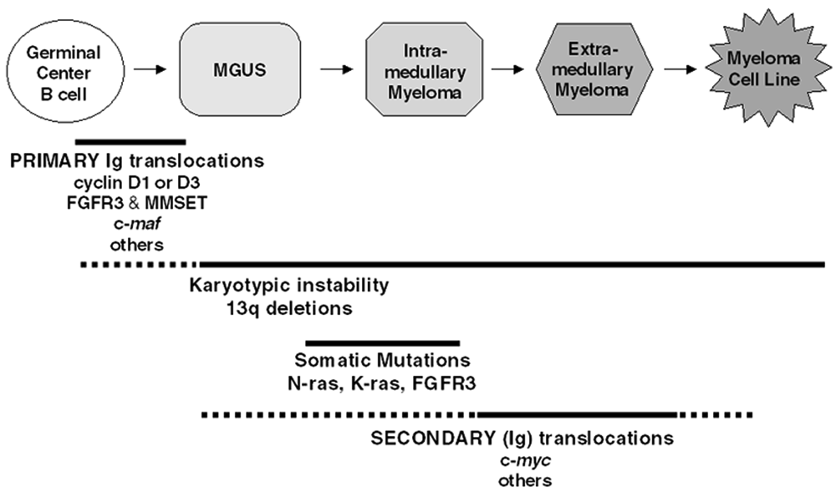
Multiple Myeloma Pathogenesis
Cancer of the plasma cells in the bone marrow leading to bone destruction and bone marrow failure.
~31,000 new Myeloma cases and an estimated ~13,000 deaths attributed.
Historically treated with Dexamethasone and bone marrow transplant.
More recent development of myeloma “block buster “drugs.
  iMids – Lenalidomide
  Proteosome inhibitors – Bortezomib, Carfilzomab
5 year survival rate has increased from 37% to 47% in last 10-15yrs!!
MM is one of the most significant health disparities among African Americans (AA) based upon SEER data.
Dalton W et al, Amer Soc Hematology 2001
USC Translational Genomics

Slide 21
We set out to determine if differences in somatic genomic alterations exist in MM between white and black patients, and if these differences do exist, can they help to explain the MM disparity.
USC Translational Genomics

Slide 22



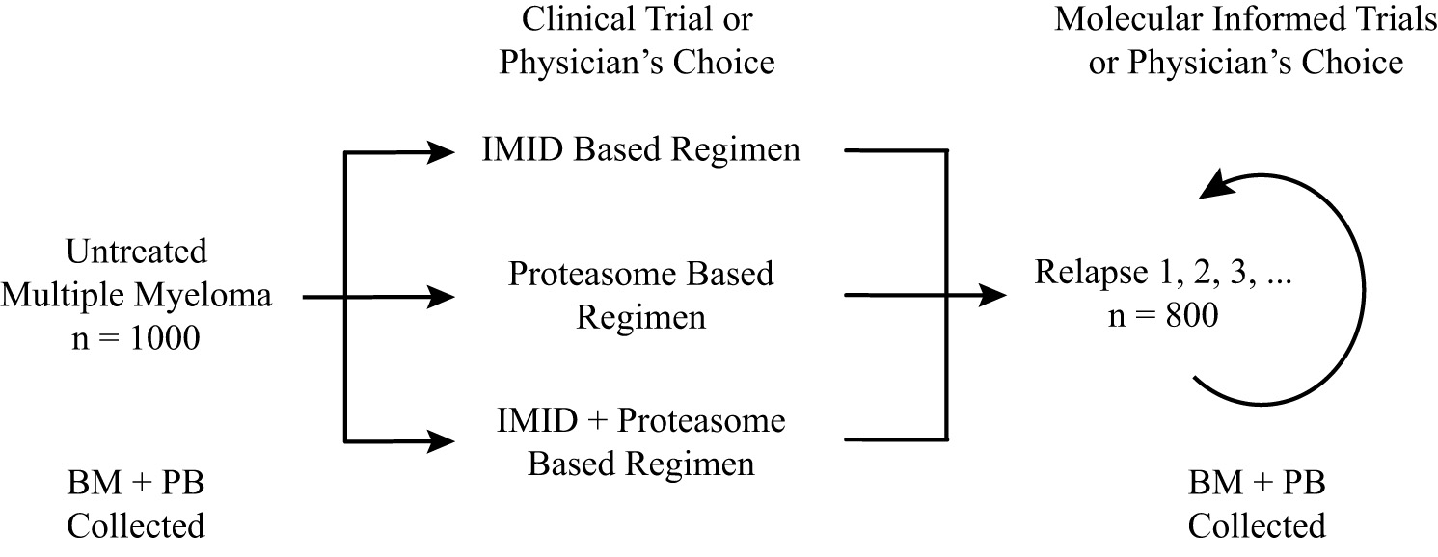
Genomic Studies of Myeloma Cancer Disparities
Jonathan Keats
Angela Baker
Winnie Liang
USC Translational Genomics

Slide 23

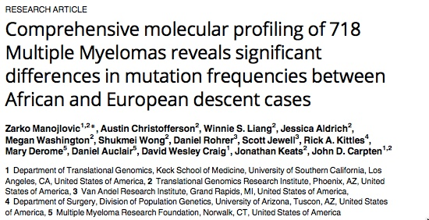
Zarko Manojlovic
USC Translational Genomics

Slide 24
Genomic Studies of Myeloma Cancer Disparities
USC Translational Genomics

Slide 25
Genomic Studies of Myeloma Cancer Disparities
African Ancestry
European Ancestry
African Ancestry AA (n=152)
European Ancestry EA (n=555)
Notes:
The most notable population difference (p<0.0001) was TP53 mutation occurrence, which was more common in EA 5.6% (21/377) compared AA 2.1% (2/93).
PTCHD3 (p = 7.07E-06, q = 3.33E-02) with 8% occurrence in AA compared to only 0.04% in EA. Furthermore, we looked at mutation occurrence difference of at least 5 fold between the two stratified populations. We have identified several additional genes that have higher mutation frequencies in tumors from AA patients including: ANKRD26, BCL7A, BRWD3. Interestingly, majority is implicated in epigenetic regulatory mechanisms.
Moreover, despite the complex karyotype in MM translocations, our analysis demonstrated a lower frequency of 14q32 translocations in tumors from AA patients (10%) compared to tumors from EA patients (37%). These data would independently validate our previously reported differences in 14q32 breakpoints between these two populations.
Ptchd3 is conserved among many organisms, including human, mouse and zebrafish.
It contains a conserved Patched domain and is predicted to have Hh receptor activity.
DAF-6/PTCHD3 is expressed in the glial (sheath) cell that forms the amphid sensory channel (primary cilia), allowing contact of the sensory cilia to the environment through pores in the cuticle
Two types of statistics calculated:
p-calculated using the 2D projection. For each gene, the mutational signal is from the observed nonsilent counts are compared to the mutational estimated background. This is done by calculating how likely it would be by chance for each sample to have a mutation in each category.
q-False discovery rate (q<0.1) it takes the p value and multiplies it by the ratio of total comparisons by total number of groups using Hochber’s procedure.

Slide 26
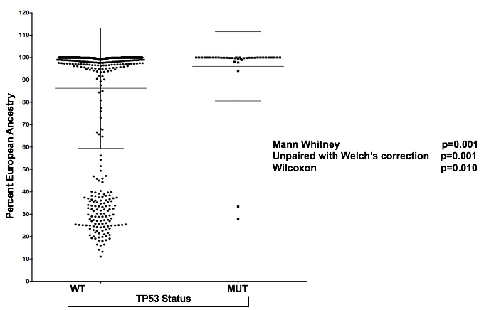
Genomic Studies of Myeloma Cancer Disparities
USC Translational Genomics

Slide 27
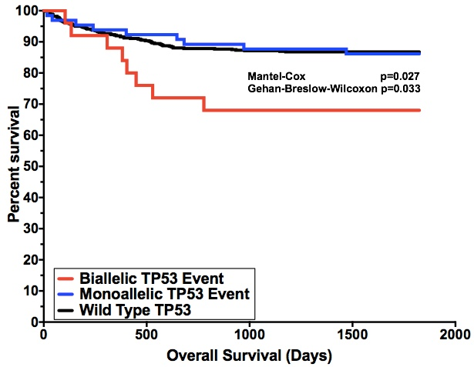
Genomic Studies of Myeloma Cancer Disparities
TP53 Status and MM among AA and CA
USC Translational Genomics

Slide 28
Genomic Studies of Myeloma Cancer Disparities
These data provide the first glimpse into similarities and differences in tumor biology among AA and EA MM patients in a sufficiently powered tumor cohort.
TP53 loss is associated with poor outcome and is enriched in EA cases.
These data suggest that AA MM patients may have tumors with molecular features associated with more favorable outcomes.
Perhaps in MM, equal treatment could lead to similar or better outcomes in AA patients.
USC Translational Genomics

Slide 29
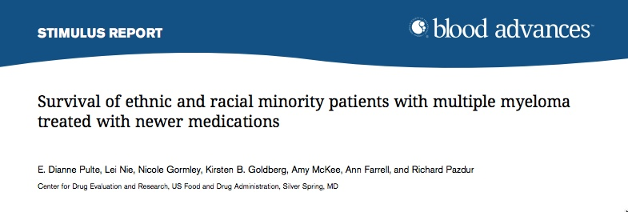
Genomic Studies of Myeloma Cancer Disparities
Results show a low participation of minorities in MM clinical trials of newer agents.
Despite this limitation, mortality was slightly lower in participants of other racial and ethnic groups.
Observed that Imid- and PI-class drugs could work, if anything, better in minorities.
Examination of survival in the current SEER data shows that overall 5-year survival from 2007 to 2013 increased to 52.3% for African Americans and 50.6% for whites, suggesting that the earlier observed disparities were related to a temporary phenomenon (ie, differences in treatment utilization).
USC Translational Genomics

Slide 30
Summary
Health disparities are real and are likely caused by a variety of factors, including socioeconomics.
Differences in tumor biology are not well understood due to significant dearth in data derived from diverse patient populations.
Recent genomic studies demonstrate differences in genomic profiles from tumors derived from diverse patient cohorts. Profiles are not likely going to always be generalizable.
Uncovering these factors may help us better understand disease etiology within different populations and could provide unique opportunities for improving disease management, potentially leading to decreases among certain known and validated cancer health disparities.
WE MUST ENSURE PATIENT DIVERSITY IN DISCOVERY AND VALIDATION STUDIES.
USC Translational Genomics

Slide 31
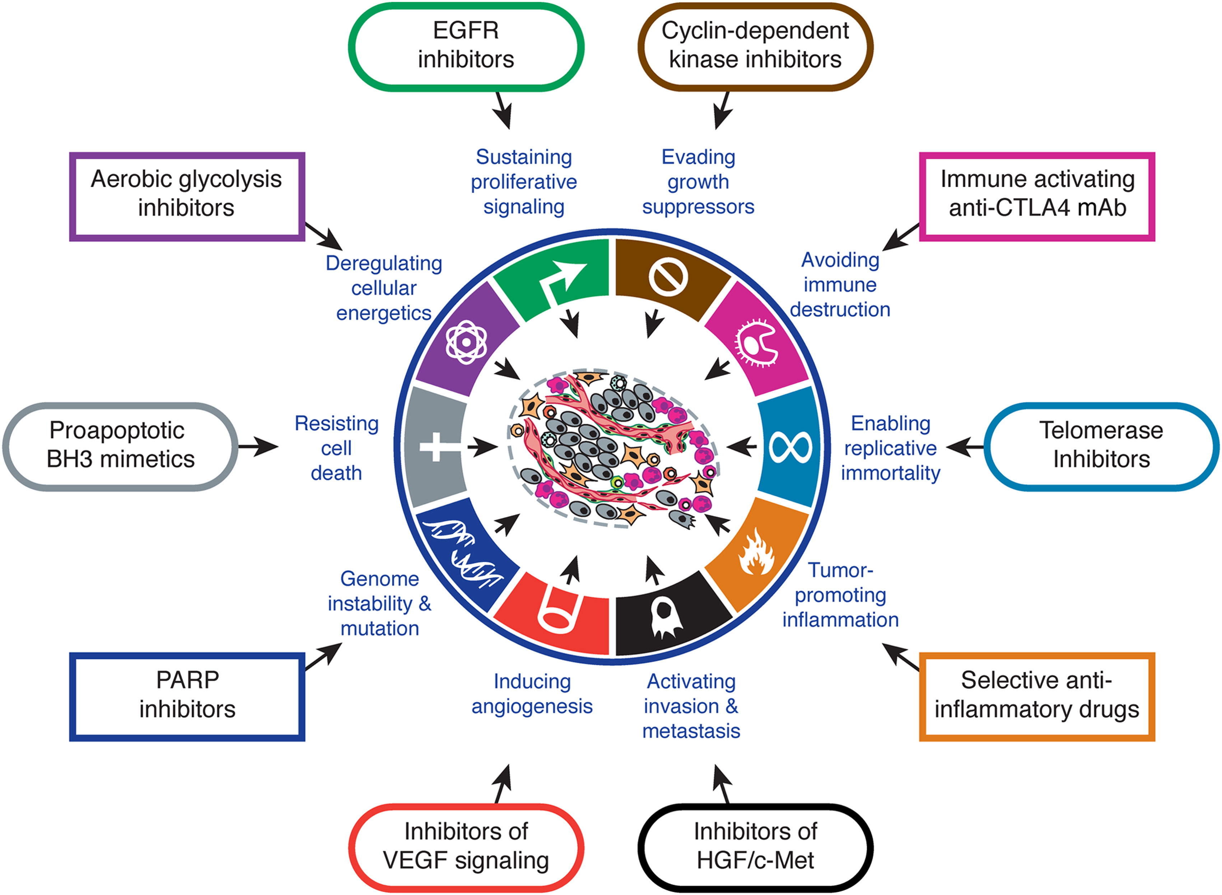
Integration of Environment/Social/Biological Sciences
Cancer exacts a heavy burden on underrepresented communities and the medically underserved.
Environmental Exposures
Social Stressors and Conditions
The Built Environment
Epigenetic changes (perhaps even in utero)
Transcriptional changes (use of isoforms)
Protein modifications
Lipid metabolism
Cellular Stress and ROS production
Physiological manifestations
Chronic Inflammation
USC Translational Genomics
Hallmarks of Cancer: The Next Generation, Hanahan and Weinberg (2011), Cell, 144:5, 646-674

