Slide 1

Identifying genetic subgroups of lethal prostate cancer
Joaquin Mateo, MD PhD
PROSTATE CANCER TRANSLATIONAL RESEARCH GROUP, VHIO
Medical Oncologist; Vall d’Hebron Univ Hospital
Barcelona, Spain

Slide 2
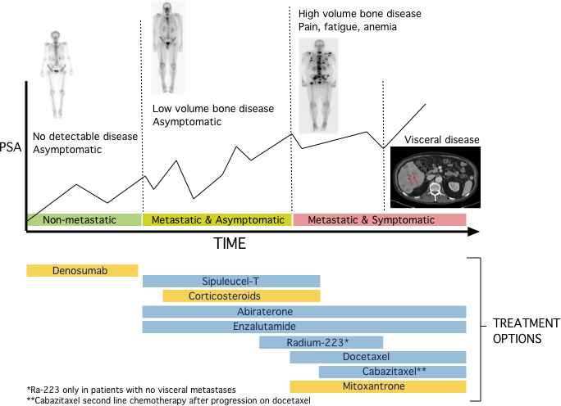
Management of castration-resistant prostate cancer remains an unmeet medical need
Taken from Lorente, Mateo, et al. Lancet Oncol 2015 (review)

Slide 3


Genomics offer an opportunity to develop clinically-relevant subsets of lethal prostate cancer.
Patient stratification is part of medical practice. Genomics adds a new variable.
Patient stratification incorporating genomics is a transition step towards personalized medicine.

Slide 4
How do we individualize decisions?
Knowing more about the tumor
      Genomics – molecular stratification of prostate cancer
      Clonal evolution
      Precision Imaging
Knowing more about the patient
      Social, personal circumstances
      Comorbidities
      Expectations, fears
PERSONALIZED MEDICINE is not a new concept, we are just trying to deliver it better by adding more variables

Slide 5
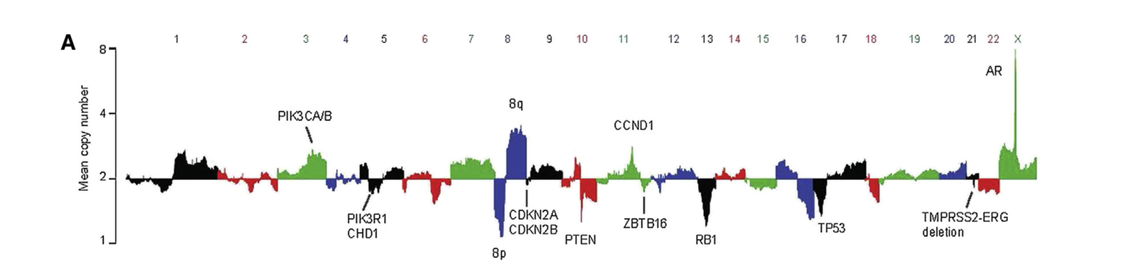
Genomics of metastatic CRPC (lethal prostate cancer)
n=150 WES mCRPC
(SU2C DT, Cell 2015)
Robinson et al, Cell 2015 – for the SU2C International Dream Team

Slide 6
Genomics of metastatic CRPC (lethal prostate cancer)
RECURRENT ABERRATIONS:
AR: amplifications, and then emergence of additional events with treatment resistance
AR-related genes: FOXA1, SPOP, CHD1
Cell-Cycle regulation: TP53, RB1, WNT pathway – more aggressive, less AR dependent disease
DNA damage repair pathways: opportunities for developing PARP inhibitors for HR-mut and immune checkpoint inhibitors for MMR-deficient, following other tumor types
PI3K/PTEN pathway: lots of hopes, very little impact – This may change (combinations)
N=1 situations that are “druggable” such as BRAF mutations (1 seems a small number unless you are the one)

Slide 7
Primary PC vs mCRPC
Armenia et al (SU2C DT), Nat Gen 2018

Slide 8
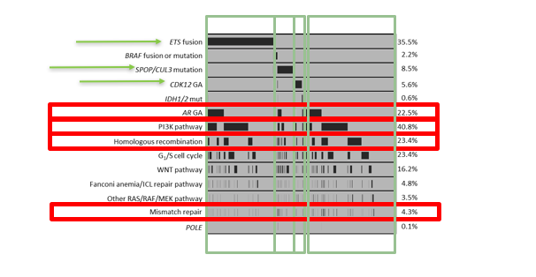
ESMO 2018 - 794pd – Ali et al: GENOMIC PROFILING OF 3343 PRIMARY AND METASTATIC PROSTATE TUMORS

Slide 9
VALUE |  | HOW CAN WE USE IT?
PROGNOSTIC | TMPRSS2-ERG | Risk stratification Limited value in lethal disease
PREDICTIVE | AR-V7 resistance to abi/enza | Guide treatment selection
PROGNOSTIC AND PREDICTIVE | SPOP/CHD1 (needs validation) | Risk stratification and treatment selection
Patient outcome disparity
Patient outcome disparity
Intervention to modify outcome
We need prognostic and predictive biomarkers for precision medicine in prostate cancer

Slide 10
However, most biomarker studies focus in a single biomarker (“pick your favorite gene studies”): how do we move forward towards true individual, patient-centric, re-classification of prostate cancer?

Slide 11
Barriers for implementing genomics into medical decision-making
DATA INTERPRETATION
ASSAYS
Lack of standardized interpretation systems for somatic variants
New variants discovery
Data sharing
Lack of expertise at tumor boards
Analytical validation
Clinical qualification
Bioinformatics
DISEASE-SPECIFIC
Tumor evolution (ADT-CRPC)
Difficult to access metastatic biopsies
Predominance of loss-of-function events
Small biopsies, fragmented DNA
TECHNOLOGY ACCESS
Inequalities in healthcare access
Financial toxicity (insurances)
Test for individual biomarkers vs multiplexed profiling

Slide 12
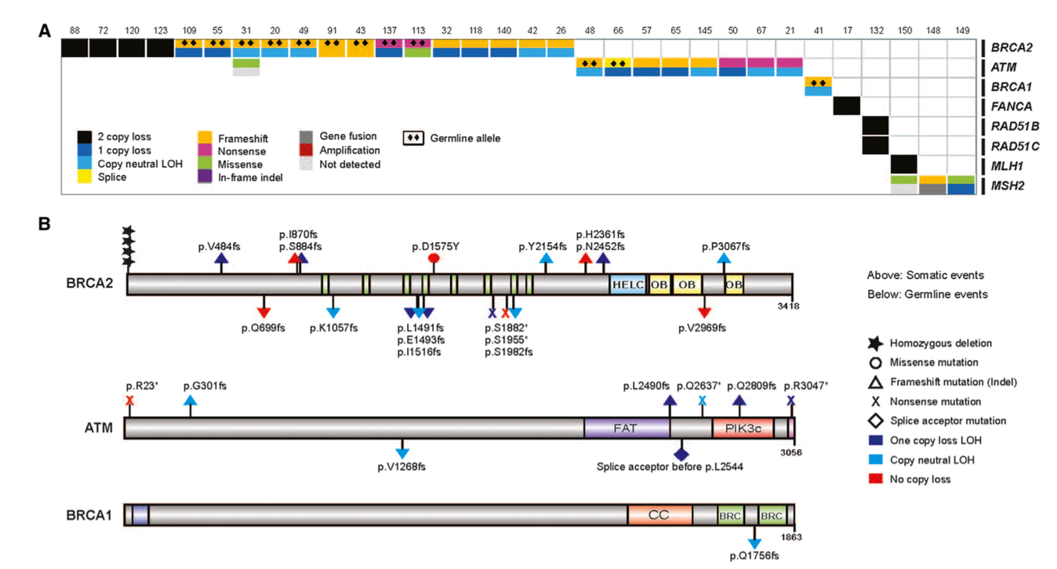
CRPC is enriched for DNA repair gene aberrations (20-25%)
Robinson et al, Cell 2015
SU2C Dream Team landscape study

Slide 13
Genomic landscape of mCRPC
SU2C mCRPC Dream Team update
n=432
(Abida et al, PNAS in press)
Almost half of these are germline mutations

Slide 14
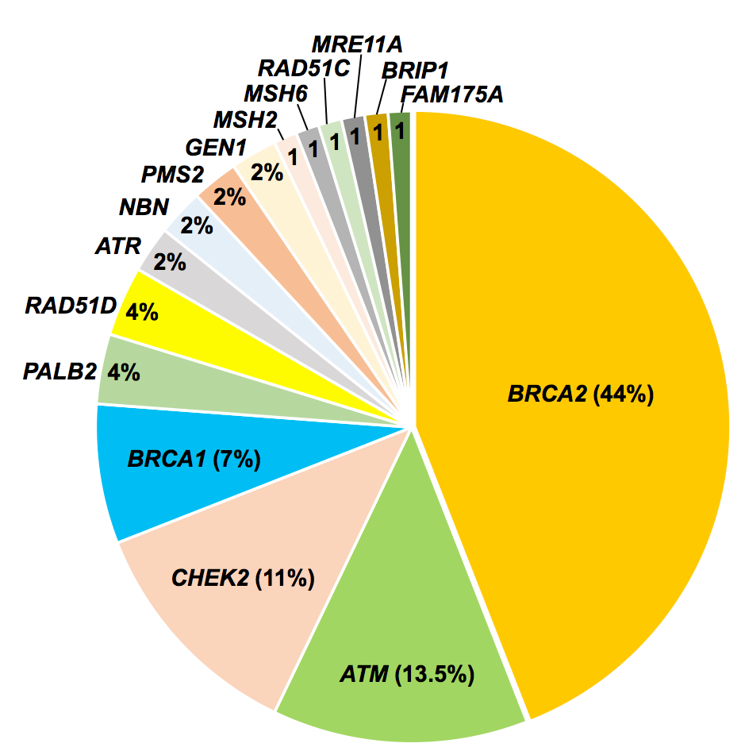
Half of these DDR gene mutations are inherited
Pritchard*, Mateo*, Walsh* et al, NEJM 2016

Slide 15
Relevance of identifying DDR germline mutations
Implication for identification of families with increased risk of cancer – precision screening
In active surveillance program, germline BRCA2/ATM mutation carriers are more likely to present disease progression and/or reclassification, triggering treatment indication
In localized disease, germline BRCA2 mutations are an independent poor prognostic factor
In advanced disease, there is opportunity for targeted agents (PARPi) and DNA damaging chemotherapy

Slide 16
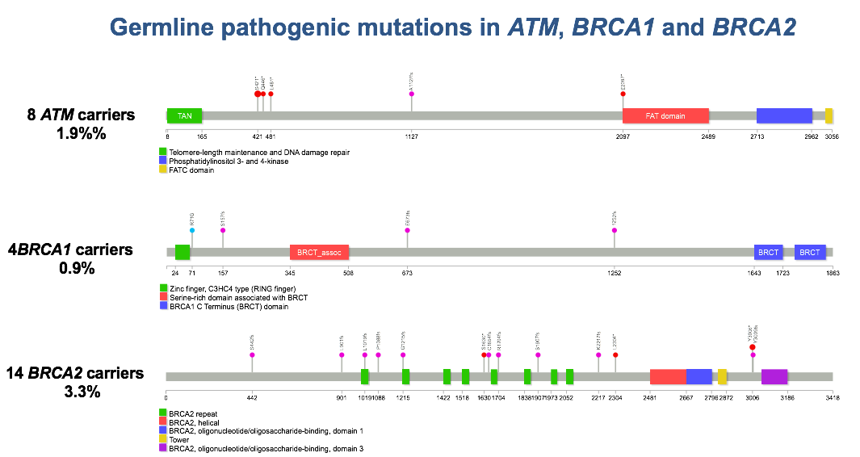
Prevalence of DDR germline mutations is cohort-dependent
Spain, 420 mCRPC patients (Castro et al, JCO 2019)

Slide 17
Prevalence of DDR germline mutations is cohort-dependent
Nicolosi et al. JAMA Oncol 2019 (adapted)
Panel germline testing for 3607 men with prostate cancer 2013-2018 at 2 US hospitals
 | BRCA2 mutations
Caucasian | 119/2954 | 4 %
Ashkenazi Jewish | 13/234 | 5,6%
African-American | 6/227 | 2,6%
Hispanic | 3/78 | 4%
Asian | 3/73 | 4%
Other/unk | 20/401 | 5%
Under representation
Selection bias

Slide 18
Current NCCN recommendations for genetic testing in prostate cancers
Risk group | Very low | Low | Favourable intermediate | Unfavourable intermediate | High | Very high | Metastatic
Germline testing | Recommended if family history positive or intraductal histology |  |  |  | Recommended
 | Family history for known germline variants and genetic testing for germline variants should include MLH1, MSH2, MSH6, and PMS2 (for Lynch syndrome) and BRCA1, BRCA2, ATM, PALB2, and CHEK2 Patients should be referred to genetic counselling following a positive test
Tumour testing | Not indicated | Consider if life expectancy ≥10 years |  | Not routinely recommended |  |  | Consider testing for HRR gene mutations and MSI/dMMR
 | Consider evaluating tumour for alterations in homologous recombination DNA repair such as: BRCA1, BRCA2, ATM, PALB2, FANCA, RAD51D, and CHEK2. (NB Trials may include other biomarkers) Consider testing for mutation in these genes (germline and somatic): BRCA1, BRCA2, ATM, PALB2, FANCA; refer to genetic counselling if positive and/or strong FH

Slide 19
How do we implement genomics in clinical practice?
 | GERMLINE MUTATIONS | SOMATIC MUTATIONS | DELETIONS | GENE FUSIONS | EPIGENETIC SILENCING
BRCA1
BRCA2
ATM
PALB2
OTHER HR GENES
Clinical and technical validation of multiplexed assays
Data interpretation
Physicians’ expectations
Patients’ expectations

Slide 20
Points for discussion
Promote genomic studies in previously under-represented populations (i.e. based on race, continent, comorbidities, age, “real-life data”….)
How do we make genomic testing global and at the same time personalize based on individual risks.
Moving genomic testing earlier (less efficient) to identify promptly lethal prostate cancers
Integration of clinical data into genomics databases
Harmonisation of genomics data to facilitate sharing
Capturing patient perspective and expectations in genomic testing

