Slide 1

Patient Perspective on Research Priorities:
Using Qualitative Assessments of Unmet Needs to Guide Research Strategies
Nihal Mohamed, PhD and Ash Tewari, MD
Department of Urology
The Icahn School of Medicine at Mount Sinai, New York, USA

Slide 2
Challenges and current limitations in patient-centered cancer research
Cancer care is a challenge for everyone (e.g., patient, provider, family caregiver).
Even within the same cancer type (e.g., PCa), impact of cancer varies by cancer stage and treatment choice.
Treatment is often toxic and complex requiring some combination of surgery, radiation, or chemotherapy for months or years.
The cost of care increased exponentially and the term financial toxicity was created to reflect how a patient’s life changes due to debilitating out-of-pocket expenses.
There is evidence that financial toxicity increases emotional distress and reduces both quality of life and adherence to treatment regiment.
Ongoing monitoring of cancer or surveillance adds to the financial, psychosocial, and care planning challenges.
Coordination of care is even more challenging than before.
Notes:
(independent of cancer and treatment impact)

Slide 3
Assessment of health-related quality of life
Health-related quality of life (HRQOL) refers to patients’ appraisal of their current level of physical, emotional, and social functioning as compared to what they expect or perceive to be possible or ideal.
Current functioning
Perceived
HRQOL
Expected functioning
Hjollund et al. Use of Patient-Reported Outcome (PRO) measures at group and patient levels: Experiences from the generic integrated PRO system, WestChronic. Interact J Med Res. February 11, 2014;3(1):e5.

Slide 4
What did we learn from research on HRQOL?
Cross-sectional studies conducted in small patients’ cohorts from single institutions.
Paucity of prospective research that examined changes from pre- to post-treatment generic and disease-specific HRQOL.
scarcity of randomized-controlled studies testing treatment-related differences in HRQOL.
The validity and reliability of tools used in the assessment of disease-specific HRQOL.
Lack of sensitivity to specific patient’s characteristics (e.g., age, sexual orientation).
HRQOL measures assess problems but NOT whether these problems are solved/addressed OR whether the patient needs help with these problems.
Botteman et al. Qual Life Res 2003; Porter et al. 2005; Urol Clin North Am; Parkinson, & Konety, 2004, J Urol; Gerharz et al. J Urol, 2005.

Slide 5
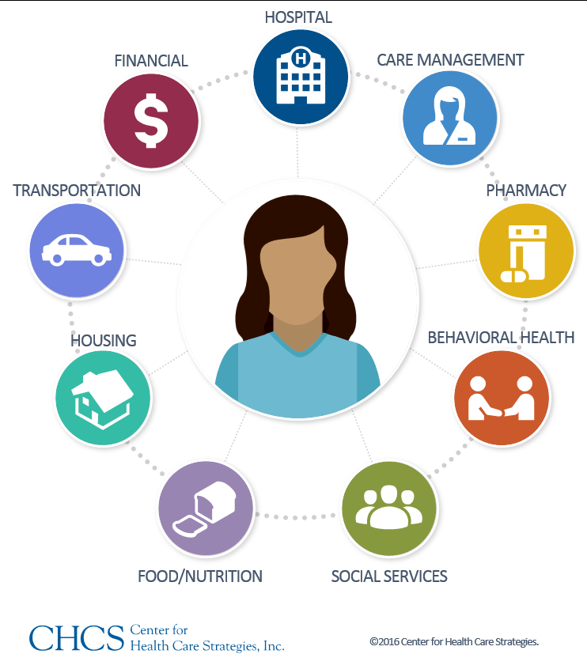

Possible Solutions:
Measurements of Patient Unmet Needs

Slide 6
Possible Solutions:
Measurements of Patient Unmet Needs
Unmet Needs – Needs/problems that lack the level of health care service or support an individual perceives is necessary to achieve optimal well-being. (Burg et al. 2015, Mohamed et al, J. of Urology, 2014).
Needs assessment can provide a set of measurable and immediately quantifiable indicators of patients’:
experience (e.g., engagement, treatment, care coordination) in health care
perceived informational and supportive care unmet needs and problems
how important these unmet needs/problems are to patients and their caregivers
the extent to which their needs/problems are addressed by the health care system
whether they still need help and support with these problems
The key strength of this approach is that it could:
Prioritize PCa research focus to address patients’ significant unmet needs
enable timely screening for needs/problems to monitor health care performance and to improve care quality
allow limited resources to be focused on the issues that patients have expressed that they need help
improve both patient’s HRQoL and satisfaction by meeting their expectations about care quality (Ullrich et al, BMC Palliative Care. 2017;16:31. doi:10.1186/s12904-017-0206-z.)

Slide 7
Examining Unmet Needs in PCa patients on Active Surveillance
Department of Defense (DoD)
Follow-up Care and Adherence to Cancer Surveillance:
DoD-PC140612 Care Planning for Prostate Cancer Patients on Active Surveillance (PI. Mohamed)
Reducing Disparity in Health Care:
DoD- PC160194 Racial, Cultural, and Dyadic Relationship Factors Influencing Treatment Decisions About Active Surveillance for Localized Prostate Cancer (PI. Mohamed; Co-PI Tewari)

Slide 8
Examining Unmet Needs in PCa patients on Active Surveillance
Participants (N = 28) were diagnosed with LrPC and were on active surveillance between January, 2016 and May, 2016.
These patients range in age from 41-79 years (median = 64.5 years and mean = 64.6 years).
19 patients self-identify as Caucasian, 1 as Asian, 2 as African American, and 10 were unknown.
19 patients were married, 2 divorced, 9 single, and 2 unknown.
All patient demographics have been identified through EPIC and via audio records of the interviews.
The recorded interviews were transcribed by 2 Research Volunteers and have been analyzed by Research Team.
Qualitative analyses involved coding of data using immersion crystallization approach.

Slide 9
Table 1: Unmet Needs Following Diagnosis and During Treatment Decision Making

Slide 10
Table 2: Unmet Needs While on Active Surveillance Protocol

Slide 11
Table 3: Patient Recommended Strategies to Improve Decision Making and Adherence to Active Surveillance

Slide 12
Integration of these priorities and values in urology care
Based on Our Research Findings We:
Have educational interventions and care planning tools to help men with PrCa on active surveillance and bladder cancer survivors adhere to their follow-up care and cancer surveillance (DoD-PC140612)
Are conducting a study to identify racial, cultural, and relationship factors that affect PrCa management decisions. Results will inform recommendations to enhance patient-provider communication and development of tailored educational tools for patients and caregivers (DoD- PC160194)

Slide 13
Using Qualitative Assessments of Unmet Needs to Guide Research Strategies
In summary: Over reliance on HRQOL measures to guide patient-centered research in PCa is problematic and might be misleading. Qualitative assessments of unmet needs provides a better approach of identifying patient-centered research priorities. Using this approach in our studies revealed that patients considering AS require comprehensive interventions that involve their caregivers to improving decision making, emotional adjustment, and adherence to AS protocol. Lifestyle changes are needed to maintain a sense of control and improve patients’ outcomes (e.g., smoking cessation, diet and nutrition, physical activities, stress and anxiety reduction).

Slide 14
Future Directions
Improving overall care quality through the delivery of person-centered and family-oriented services:
Improving quality measures (including patient-centered outcomes)
Integrated electronic medical records available for patients and their caregivers
More “trained” patient navigators and health educators are needed
Organization of health care during treatment and follow-ups
What happens after cancer treatment ends?
When should health promotion and chronic disease prevention become the focus for cancer patients and their family caregivers?

Slide 15



Thank You
Research Coordinators:
Our patients and their family members
Research Team and Collaborators including:
Funding Institution: DoD
MSSM Team
A. Tewari
C. Knauer
E. Benn
E. Goluboff
H. Lavery
J. Kannry
J. Sfakianos
M. Foley
R. Mehrazin
S. Nair
W. Karnilowcz
Baylor Team
H. Badr
H. Goltz
D. Latini
JJJ VA Team:
G. McWilliams
Q. Shah
SUNY-DMC Team
A. Winer
L. Hyacinth
N. Biverger
H. Kata

