Slide 1

Addressing Inequalities in Prostate Cancer Healthcare:
Defining Disparities
Folakemi T. Odedina, PhD
Professor, Colleges of Pharmacy & Medicine
PI, Prostate Cancer Transatlantic Consortium (CaPTC)
US Fulbright African Region Scholar (2006)
Carnegie African Diaspora Fellow (2017, 2018)

Slide 2
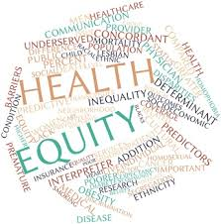
Why is it that? A Look at Health Disparities
http://www.youtube.com/watch?v=CxCSeqO3DZ0

Slide 3
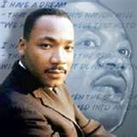
Of all the forms of inequality, injustice in health care is the most shocking and inhumane.
  Martin Luther King Jr.

Slide 4
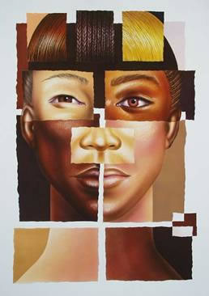
People do not care how much you know until they know how much you care.
John Maxwell quotes (American Author and motivational speaker )

Slide 5
Defining Health Disparity
    Healthy People 2020
  a particular type of health difference that is closely linked with social, economic, and/or environmental disadvantage.
  Health disparities adversely affect groups of people who have systematically experienced greater obstacles to health based on their ....

Slide 6
racial or ethnic group;
Immigrants
religion;
socioeconomic status;
gender;
age;
mental health;
cognitive, sensory, or physical disability;
sexual orientation or gender identity;
geographic location;
Veterans
or other characteristics historically linked to discrimination or exclusion.

Slide 7
Differences in morbidity, prevalence, mortality and overall burden of disease.
Groups mostly affected:
  Minority; Medically underserved; Rural; Poor; Disabled; Elderly; Gay, Lesbian, Bisexual, and Questioning (GLBQ)

Slide 8
Institute of Medicine (2002)
  Racial or ethnic differences in the quality of health care that are not due to access-related factors or clinical needs, preferences, and appropriateness of intervention.

Slide 9
Health Equity
Healthy People 2020
  “attainment of the highest level of health for all people.
  Achieving health equity requires valuing everyone equally with focused and ongoing societal efforts to address avoidable inequalities, historical and contemporary injustices, and the elimination of health and health care disparities.

Slide 10

Does Health Disparities Really Exist?
CDC Health Disparities and Inequalities Report

Slide 11
What Causes Health Disparities?

Slide 12
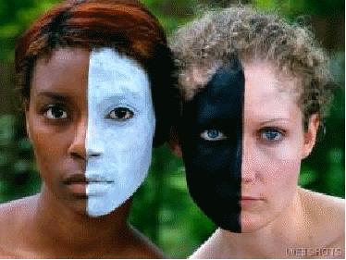
Documented Etiologies
Bias
Racism
Language
Literacy
Acculturation
Immigrant status
Insurance status
Income

Slide 13

Non-Clinical Factors affecting Health Disparities
IOM Report
  Unequal Treatment: Confronting Racial and Ethnic Disparities in Health Care
  Released March 20, 2002

Slide 14
Health systems factors
Patient Level factors
Cultural factors
Psychosocial factors
Decision making & preferences
Comprehension / understanding
Past experience
Perceived behavioral control in accessing the system
Type of healthcare institution
Quality of care coordination
Competency of Staff
  Cultural
Coordination of care

Slide 15
Provider / Care Process Factors
Provider actual / perceived bias
Level of involvement of patient in decisions
Quality & Quantity of interaction with patient
Provider’s knowledge
Time pressure

Slide 16
Disparities in the Clinical Encounter: The Core Paradox
How could well-meaning and highly educated health professionals, working in their usual circumstances with diverse populations of patients, create a pattern of care that appears to be discriminatory?
It can happen & it happens!

Slide 17
What is the Evidence …?
Green et al 2007: Physicians who were more racially biased were less likely to prescribe thrombolysis for black patients than for whites presenting with heart attack symptoms.
  "It's not a matter of you being a racist. It's really a matter of the way your brain processes information is influenced by things you've seen, things you've experienced, the way media has presented things,"
Green A et al Implicit Bias among Physicians and its Prediction of Thrombolysis Decisions for Black and White Patients Journal of General Internal Medicine (22) 9 September, 2007
“Bias is the central problem -- bias so deeply internalized that people are sincerely unaware that they hold it.”
Vedantam - The Color of Health Care: Diagnosing Bias in Doctors, Washington Post, August 13 2007
Notes:
17

Slide 18
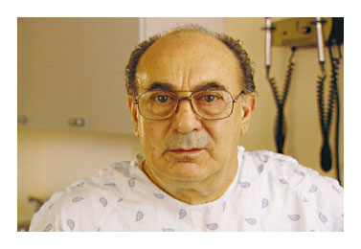
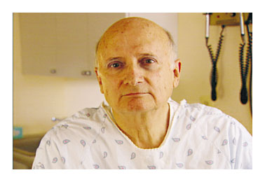
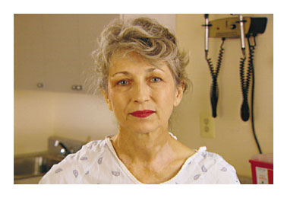
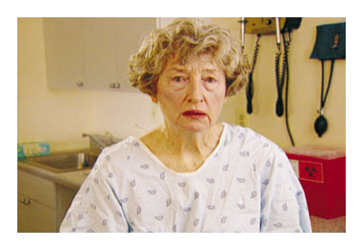
THE EFFECT OF RACE AND SEX ON PHYSICIANS’ RECOMMENDATIONS FOR CARDIAC CATHETERIZATION - Schulman et al. (1999)
Notes:
18
Kevin Shulman New England Journal of Medicine

Slide 19
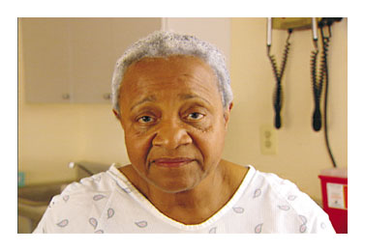
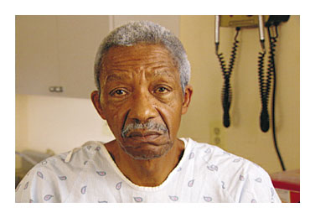
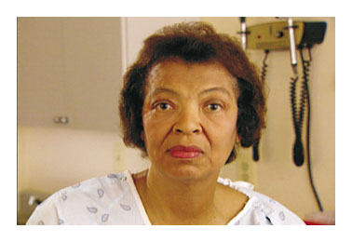
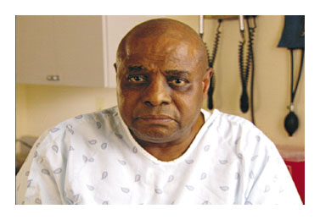
THE EFFECT OF RACE AND SEX ON PHYSICIANS’ RECOMMENDATIONS FOR CARDIAC CATHETERIZATION - Schulman et al. (1999)
Source: New England Journal of Medicine
Notes:
19

Slide 20
Findings suggest that the race and sex of a patient independently influence how physicians manage chest pain.
Schulman et al. (1999) ...

Slide 21
Before we can eliminate health disparities ….
we must face racism and prejudice!

Slide 22

Global Landscape of
Prostate Cancer Burden

Slide 23
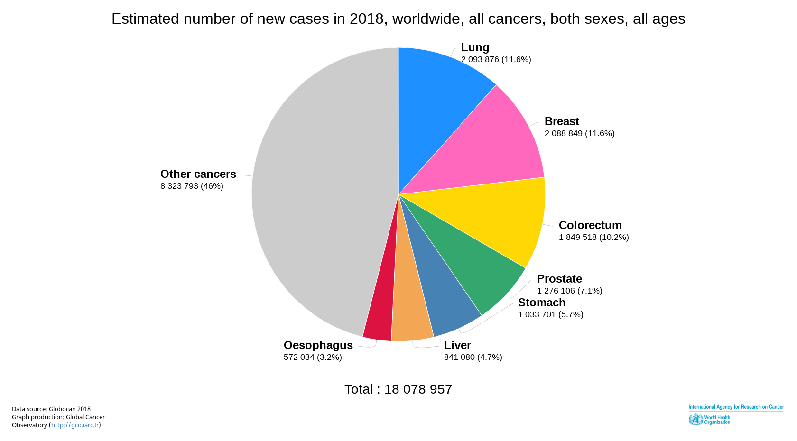
BOTH SEXES, Incidence

Slide 24
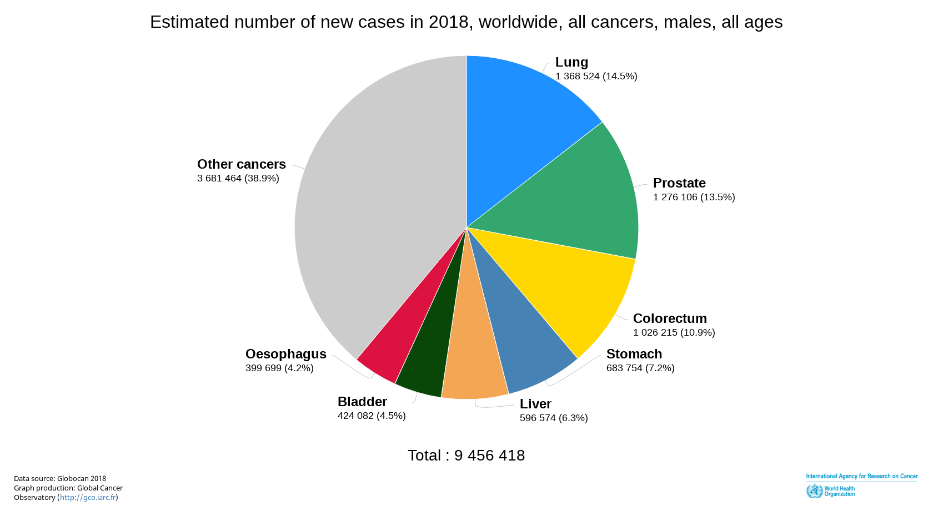
MALES, Incidence

Slide 25
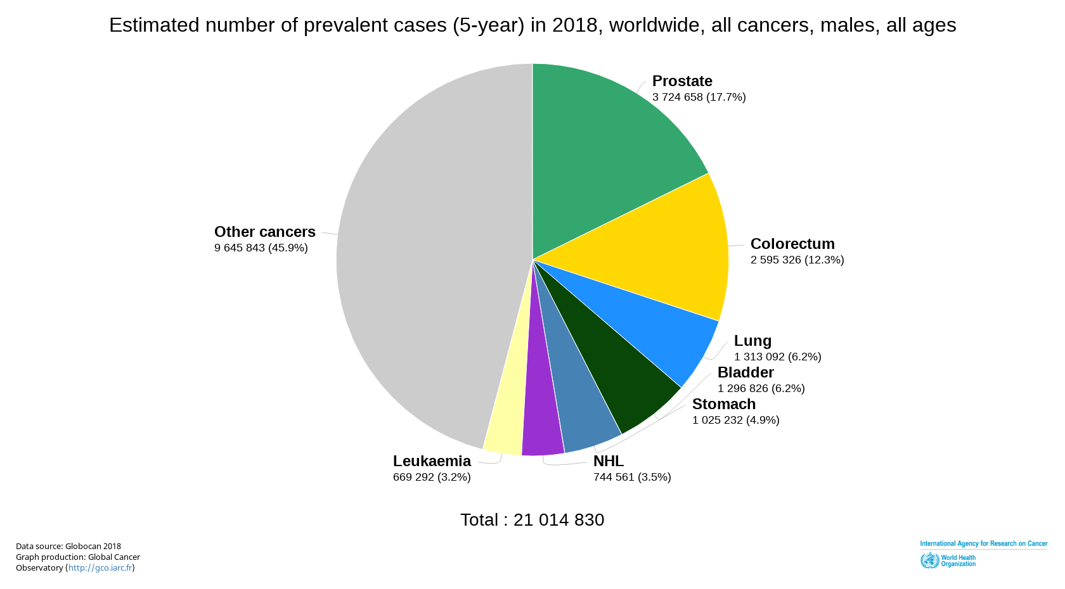
MALES, Prevalence

Slide 26
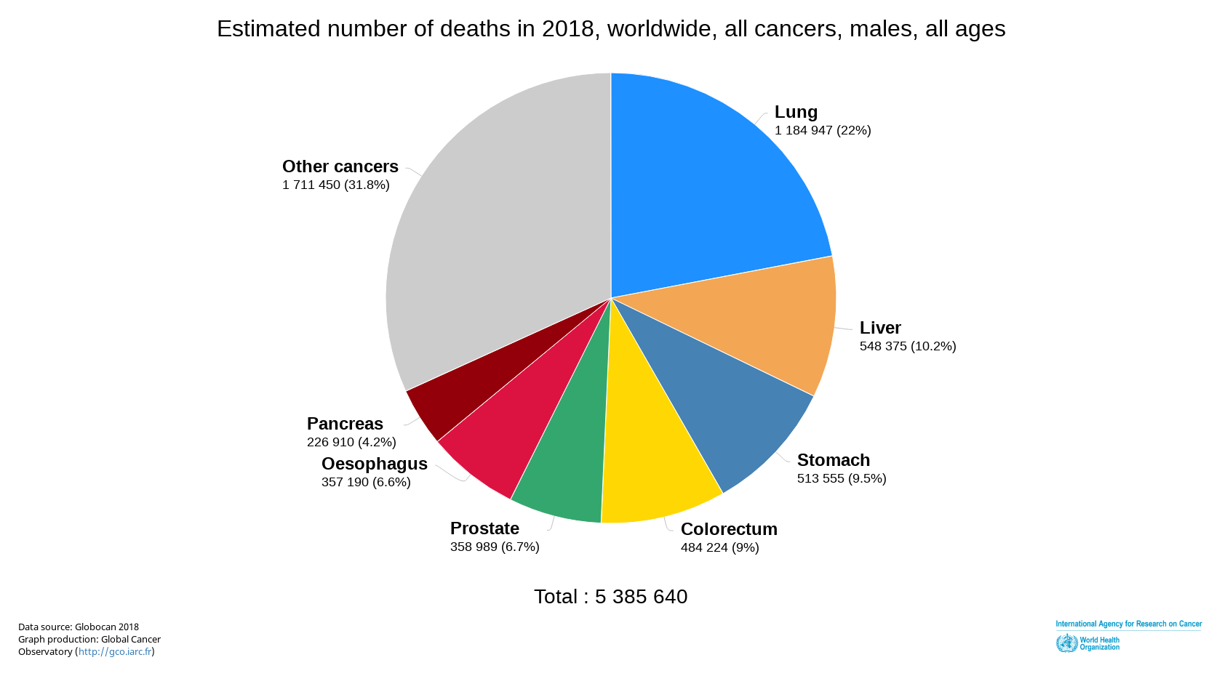
MALES, Mortality

Slide 27
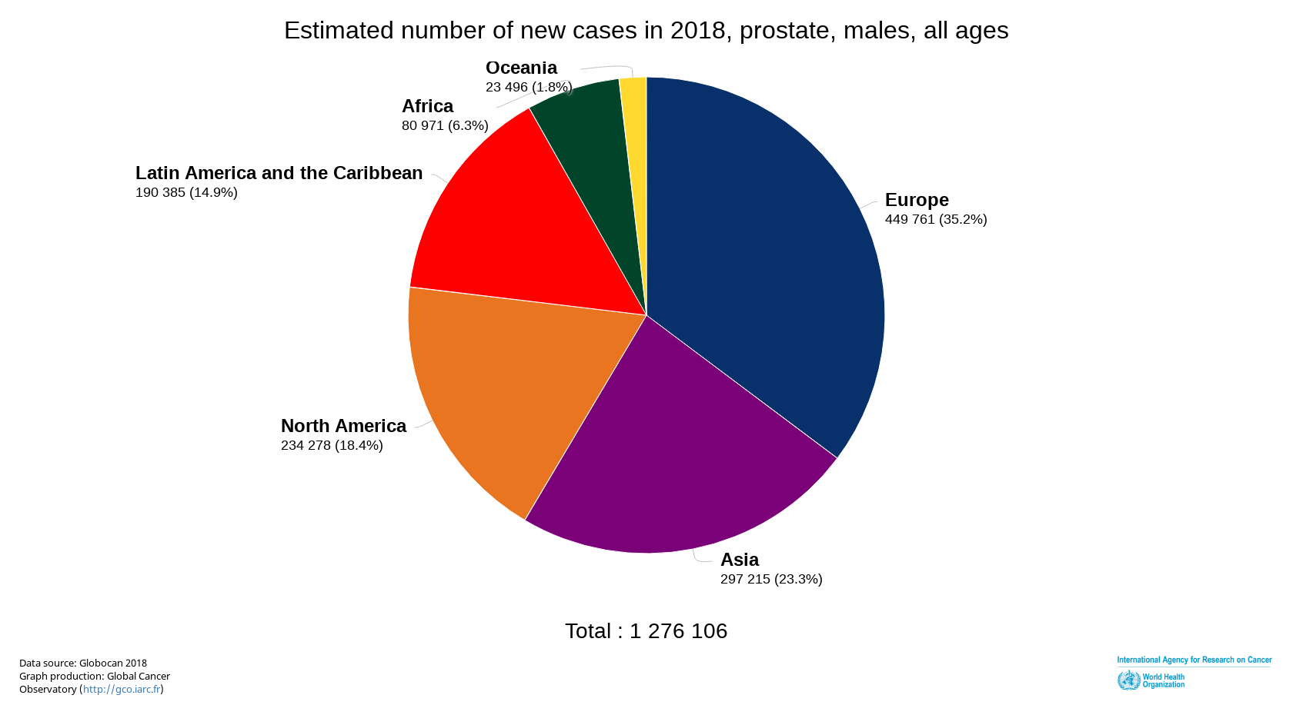
CONTINENTS, CaP Incidence

Slide 28
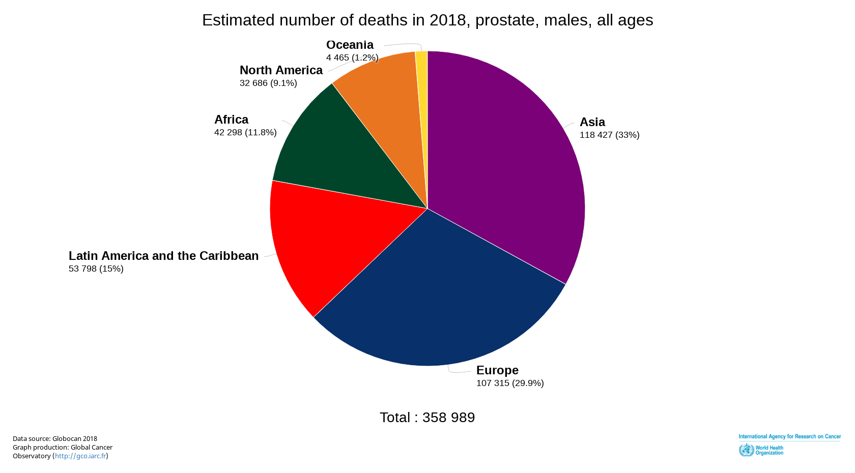
CONTINENTS, CaP Mortality

Slide 29
Prostate Cancer New Cases, 2018, males
WHO AMERICA REGION
Population | Cases
United States of America | 212 783
Brazil | 84 992
Mexico | 25 049
Canada | 21 412
Colombia | 12 712
Argentina | 11 600
Peru | 7 598
Venezuela, Bolivarian Republic of | 7 445

Slide 30
Prostate Cancer Age-Standardized Incidence Rates, 2018, males
WHO AMERICA REGION
Population | Incidence
France, Guadeloupe | 189.1
France, Martinique | 158.4
Barbados | 129.3
Puerto Rico | 101.7
French Guyana | 92.3
Bahamas | 85.8
United States of America | 75.7
Brazil | 74.0

Slide 31
Prostate Cancer Deaths, 2018, males
WHO AMERICA REGION
Population | Cases
United States of America | 28 705
Brazil | 16 730
Mexico | 6 915
Argentina | 3 974
Canada | 3 971
Venezuela, Bolivarian Republic of | 3 399
Colombia | 3 166
Others | 19 419

Slide 32
Prostate Cancer New Cases, 2018, males
WHO AFRICA REGION
Population | Cases
Nigeria | 13 078
South Africa | 12 452
Congo, Democratic Republic of | 5 718
Tanzania, United Republic of | 4 362
Kenya | 2 864
Algeria | 2 578
Côte d'Ivoire | 2 485
Others | 27 076

Slide 33
Prostate Cancer Deaths, 2018, males
WHO AFRICA REGION
Population | Cases
Nigeria | 5 806
South Africa | 4 400
Congo, Democratic Republic of | 3 789
Tanzania, United Republic of | 2 722
Kenya | 1 663
Côte d'Ivoire | 1 539
Ethiopia | 1 195
Others | 16 273

Slide 34
Putting Things in Perspective ..
Need to study the impact of migration on CaP (CaPTC Focus)
  identification of CaP risk factors
  identification of relative contributions of genetics and the environment to CaP
  comparison of genetically similar groups with different morbidity/mortality rates.

Slide 35
Transatlantic Roots of Prostate Cancer Disparities in Black Men

Slide 36
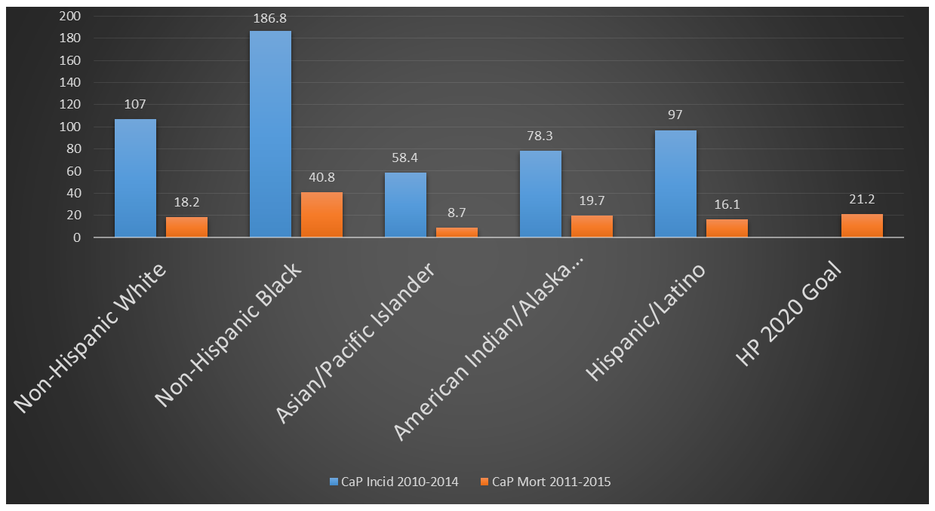
Incidence and Mortality Rates for Prostate Cancer by Race and Ethnicity, US, 2010-2015

Slide 37
America’s Black Population
In Studying Blacks in the US, who are we really studying?

Slide 38
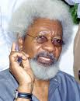
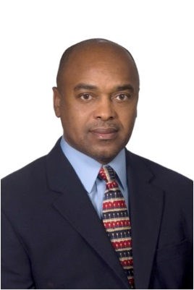

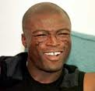
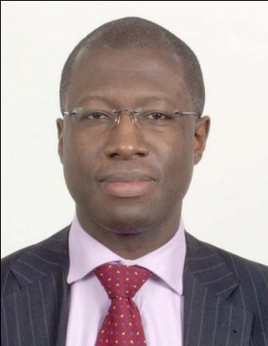



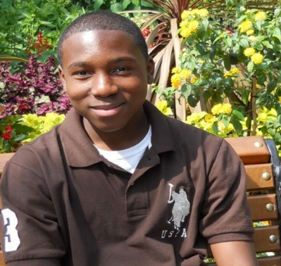
Defining Blacks in America ... Who is African American?

Slide 39
Use of one racial/ethnic category for Blacks obscures the heterogeneity in health outcomes among subgroups of Black men in the US
Year 2005 Thoughts
Foreign-born Blacks continue to transform the ethnic composition of the Black population in the US.
Studying the source population of Black men will move the needle towards better understanding of the relative contributions of genetic and environmental factors implicated in prostate cancer disparities.

Slide 40
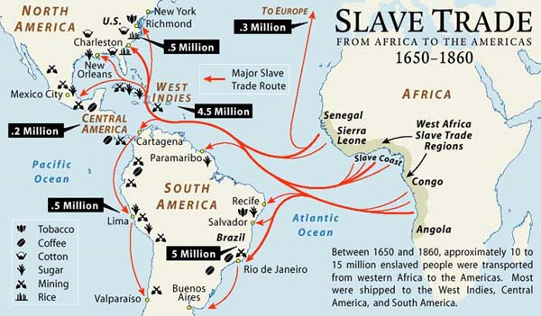

Slide 41
Who are Connected? The Slave Routes…
Africa
  Benin
  Nigeria
  Ghana
  Gambia
  Senegal
  Mozambique
  Angola
Americas & Caribbean
  Barbados
  Cuba
  Haiti
  Dominican Republic
  Netherlands Antilles
  Trinidad and Tobago
  Jamaica
  Brazil
  USA
Europe
  Portugal
  France
  Netherlands
  Spain
  Denmark
  Norway
  UK

Slide 42
United Kingdom provided the most common European genetic source in African-Americans.
The ancestors of Yoruba people (mostly from Nigeria) provided the largest contribution of genes from Africa to African-Americans.

Slide 43
Montinaro et al. Unravelling the hidden ancestry of American admixed populations. Nature Communications. 2015 Mar 24;6:6596.

Slide 44
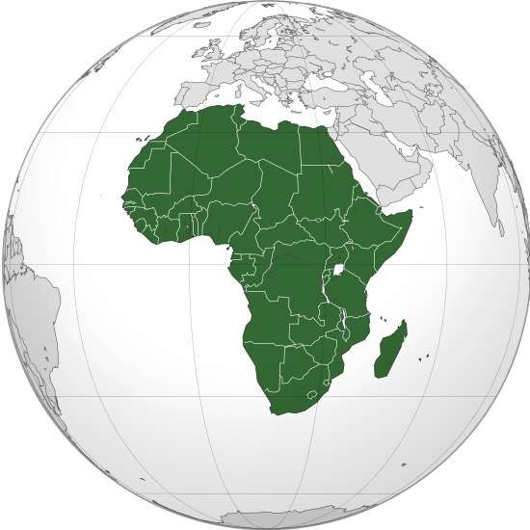
All Roads To Africa for Genetics Research

Slide 45
Studying populations of African ancestry …Advantages
Understanding human variation
Determining evolutionary histories of variants
Demonstrating the analytical and clinical validity of new genetics-based tests for multiple populations
Explaining the heritability of common quantitative traits
Enabling prioritization of candidate genes
Examining the genetic architecture of complex diseases, such as cancer
Identifying SNPs associated with disease risk in admixed populations
Facilitating the development of new clinical tools for diverse populations

Slide 46
Studying populations of African ancestry …Advantages
Nature | GENES
Nurture | ENVIRONMENT
Is the development of disease predisposed in the DNA?
Is the development of disease influenced by life experiences and environment?

Slide 47
Prostate Cancer Transatlantic Consortium Program
Unique paradigm in understanding prostate cancer in people of African Ancestry

Slide 48
The complexity of health disparity and the need for a unique approach to better understand and address complex chronic diseases underscore the need for team science research that is multilevel, collaborative, translational, and global.

Slide 49
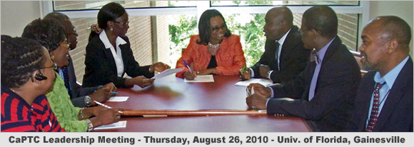
The Global Team
Website
http://epi.grants.cancer.gov/captc/
Notes:
49

Slide 50
CaPTC … An NCI EGRP Consortium
Formed in 2005 to address the globally disproportionate burden of prostate cancer among Black men.
Received NCI-Epidemiology & Genomics Research Program (EGRP) Consortium approval in 2011.
Open consortium comprising a team of prostate cancer scientists, clinicians, survivors, and advocates
  North America, Europe, the Caribbean Islands, and West Africa.
  148 scientists from 12 countries
    Significant International Research in West Africa (especially Nigeria & Cameroon)

Slide 51
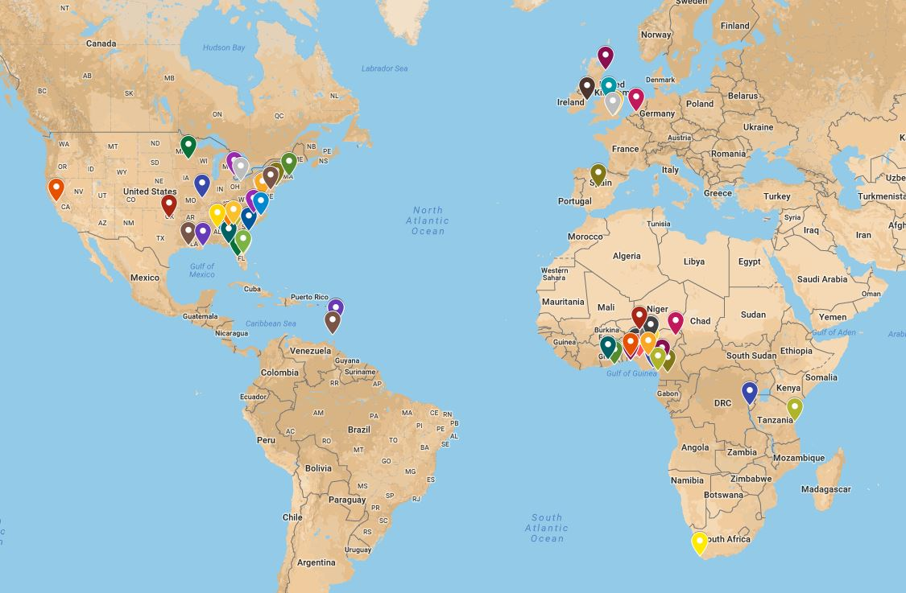
CaPTC
Around the World

Slide 53

Any Questions?

Slide 54
Addressing Inequalities in Prostate Cancer Healthcare:
Social Determinants of Health
Folakemi T. Odedina, PhD
Professor, Colleges of Pharmacy & Medicine
PI, Prostate Cancer Transatlantic Consortium (CaPTC)
US Fulbright African Region Scholar (2006)
Carnegie African Diaspora Fellow (2017, 2018)

Slide 55
Social-Determinants Definition ...
Conditions in the environments in which people are born, live, learn, work, play, worship, and age that affect a wide range of health, functioning, and quality-of-life outcomes and risks.
  Conditions
    social, economic, and physical
  Environments and settings
    school, church, workplace, and neighborhood

Slide 56

Models of SDOH

Slide 57
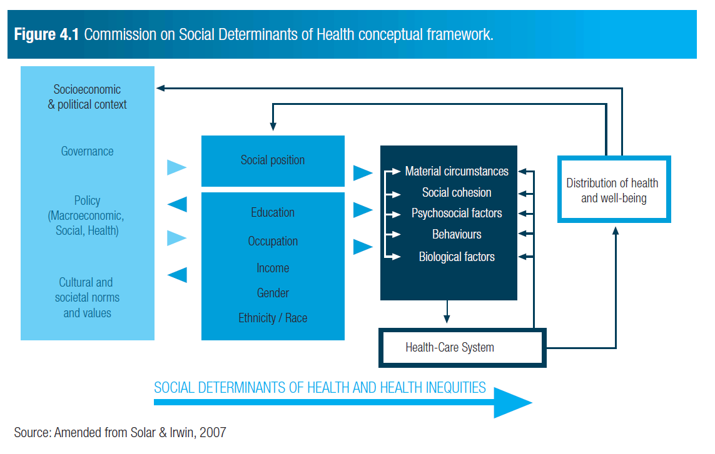

Slide 58
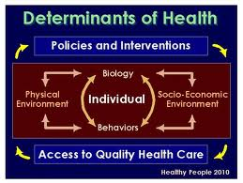

Slide 59
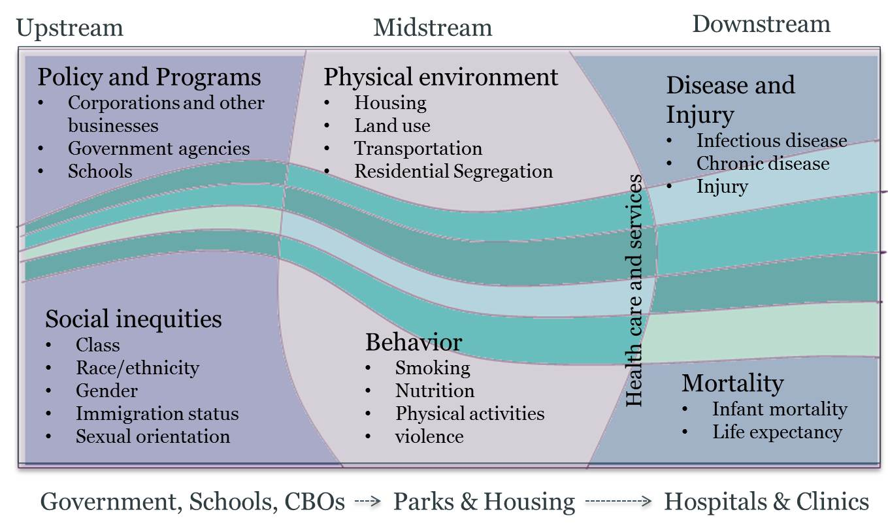
Health in All Policies (HiAP), Richmond CA

Slide 60
Healthy People 2020 Approach to Social Determinants of Health

Slide 61
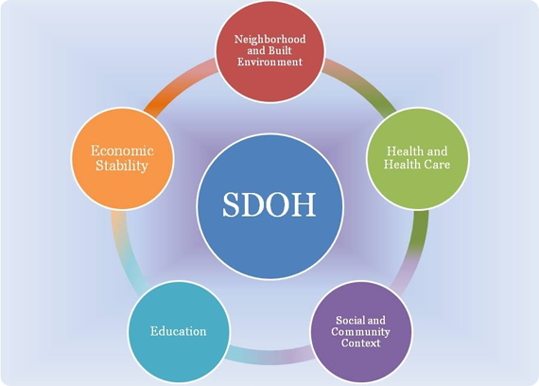

Slide 62
Economic Stability
  Poverty
  Employment Status
  Access to Employment
  Housing Stability (e.g., homelessness, foreclosure)
Education
  High School Graduation Rates
  School Policies that Support Health Promotion
  School Environments that are Safe and Conducive to Learning
  Enrollment in Higher Education

Slide 63
Social and Community Context
  Family Structure
  Social Cohesion
  Perceptions of Discrimination and Equity
  Civic Participation
  Incarceration/Institutionalization
Health and Health Care
  Access to Health services—including clinical and preventive care
  Access to Primary Care—including community-based health promotion and wellness programs
  Health Technology

Slide 64
Neighborhood and Build Environment
  Quality of Housing
  Crime and Violence
  Environmental Conditions
  Access to Healthy Foods

Slide 65
Addressing disparities:
What To Do?

Slide 66
Knowledge is Power
  Know your community cancer health statistics
  Know the key stake holders in your community
  Know the important cancer resources within your community
Address aspects of health and medical care
Expand access
Patient navigation for health, medical care and clinical trials
  Pharmacy technicians can make outstanding navigators
Integrated and well coordinated care

Slide 67
Addressing disparities:
How To Do It?

Slide 68

Right Relationships
Trust
Respect
Partnership
Communication
Flexibility
Empowerment

Slide 69
Right Cultural Communication Skills
Being nonjudgmental
Understanding stereotypes
Treating people as individuals
Looking at whether expectations are real
Accepting ambiguity
Empathizing
Checking assumptions
Being open to differences
        Selma Myers & Barbara Filner, Conflict Resolution Across Cultures

Slide 70
Right Steps
Team care approach
Culturally competent care and services
Patient- and family-centered communication
Community engagement and partnerships
Partnership with people who share same life experiences with the community members targeted
  Lay Navigators
  Community Health Workers

Slide 71
Right Services
What are the potential SDOH factors at play?
  Barriers? Support services? Resources?
What are the etiologies of the disparity?
How can you foster best practices for this case?
  Document, track, share?
What is the best solution?
  Capacity to meet needs and services
  Collaboration with community leaders/advocates/other stakeholders?
  Shared decision-making with patients.
  Link patients to appropriate services?
  Help develop self-management plan?

Slide 72
What SDOH Factors Can Providers Impact to Address Disparities

Slide 73
Availability of resources to meet daily needs (e.g., safe housing and local food markets)
Access to educational, economic, and job opportunities
Access to health care services
Quality of education and job training
Availability of community-based resources in support of community living and opportunities for recreational and leisure-time activities
Transportation options
Public safety

Slide 74
Social support
Social norms and attitudes (e.g., discrimination, racism, and distrust of government)
Exposure to crime, violence, and social disorder (e.g., presence of trash and lack of cooperation in a community)
Socioeconomic conditions (e.g., concentrated poverty and the stressful conditions that accompany it)
Residential segregation
Language/Literacy
Access to mass media and emerging technologies (e.g., cell phones, the Internet, and social media)
Culture

Slide 75
Resources
The Institute of Medicine. Disparities in Health Care: Methods for Studying the Effects of Race, Ethnicity, and SES on Access, Use, and Quality of health care, 2002. Available from http://www.iom.edu/~/media/Files/Activity%20Files/Quality/NHDRGuidance/DisparitiesGornick.pdf [PDF - 108 KB]
Healthy People 2020. Social Determinants of Health. Available at: http://www.healthypeople.gov/2020/topicsobjectives2020/overview.aspx?topicId=39
Amended from O. Solar and A. Irwin, “A conceptual framework for action on the social determinants of health,” in Discussion paper for the Commission on Social Determinants of Health (Geneva: World Health Organization, 2007). Available at http://www.who.int/social_determinants/resources/csdh_framework_action_05_07.pdf.
Commission on Social Determinants of Health, Closing the gap in a generation: Health equity through action on the social determinants of health. Final Report on Social Determinants of Health (Geneva: World Health Organization, 2008), p. 43. Available at http://whqlibdoc.who.int/publications/2008/9789241563703_eng.pdf.
Health in All Policies. Richmond Health Equity Partnership, Richmond, CA. Accessed February 14, 2014. http://www.ci.richmond.ca.us/index.aspx?NID=2575
Notes:
75

Slide 76
NCI Cancer Prevention & Control Colloquia Series
Transatlantic Roots of Prostate Cancer Disparities in Black Men:
The CaPTC Program
Folakemi T. Odedina, PhD
Professor, College of Pharmacy and College of Medicine
PI, Prostate Cancer Transatlantic Consortium
University of Florida

Slide 77
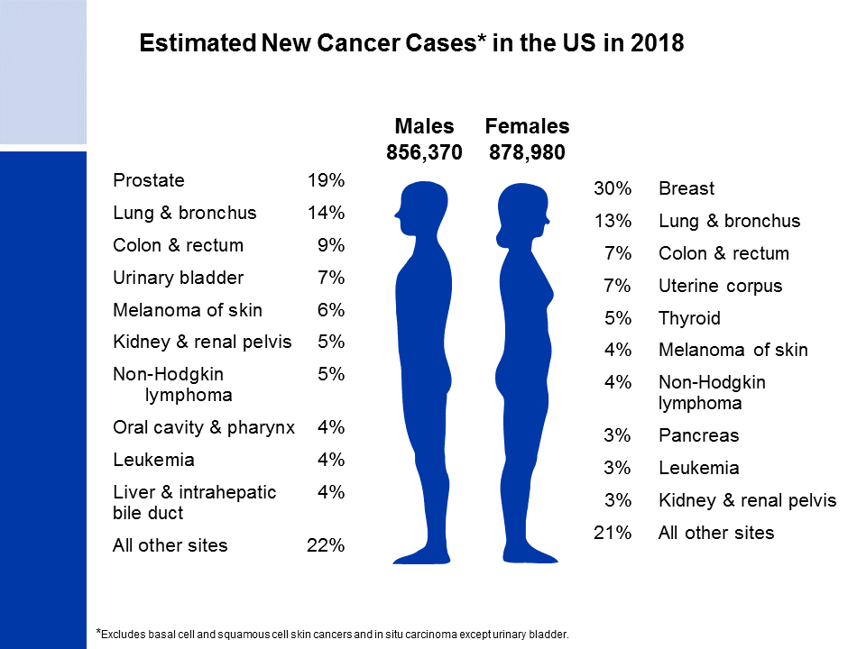
ACS, 2018
Notes:
It is estimated that about 1.7 million new cases of cancer will be diagnosed in 2018. Prostate cancer is the most common cancer among males (19%), followed by lung (14%) and colorectal (9%) cancers. Among females, breast (30%), lung (13%), and colorectal (7%) cancers are the most common.
Rankings based on estimates should be interpreted with caution because they are model-based projections.

Slide 78
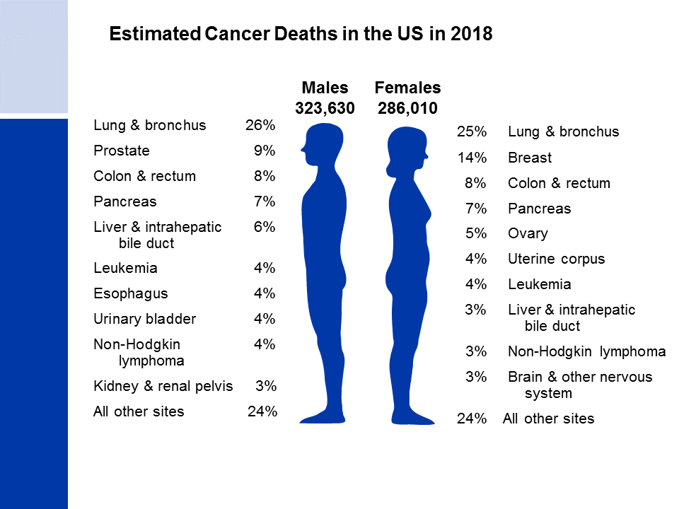
ACS, 2018
Notes:
Now we will turn our attention to cancer mortality. Lung cancer is by far the leading cause of cancer death among males (26%), followed by prostate and colorectal cancers. Among females, lung, breast, and colorectal cancers are the leading causes of cancer death.

Slide 79
Incidence and Mortality Rates for Prostate Cancer by Race and Ethnicity, US, 2010-2015

Slide 82
Do we know the true burden of chronic diseases/health disparities in US Blacks?
2005 Comment from a Community Member Led to CaPTC!

Slide 83
Global Perspective ... Research Idea from the Community
On Saturday, September 18, 2004, one of the participants of a town hall meeting during the 1st state-wide African American Men’s Prostate Cancer Forum held in Tallahassee, Florida, raised a question about why prostate cancer was so high among African American men. He further stated that he heard that the disease was not so high among other Black men from other countries but when other Black men come to America, they have a higher chance of developing prostate cancer. He added with a laugh, “Maybe we should all move back to Africa.”

Slide 84
II. Studying Prostate Cancer in Blacks

Slide 85
America’s Black Population
In Studying Blacks in the US, who are we really studying?

Slide 87
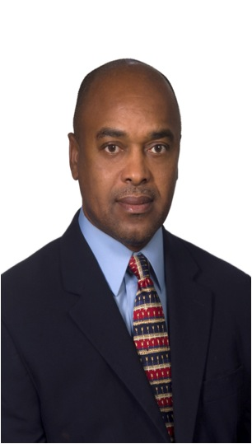





Defining Blacks in America ... Who is African American?

Slide 88
Use of one racial/ethnic category for Blacks obscures the heterogeneity in health outcomes among subgroups of Black men in the US
Year 2005 Thoughts
Foreign-born Blacks continue to transform the ethnic composition of the Black population in the US.
Studying the source population of Black men will move the needle towards better understanding of the relative contributions of genetic and environmental factors implicated in prostate cancer disparities.

Slide 90
Who are Connected? The Slave Routes…
Africa
  Benin
  Nigeria
  Ghana
  Gambia
  Senegal
  Mozambique
  Angola
Americas & Caribbean
  Barbados
  Cuba
  Haiti
  Dominican Republic
  Netherlands Antilles
  Trinidad and Tobago
  Jamaica
  Brazil
  USA
Europe
  Portugal
  France
  Netherlands
  Spain
  Denmark
  Norway
  UK

Slide 91
Ancestry Landscape of Admixed American Population

Slide 92
Investigators applied a haplotype-based ancestry identification approach to a large set of genome-wide SNP data from a variety of American, European and African populations to determine the contributions of different ancestral populations to the Americas.

Slide 93
Study Samples:
4,000 DNA samples from 64 populations
United Kingdom provided the most common European genetic source in African-Americans.
The ancestors of Yoruba people (mostly from Nigeria) provided the largest contribution of genes from Africa to modern Americans.

Slide 94
Montinaro et al. Unravelling the hidden ancestry of American admixed populations. Nature Communications. 2015 Mar 24;6:6596.

Slide 95
Montinaro et al. Unravelling the hidden ancestry of American admixed populations. Nature Communications. 2015 Mar 24;6:6596.

Slide 96
All Roads To Africa for Genetics Research

Slide 97

Connection…

Slide 98

Connection…

Slide 99
Studying populations of African ancestry …Advantages
Understanding human variation
Determining evolutionary histories of variants
Demonstrating the analytical and clinical validity of new genetics-based tests for multiple populations
Explaining the heritability of common quantitative traits
Enabling prioritization of candidate genes
Examining the genetic architecture of complex diseases, such as cancer
Identifying SNPs associated with disease risk in admixed populations
Facilitating the development of new clinical tools for diverse populations

Slide 100
Studying populations of African ancestry …Advantages
Nature | GENES
Nurture | ENVIRONMENT
Is the development of disease predisposed in the DNA?
Is the development of disease influenced by life experiences and environment?

Slide 101
III. Prostate Cancer Transatlantic Consortium Program
Unique paradigm in understanding prostate cancer in people of African Ancestry

Slide 102
The complexity of health disparity and the need for a unique approach to better understand and address complex chronic diseases underscore the need for team science research that is multilevel, collaborative, translational, and global.

Slide 103
The Global Team
Website
http://epi.grants.cancer.gov/captc/
Notes:
103

Slide 104
Why form a Consortium …
Problem that cannot be solved individually.
Special initiatives requiring national/international collaboration.
Need for shared resources and expertise.
“Whole bigger than the sum of its parts”.

Slide 105
CaPTC … An NCI EGRP Consortium
Formed in 2005 to address the globally disproportionate burden of prostate cancer among Black men.
Received NCI-Epidemiology & Genomics Research Program (EGRP) Consortium approval in 2011.
Open consortium comprising a team of prostate cancer scientists, clinicians, survivors, and advocates
  North America, Europe, the Caribbean Islands, and West Africa.
  148 scientists from 12 countries
    Significant International Research in West Africa (especially Nigeria & Cameroon)

Slide 106
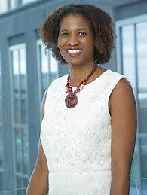
CaPTC NCI-EGRP Program Director
Damali Martin, PhD, MPH
Program Director, Genomic Epidemiology Branch
Global Health Coordinator, Epidemiology and Genomics Research Program
Division of Cancer Control and Population Sciences
National Cancer Institute, National Institutes of Health

Slide 107
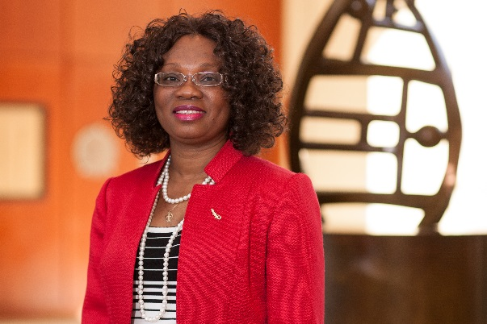
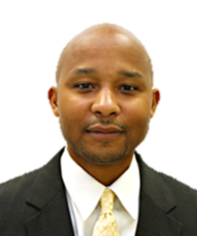
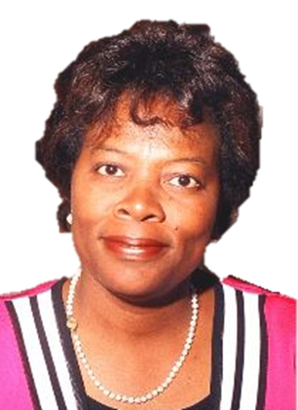
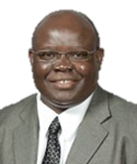
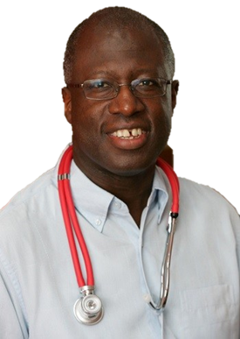
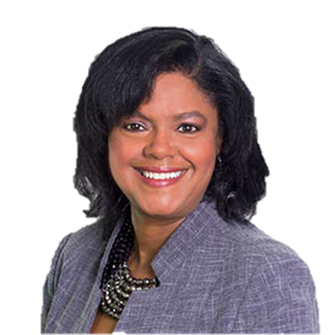
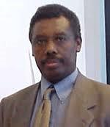
CaPTC Leadership Team
R. Renee Reams, PhD
Training & Education Director
Clayton Yates,
PhD
Research Director
Folakemi Odedina, PhD
Consortium PI & Director
Frank Chinegwundoh,
MBBS
Medical Director
Windy Dean-Colomb, MD
Clinical Trials Director
Chindo Hicks,
PhD
Bioinformatics Director
Getachew Dagne, PhD
Biostatistics Director

Slide 108

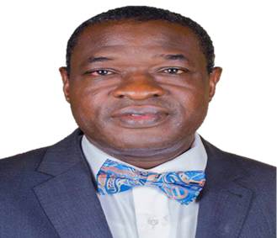
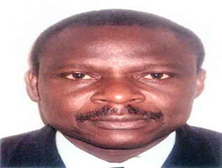
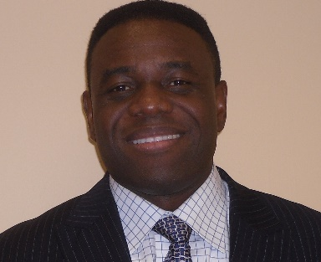
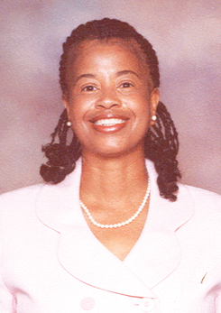

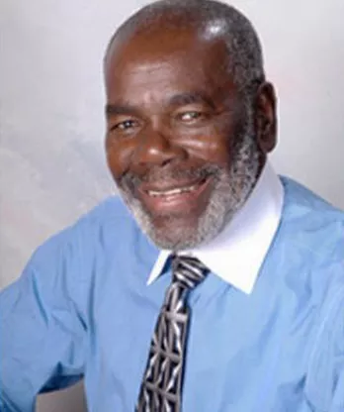
CaPTC Africa Leadership Team
CaPTC Manager
Prof. Emeka Iweala
CaPTC Region 1 Director
Dr. Ademola Popoola
CaPTC Region 2 Directo
Dr. Kayode A. Adeniji
CaPTC Pathology Director
Dr. Ernie Kaninjing
Consortium Manager
CaPTC Community Leadership Team
Mr. Arnold Merriweather
Prostate Cancer Survivor & Advocate
Mr. Jim West
Prostate Cancer Survivor & Advocate
Dr. Angela Adams
Prostate Cancer Advocate

Slide 109
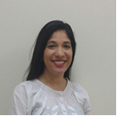

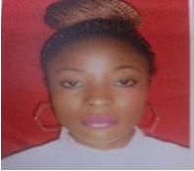

CaPTC, USA
CaPTC Research Coordinators
CaPTC, Africa
Nissa Askins, MPH
Kimberly Meza
Ruth Agaba, MSc
Sarah A. Oluwaseun, MSc

Slide 110

CaPTC Members Around the World
The Bahamas
Cameroon
England
Ghana
Ireland
Martinique
Netherlands
Nigeria
Scotland
South Africa
Tanzania
United States

Slide 111

CaPTC Nigeria Sites
Site | PI
Ace Medical Clinics Limited | Dr. Oluwole Kukoyi
Ahmadu Bello University | Dr. Mohammed Faruk
Covenant University | Dr. Emeka Iweala
Ekiti State University | Dr. Abidemi Omonisi
Federal medical Center, Abeokuta | Dr. Chidiebere Ndukwe Ogo
Federal University of Agriculture Abeokuta | Dr. Catherine Badejo
Lagos State University Teaching Hospital, Ikeja | Prof. John O. Obafunwa
Lagos University Teaching Hospital, Yaba | Dr. Anthonia Sowunmi
National Hospital Abuja | Dr. Paul Jibrin
Obafemi Awolowo University Teaching Hospital | Prof. Ayo Salako
University of Nigeria College of Medicine Enugu | Prof. Iheanyi Okpala
University of Calabar | Dr. Iya Eze Bassey
University of Ibadan Department of Nursing | Dr. Adenike Onibokun
University of Ilorin Teaching Hospital | Dr. Ademola Popoola
University of Maiduguri | Prof. H.A. Nggada

Slide 112


CaPTC “Royal” Members
Chief Olusegun Obasanjo
Former President of Nigeria
Alhaji Dr. Shehu Idris
Amir of Zazzau, Zazzau Palace

Slide 113
Selected CaPTC Contributions

Slide 114


JOURNAL OF THE NATIONAL MEDICAL ASSOCIATION VOL. 98, NO. 4, APRIL 2006

Slide 117



Slide 118



Slide 120


Slide 121
Camille CR Ragin. Research agenda for black prostate health: issues, challenges and future directions. Infectious Agents and Cancer 2011 6(Suppl 1):A1
Olabode Peter Oluwole et al. Histopathological review of prostate cancer in Lokoja, Nigeria. Infectious Agents and Cancer 2011 6(Suppl 1):A2
E Oluwabunmi Olapade-Olaopa et al. Histology of orchidectomy specimens in Nigerian patients with prostate cancer. Infectious Agents and Cancer 2011 6(Suppl 1):A3
Olabode Peter Oluwole et al. Prostate cancer: histopathological analysis of 66 cases. Infectious Agents and Cancer 2011 6(Suppl 1):A4
Ayokunle Osho et al. The role of dietary fat in prostate cancer risk in Jamaican men: a pilot study. Infectious Agents and Cancer 2011 6(Suppl 1):A5
Hernan Flores-Rozas. Differential contribution of mismatch repair genes in the processing of DNA damage. Infectious Agents and Cancer 2011 6(Suppl 1):A6
Rose Mary Stiffin et al. The role of megakaryocytes in breast cancer metastasis to bone. Infectious Agents and Cancer 2011 6(Suppl 1):A7

Slide 122
CaPTC Ecancer Medical Science Special Issue (2014):
Addressing the Global Burden of Prostate Cancer among Black men
Development and assessment of an evidence-based prostate cancer intervention programme for black men. Odedina et al.
Polyisoprenylated methylated protein methyl esterase as a putative drug target for androgen insensitive prostate cancer. Poku et al
From bench to bedside: the realities of reducing global prostate cancer disparity in black men. Robin Roberts
Need for and relevance of prostate cancer screening in Nigeria. Akinremi et al.
Current state of prostate cancer treatment in Jamaica. Morrison et al.
Update on prostate cancer in black men within the UK. Jones and Chinegwundoh
Biospecimens, biobanking and global cancer research collaborations. Ragin and Park

Slide 124
CaPTC West Africa Projects

Slide 125
Next-Generation Sequencing (NGS) of Archived FFPE Tissue of Men of African Ancestry
NIH/National Cancer Institute contract (HSN261201600732P )
To determine whether DNA and RNA obtained from tissues in archival FFPE blocks is of sufficient quality and quantity to conduct NGS assays.
Nigeria FFPE Samples
UF CaPTC Site - Check for Damage or Adverse Conditions and Catolog
Yate’s Lab in Tuskegee – Samples prepared for Gross Quality Control (Curls)
NCI/Leidos for Gross Quality Control

Slide 126

Site | PI
Ace Medical Clinics Limited | Dr. Oluwole Kukoyi
Ahmadu Bello University | Dr. Mohammed Faruk
Covenant University | Dr. Emeka Iweala
Ekiti State University | Dr. Abidemi Omonisi
Federal medical Center, Abeokuta | Dr. Chidiebere Ndukwe Ogo
Federal University of Agriculture Abeokuta | Dr. Catherine Badejo
Lagos State University Teaching Hospital, Ikeja | Prof. John O. Obafunwa
Lagos University Teaching Hospital, Yaba | Dr. Anthonia Sowunmi
National Hospital Abuja | Dr. Paul Jibrin
Obafemi Awolowo University Teaching Hospital | Prof. Ayo Salako
University of Abuja | Dr. Olabode Oluwole
University of Calabar | Dr. Iya Eze Bassey
University of Ibadan Department of Nursing | Dr. Adenike Onibokun
University of Ilorin Teaching Hospital | Dr. Ademola Popoola
University of Maiduguri | Prof. H.A. Nggada
University of Nigeria College of Medicine Enugu | Prof. Iheanyi Okpala
CaPTC
Principal Investigators in Nigeria

Slide 127

Overview of Sample Manifest
Samples 2002-2017 | Passed DNA Quantity (>.2ug) | Passed DNA Quality QC | Samples that Passed both Quantity and Quality
604 | (364) 60% | (286) 47% | (220) 36%
220 samples exosome sequenced || 172 samples RNA sequenced Clinical Data provided to NCI for 176 patients

Slide 128
Jun ‘17
Years 2002-2017

Slide 129
West Africa Transatlantic Prostate Cancer (WATCaP) Familial Project

Slide 130









CaPTC Nigeria Region 1 Principal Investigators
Prof. Emeka Iweala
Professor
Covenant University
Dr. Wole Kukoyi
Owner and Medical Director
Ace Medicare
Dr. Chidiebere Ogo
Consultant Urologist
Federal Medical Center, Abeokuta

Slide 131













CaPTC Nigeria Region 2 Principal Investigators
Prof. Ayo Salako
Deputy Provost
Obafemi Awolowo University

Slide 132


CaPTC Cameroon Principal Investigators
Prof. Blaise Nkegoum
Pathologist
University Hospital Center, Yaounde
Dr. Paul Achu
Pathologist
Mezam Polyclinic - Bamenda

Slide 133
WATCaP Familial Project …
Funded by: University of Florida CaPTC; Carnegie Foundation of NY; NCI GMAP Pilot Funding (Moffitt Cancer Center)
Specific Aims:
  Create a Familial Cohort of West African Black men (WABM Familial Cohort) in United States who can be followed prospectively annually to better understand the bio-behavioral etiology of CaP among West African men.
  Using REDCap database, integrate the United States WABM Familial Cohort data with an international WABM Familial Cohort data of Nigerian and Cameroonian men to better understand the bio-behavioral etiology of CaP among West African men.

Slide 134
Specific Aim 1: Create a Familial Cohort of West African Black men (WABM Familial Cohort) in United States who can be followed prospectively annually to better understand the bio-behavioral etiology of CaP among West African men.
Recruit a minimum of 1,000 West African immigrant men, including the male relatives of participants (father, full brothers, half-brothers, and sons).
Assess baseline behavioral, clinical, epidemiological, and environmental variables that may explain the etiology of CaP risk in the WABM Familial cohort using the standardized C.A.M. CaP measures.
Assess baseline biological/biochemical variables that may explain the etiology of CaP risk in the WABM familial cohort from saliva samples.
Whenever possible, access and link past and future clinical data of participants to the cohort database.

Slide 135
Specific Aim 2: Using REDCap database, integrate the United States WABM Familial Cohort data with an international WABM Familial Cohort data of Nigerian and Cameroonian men to better understand the bio-behavioral etiology of CaP among West African men.
Integrate the 1,000 United States WABM Familial Cohort data with 1,000 international WABM Familial Cohort data of Nigerian and Cameroonian men using the REDCap database management system.
Conduct exploratory analysis on the bio-behavioral etiology of CaP among West African men.

Slide 136
Update
Data Collection ongoing
715 participants recruited in Nigeria, Cameroon and United States
  ReDCaP Database of Clinical, Behavioral and Epidemiological measures
  Saliva samples

Slide 137
Pending Publications | Lead Author(s)
Prostate Cancer Burden in Ethnically Diverse West African Men: The CaPTC Cohort Study | Odedina (UF)
Modifiable Risk and Protective Factors Implicated in Prostate Cancer Mortality and Morbidity among West African Men | Kaninjing (UF)
Community Access the Gateway to Community Engagement Research: Best practices from CaPTC Cohort Study | Omonisi (ESU)
Behavioral Risk Factors Associated with Prostate Cancer: A Comparison of West African Men and US West African Immigrants from the CaPTC Cohort Study | Oladoyinbo (FUNAAB)
Comparing Salivary Cortisol Levels, Performance Status as Prognostic Indicators for Prostate Cancer Risk in Nigerian Men and Nigerian Immigrants in US: The CaPTC Cohort Study | Mohammed (ABU)
Biological Factors Implicated in Prostate Cancer in West African Men: The CaPTC Cohort Study | Iweala (Covenant)
Clinical Determinants of Prostate Cancer in West African Men: The CaPTC Cohort Study | Kukoyi (ACE)
Factors Determining the Health Seeking Behavior of Nigerian men Relative to Prostate Cancer: A Comparison of Nigerian Men in Nigeria and in the Diaspora ( The CaPTC Cohort Study) | Popoola (UNILORIN)
Overcoming Barriers in Conducting a Transatlantic Prostate Cancer Familial Study in Africa: Best Practice from the CaPTC Cohort Study | Bassey (UNICAL)

Slide 138
IV. Opportunities for Collaboration with CaPTC Program

Slide 139
Global sites
  Primed for collaborative research projects
Significant Research Database
  Collaborative projects
  Publications
Tri-Consortia Collaborations:
  Uniform measures for prostate cancer studies
  Pathology SOPs for West Africa

Slide 140

www.globalprostatecancerconference.com

Slide 141

www.globalclinicaltrialscongress.com

Slide 142

Join Us For the Historic Journey of the Transatlantic Slave Trade!

Slide 143



Slide 144




Slide 145




Slide 146






Slide 147



Slide 148





Slide 149
Acknowledgement - Funding
  NIH/NCI P20 Award P20CA192992
  Florida Minority Cancer Research & Training (MiCaRT) Center
Department of Defense PCRP Awards (2013-Present)
NIH/National Cancer Institute Epidemiology & Genomics Research Program (2012 – Present).
NIH/National Cancer Institute R13 grant awards (2010 – Present)
Carnegie African Diaspora Fellowship (2017)
US Fulbright Research Scholar Award (2006)

Slide 150


Acknowledgement: The Global Team

Slide 151
Acknowledgement
Study Participants
  Over 20,000 participants …
Community Partners
  Global network of prostate cancer advocates

Slide 152
Contact CaPTC
http://epi.grants.cancer.gov/captc
United States
Dr. Ernie Kaninjing
Ms. Nissa Askins
Ms. Kimberly Meza
+1 (407) 313-7112
captc@cop.ufl.edu
Africa
Mrs. Sarah Adewumi
+ 234(809)9427482
seunadewumi2014@gmail.com
Ms. Ruth Joseph Agaba
+ 234(809)9427481
agabaruth12@gmail

Slide 153
John Maxwell quotes
“People do not care how much you know until they know how much you care.”

