Slide 1


Are We Comparing Apples To Oranges?
Prostate Cancer In Black Men And White Men
R. Renee Reams, PhD
Professor of Biochemistry
College of Pharmacy & Pharmaceutical Sciences
Florida A& M University
Tallahassee, Florida, USA
Inequalities in Prostate Cancer Health Disparities-Symposium
Barcelona, Spain
April 10 -11, 2019

Slide 2
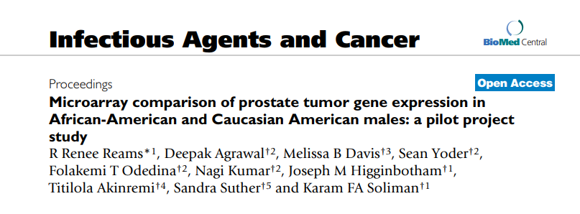
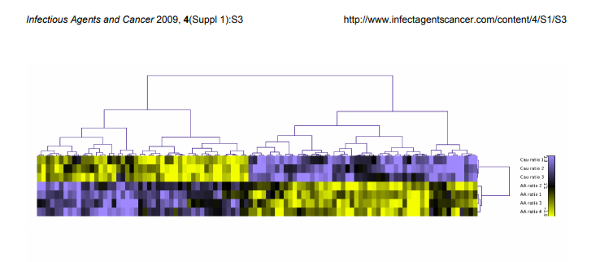
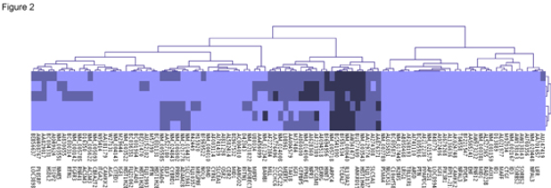
Real Differences in Prostate Tumors in Black Men Vs White Men
R. Renee Reams, et al 2009

Slide 3
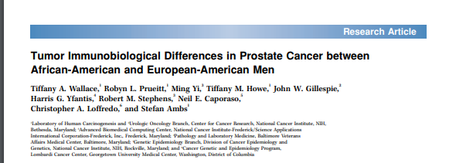
Real Differences in Prostate Tumors in Black Men

Slide 4
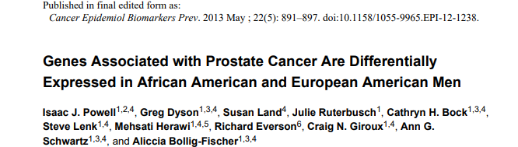
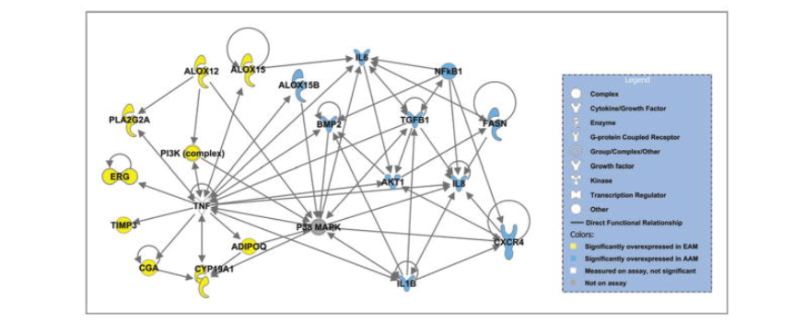
Real Differences in Prostate Tumors in Black Men

Slide 5
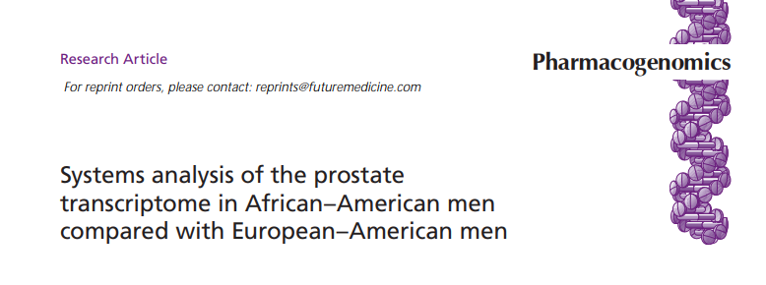
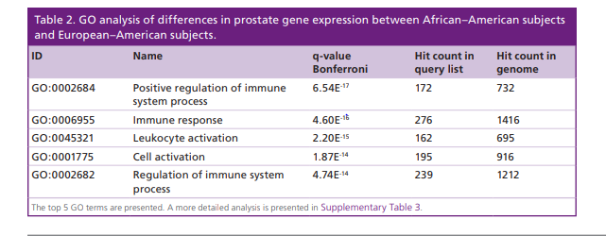
RNA/Seq: Real Differences in Prostate Tumors in Black Men vs White Men
Gary Hardiman*,1,2 , Stephen J Savage4,5 , E Starr Hazard2,3 , Robert C Wilson2,6, Sean M Courtney2 , Michael T Smith6, Bruce W Hollis7 , Chanita Hughes Halbert5,8 & Sebastiano Gattoni-Celli**,5,9
An RNA-Sequence Analysis of Prostate Tumors

Slide 6
What’s Driving These “Hot” Prostate Tumors In Black Men?
Are Black Men Inherently wired with increased inflammation? And Why?
Do Hot tumors exist in Native Born African Men or is increased Inflammation
Inherent in African Immigrants to the USA
Does Mom’s mitochondrial DNA pre-dispose Black Men to have
increased inflammation, If so why?
Is increased inflammation in Black Men in USA associated with societal stress
of being born Black in America; especially in the southeastern United States?

Slide 7
EAT MORE VEGETABLES

Slide 8
What Are Your Thoughts: RACE vs ETHNICITY/ANCESTRY
When we stop using the label “race” in
association with health and health outcomes?
Ethnicity and ancestry should be the information
Collected on all health records?
Going Forward, What are the barriers to collecting
Ethnicity and ancestry data on health records

Slide 9
Opinion Poll from PhD Nurses: Pros for Using Ethnicity
Patient race can be used by physicians to predict disease risk and determine drug therapy
Patient race important to understand the patient's views, such as alternative medicine preferences and cultural beliefs about illness
Scientists continue to develop models of how race can be used to predict disease risk
We will have more granular data, namely instead of a generic Asian, one may report Korean, Vietnamese, etc. (No cons since one can always deduct race from the more detailed ethnicity data.)
The potential benefit is it may facilitate the discovery and implementation of more targeted intervention
Help with deeper understanding of how ethnic beliefs about health and illness truly influences health outcomes (whether therapies are accepted, utilized as prescribed, or used in conjunction with ethnic remedies)
Understand how languages spoken at home can foster trust or mistrust of providers who may not appreciate the nuanced behaviors associated with patient-provider relationships
Understand how the process of acculturation can cause under stress and influence poor health outcomes
Understand how to leverage ancestral practices to promote adherence to healthy lifestyles
Some journals and editors offer suggestions and guidelines to follow, there is an attempt to standardize reporting
Results from racial and ethnic testing vary between groups. Results are needed for all groups
We can gain a better understanding of how to characterize and determine differences in human populations
Genetic ancestry markers is based on genetic/genomic data, instead of social constructs
Example: Some self-reported African American ancestry can have up to 99% European admixture while some self-reported European ancestry has African American admixture. doi:10.1186/s40246-014-0023-x
Course categorization may allow identification of associated variables that can be studied in more granular manner with a variety of tools and analytics

Slide 10
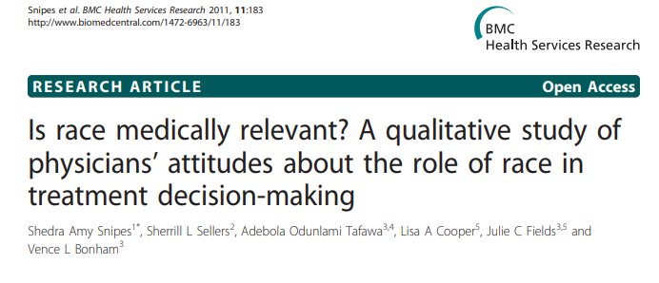
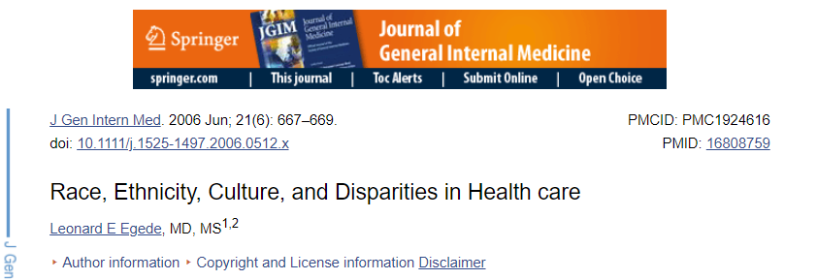
Opinion Poll from PhD Nurses: Cons for Using Race/Ethnicity
​Bias and stereotyping by clinicians based on race
Misuse of the data can create more mistrust of the medical establishment leading to refusal to participate in research or non-adherence to medical therapies
Future governments not sympathetic to the ethnic groups may use the data against them
The data could be used as the basis for discrimination in employment, housing, and insurance coverage
​Race is typically inadequately explained and inconsistently used
​It can be difficult to differentiate the social construct from a genetic variable
Family history details for many generations with environmental information may provide more information than race/ethnicity about likely ancestry and culture mixture that could inform healthcare

Slide 11

ACKNOWLEDGEMENTS
Mr. Vigil Simmons, Organizer
Prostate Net
IT Staff for this conference
Meeting Organizers
Fellow Conference Participants
All Black Male Prostate Tissue Donors
NIH, NCI, HERI, and my other funding agents

