Slide 1
Social determinants of Health Disparity
Professor Frank Chinegwundoh MBE
Consultant Urological Surgeon, London, UK
Disparities symposium Barcelona 10-11 April 2019

Slide 2
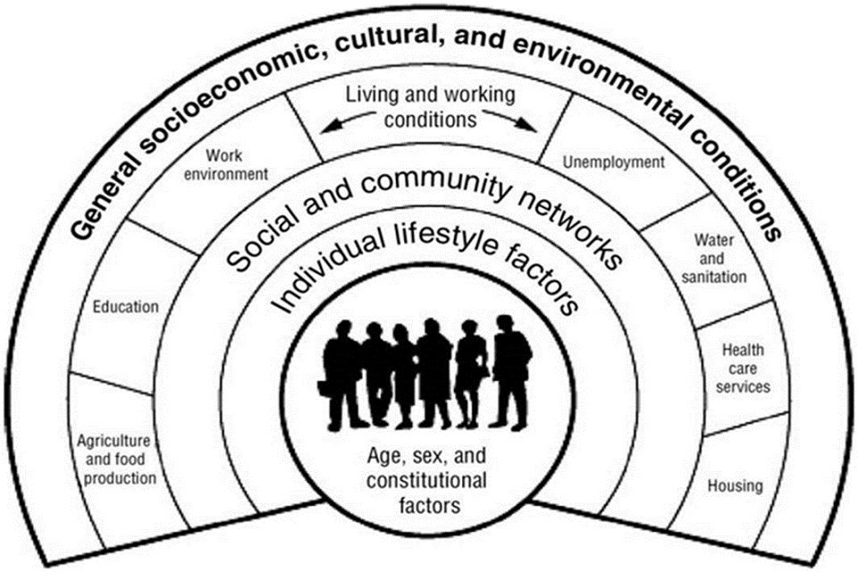
Social & economic determinants of health
Dahlgren & Whitehead 1991

Slide 3
Social determinants Healthy people 2020
Availability of resources to meet daily needs (e.g., safe housing and local food markets)
Access to educational, economic, and job opportunities
Access to health care services
Quality of education and job training
Availability of community-based resources in support of community living and opportunities for recreational and leisure-time activities
Transportation options
Public safety
Social support
Social norms and attitudes (e.g., discrimination, racism, and distrust of government)
Exposure to crime, violence, and social disorder (e.g., presence of trash and lack of cooperation in a community)
Socioeconomic conditions (e.g., concentrated poverty and the stressful conditions that accompany it)
Residential segregation
Language/Literacy
Access to mass media and emerging technologies (e.g., cell phones, the Internet, and social media)
Culture

Slide 4
Socialness
Relationships are important
Social cohesion
Social capital …….. Religion Family
Social networks …….. Spread health behaviours
Social support
Social isolation
Notes:
Relationships are important for physical health and psychosocial well-being.^{1, 2, 3, 4, 5} Relationships are conceptualized through terms such as social cohesion, social capital, social networks, and social support. Social cohesion refers to the strength of relationships and the sense of solidarity among members of a community.⁶ One indicator of social cohesion is the amount of social capital a community has. Social capital deals with shared group resources,^{6, 7, 8} like a friend-of-a-friend’s knowledge of a job opening.⁹ Individuals have access to social capital through their social networks,⁸ which are webs of social relationships.^{10, 11}Social networks are sources of multiple forms of social support, such as emotional support (e.g., encouragement after a setback) and instrumental support (e.g., a ride to a doctor’s appointment).^{10, 11} This summary will review the positive and negative health effects social cohesion has on an individual’s life.
Social capital is an important marker of social cohesion, and it has significant ramifications for health. For example, one study examined the link between 4 measures of social capital (perceived fairness, perceived helpfulness, group membership, and trust), income inequality, and mortality.¹² The authors found that all 4 measures of social capital were associated with mortality. They also found that the relationship between income inequality and mortality may be partially explained by reductions in social capital as income inequality increases.^{12, 13}
Collective efficacy, an aspect of social capital and social cohesion, is grounded on mutual trust and describes a community’s ability to create change and exercise informal social control (i.e., influence behavior through social norms).¹⁴ Collective efficacy is associated with better self-rated health,¹⁵ lower rates of neighborhood violence,¹⁴ and better access to health-enhancing resources like medical care, healthy food options, and places to exercise.¹⁶ Social institutions like religion and the family are common sources of social capital and social control, as well as social networks and social support.^{7, 17, 18}
Social networks spread social capital, ⁸ but they can also spread health behaviors and outcomes, a phenomenon known as “social contagion.”¹⁹ For example, if an individual’s friend, sibling, or spouse is obese, the individual’s likelihood of also becoming obese increases.²⁰ Similar patterns are seen for smoking²¹ and drinking²² behaviors.
High levels of social support can positively influence health outcomes through behavioral and psychological pathways.^{11, 23} For example, social support may help people stick to healthier diets ²³ and reduce emotional stress.¹ Both of these pathways can affect biological functioning in the cardiovascular, neuroendocrine, and immune systems.^{11, 23} Social support can therefore both directly benefit people and indirectly buffer them from risk factors that might otherwise damage health.²⁴ In a study conducted on the relationship between social support and atherosclerosis (plaque in the arteries), social support contributed to lower atherosclerosis levels in women at high risk for heart disease.²⁵ The protective nature of social support may be especially important for minority populations. One study of Mexican-origin adults in California found that social support acted as a barrier against the harmful health effects of discrimination.²⁶
While social ties sometimes transmit negative health behaviors or add stress,^{5, 27} social isolation is usually detrimental to health and increases mortality.^{4, 28} Social isolation is a special concern for older adults, as contact with friends decreases with age.29 Older individuals in long-term care facilities or with conditions that interfere with daily activities, like arthritis, may suffer from loneliness and a lack of social cohesion,^{30, 31} which may negatively impact health. For example, one study conducted among older adults found an association between reduced neighborhood social cohesion and a heightened likelihood of insomnia, which can have negative health effects.³² Similarly, during natural disasters like heat waves, elderly individuals living in neighborhoods with low social cohesion may lack social support from concerned neighbors who will check on them, and they have fewer safe communal areas where they can seek refuge.³³
Given the complex nature of the association between social ties and health,^{1, 11} social interventions designed to improve health vary significantly. These interventions can occur at multiple levels (e.g., family, group, neighborhood) and sometimes require cross-sector collaboration (e.g., education, public health, housing) to foster community building and improve health.^{34, 35, 36, 37} Further research is needed to better understand how social cohesion affects health, as well as how it can be used to reduce health disparities. This evidence will facilitate public health efforts to address social cohesion as a social determinant of health.
Disclaimer: This summary of the literature on social cohesion as a social determinant of health is a narrowly defined examination that is not intended to be exhaustive and may not address all dimensions of the issue.^{1, 2}Please keep in mind that the summary is likely to evolve as new evidence emerges.

Slide 5
The End

Slide 6
Relationships are important for physical health and psychosocial well-being.^{1, 2, 3, 4, 5} Relationships are conceptualized through terms such as social cohesion, social capital, social networks, and social support. Social cohesion refers to the strength of relationships and the sense of solidarity among members of a community.⁶ One indicator of social cohesion is the amount of social capital a community has. Social capital deals with shared group resources,^{6, 7, 8} like a friend-of-a-friend’s knowledge of a job opening.⁹ Individuals have access to social capital through their social networks,⁸ which are webs of social relationships.^{10, 11}Social networks are sources of multiple forms of social support, such as emotional support (e.g., encouragement after a setback) and instrumental support (e.g., a ride to a doctor’s appointment).^{10, 11} This summary will review the positive and negative health effects social cohesion has on an individual’s life.
Social capital is an important marker of social cohesion, and it has significant ramifications for health. For example, one study examined the link between 4 measures of social capital (perceived fairness, perceived helpfulness, group membership, and trust), income inequality, and mortality.¹² The authors found that all 4 measures of social capital were associated with mortality. They also found that the relationship between income inequality and mortality may be partially explained by reductions in social capital as income inequality increases.^{12, 13}
Collective efficacy, an aspect of social capital and social cohesion, is grounded on mutual trust and describes a community’s ability to create change and exercise informal social control (i.e., influence behavior through social norms).¹⁴ Collective efficacy is associated with better self-rated health,¹⁵ lower rates of neighborhood violence,¹⁴ and better access to health-enhancing resources like medical care, healthy food options, and places to exercise.¹⁶ Social institutions like religion and the family are common sources of social capital and social control, as well as social networks and social support.^{7, 17, 18}
Social networks spread social capital, ⁸ but they can also spread health behaviors and outcomes, a phenomenon known as “social contagion.”¹⁹ For example, if an individual’s friend, sibling, or spouse is obese, the individual’s likelihood of also becoming obese increases.²⁰ Similar patterns are seen for smoking²¹ and drinking²² behaviors.
High levels of social support can positively influence health outcomes through behavioral and psychological pathways.^{11, 23} For example, social support may help people stick to healthier diets ²³ and reduce emotional stress.¹ Both of these pathways can affect biological functioning in the cardiovascular, neuroendocrine, and immune systems.^{11, 23} Social support can therefore both directly benefit people and indirectly buffer them from risk factors that might otherwise damage health.²⁴ In a study conducted on the relationship between social support and atherosclerosis (plaque in the arteries), social support contributed to lower atherosclerosis levels in women at high risk for heart disease.²⁵ The protective nature of social support may be especially important for minority populations. One study of Mexican-origin adults in California found that social support acted as a barrier against the harmful health effects of discrimination.²⁶
While social ties sometimes transmit negative health behaviors or add stress,^{5, 27} social isolation is usually detrimental to health and increases mortality.^{4, 28} Social isolation is a special concern for older adults, as contact with friends decreases with age.29 Older individuals in long-term care facilities or with conditions that interfere with daily activities, like arthritis, may suffer from loneliness and a lack of social cohesion,^{30, 31} which may negatively impact health. For example, one study conducted among older adults found an association between reduced neighborhood social cohesion and a heightened likelihood of insomnia, which can have negative health effects.³² Similarly, during natural disasters like heat waves, elderly individuals living in neighborhoods with low social cohesion may lack social support from concerned neighbors who will check on them, and they have fewer safe communal areas where they can seek refuge.³³
Given the complex nature of the association between social ties and health,^{1, 11} social interventions designed to improve health vary significantly. These interventions can occur at multiple levels (e.g., family, group, neighborhood) and sometimes require cross-sector collaboration (e.g., education, public health, housing) to foster community building and improve health.^{34, 35, 36, 37} Further research is needed to better understand how social cohesion affects health, as well as how it can be used to reduce health disparities. This evidence will facilitate public health efforts to address social cohesion as a social determinant of health.
Disclaimer: This summary of the literature on social cohesion as a social determinant of health is a narrowly defined examination that is not intended to be exhaustive and may not address all dimensions of the issue.^{1, 2}Please keep in mind that the summary is likely to evolve as new evidence emerges.

