Slide 1
Health disparities – general discussion
Professor Frank Chinegwundoh MBE
Consultant Urological Surgeon, London
For the Barcelona Disparities Symposium 10-11 April 2019

Slide 2
Definition of health disparities
Where a health outcome is seen to a greater or lesser extent between populations
          USA Healthy people 2020
Reducing health inequalities means giving everyone the same opportunities to lead a healthy life, no matter where they live or who they are
          UK Public Health England 2017
NIH differences in the incidence, prevalence, and mortality and other adverse health conditions that exist among specific population groups in the US

Slide 3


Slide 4

Health disparities
Health inequities = health disparities = health inequalities
WHO health inequities are systematic differences in health outcomes
significant social and economic costs to society and individuals
can be reduced by government policies
Development is slowed by inequities

Slide 5
Examples of health disparities
Sex
Race or ethnicity
Income
Education
Sexual orientation
geography
CONSIDER
  Transport
  Food & agriculture
  Housing
  Waste
  Energy
  Industry
  Urbanisation
  Genetics-social support-health services
      https://www.who.int/hia/evidence/doh/en/ accessed 7 April 2019

Slide 6
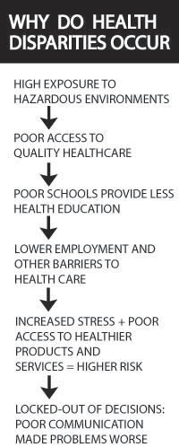

Slide 7
World Health Organisation data
Child mortality
Rural and poor households – higher deaths
20% poorest households x2 die < 5years cf. to wealthiest 20%
Pneumonia
Malaria
Diarrhoea
x 14 death rate in sub-Saharan Africa cf rest of the World

Slide 8
Maternal mortality
99% of maternal deaths occur in developing countries
Chad 1 in 16
Sweden 1 in 10 000

Slide 9
TB. NCD
95% of deaths in developing world
Young adults
87% of deaths due to non communicable diseases occur in low and middle income countries
USA. HIV 50% African Americans but only 13% of population
  No biological or genetic reason
                www.who,int/features/factfiles/health_inequities/en

Slide 10
Life expectancy
LIC average life expectancy is 62 years. /high income 81
Sierre Leone 50 yrs
Japan 84 yrs
In UK Glasgow 66.2 yrs to 81.7
London – tube line effect

