Slide 1
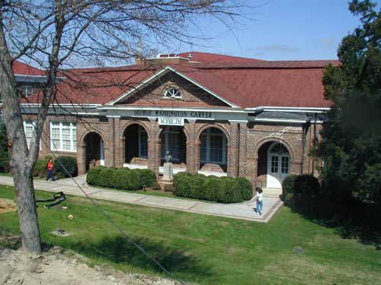
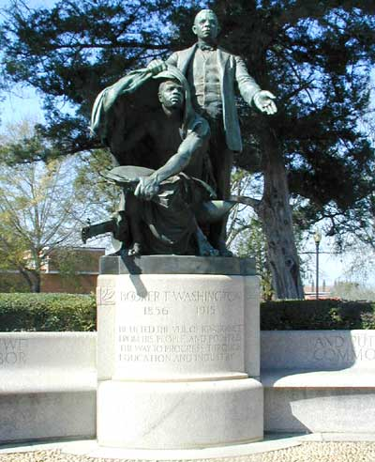
Disparate Populations and the impact of Prostate Cancer
Clayton C. Yates , PhD
Tuskegee University
Center for Cancer Research
Barcelona, Spain
April 10, 2019

Slide 2
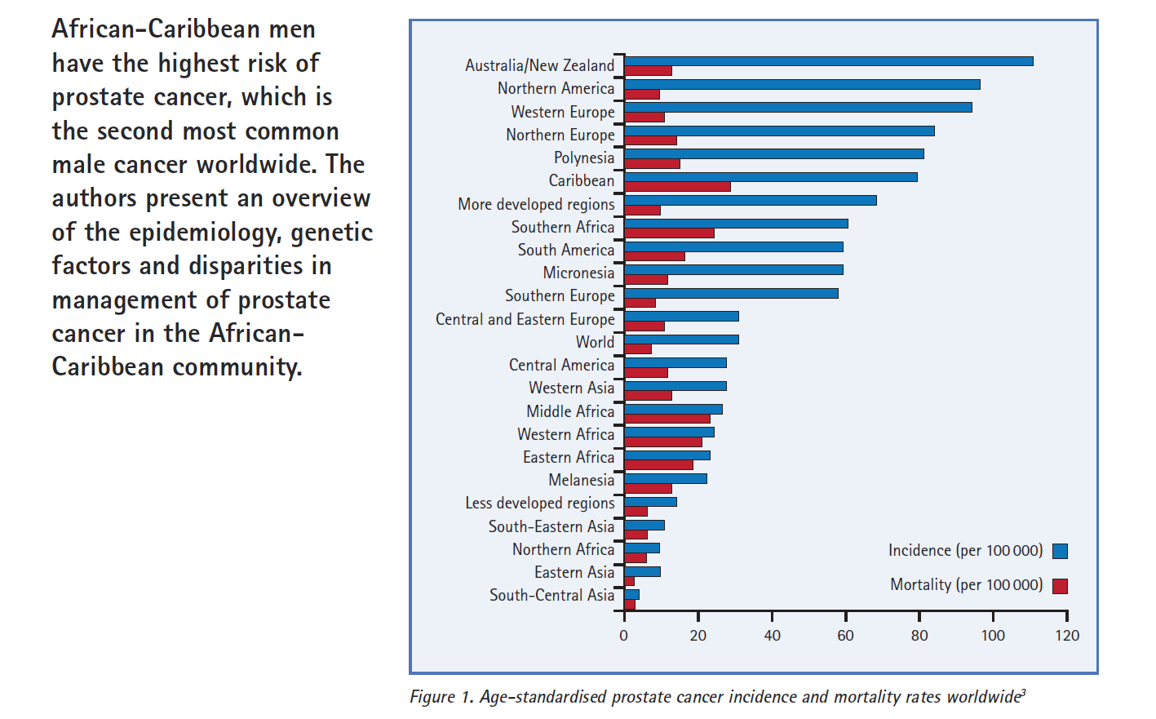
African-Caribbean Men have highest Risk of Prostate Cancer

Slide 3
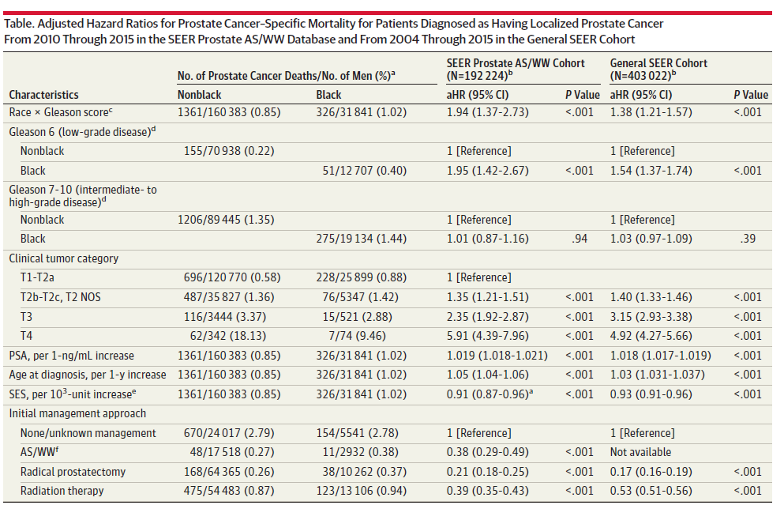
Prostate Cancer–Specific Mortality Across Gleason Scores in Black vs Nonblack Men
Maha et al JAMA. 2018;320(23):2479-2481.

Slide 4
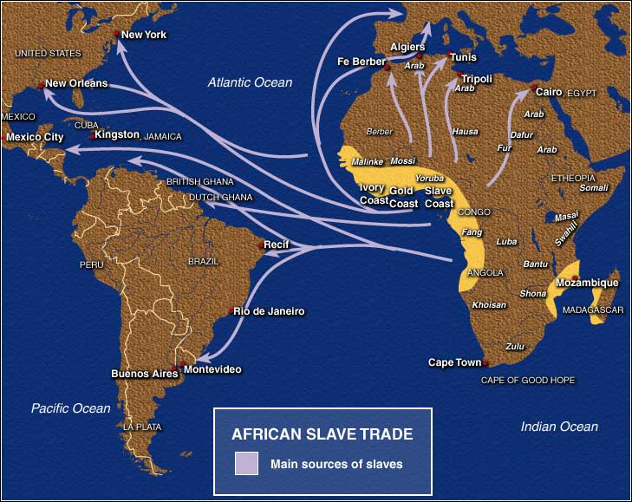
African Diaspora &
Prostate and Breast Cancer
Courtesy Rick Kittles
Notes:
4
Historical shipping, naval and trade records reveal that the sources of enslaved Africans originated from eight coastal regions.
Senegambia (Senegal and Gambia) 5 %
Sierra Leone (Guinea, S. L., and Liberia) 3 %
Windward Coast (Ivory Coast and Liberia) 4 %
Gold Coast (Ghana west of Volta River) 10 %
Bight of Benin (between Volta and Benin Rivers) 18 %
Bight of Biafra (east of Benin River to Gabon) 20 %
Central Africa (Gabon and Angola) 40 %
East Africa (cape of Good Hope to Cape Delgado, including Madagascar) 5 %
(X)

Slide 5
Reducing Cancer Disparities
Birth
Death
Social Circumstances 15%
Genetic
Factors
30%
Medical
Care 10%
Health Behaviors 40%
Environmental Exposure 5%
SOCIAL JUSTICE
Equity in
pharmaceutical
research &
medications
Equity in housing, education,
economic opportunity, and
health opportunity
Equity in
medical
care
Adapted from McGinnis et al. Health Affairs, 2002

Slide 6
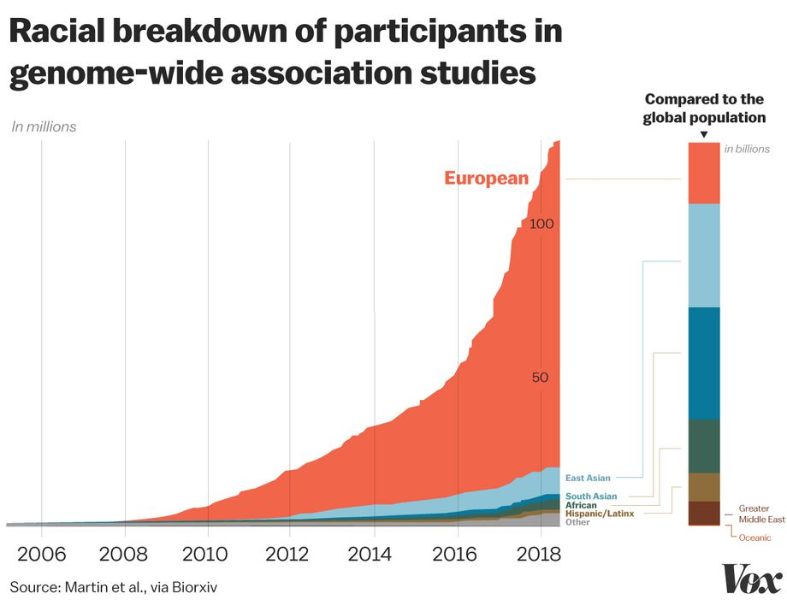

Slide 7
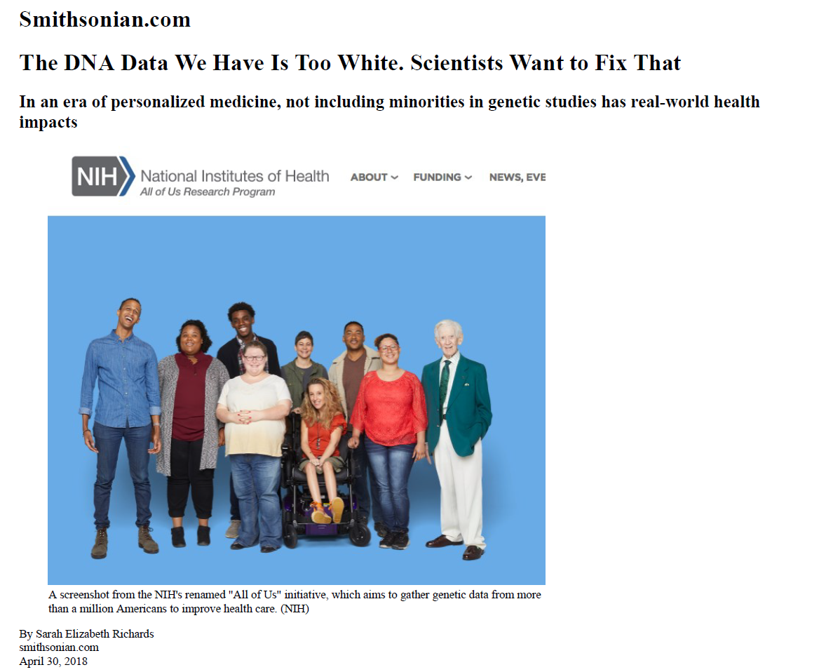

Slide 8
“If people aren’t involved in the research, they may not benefit from the advances”

Slide 9
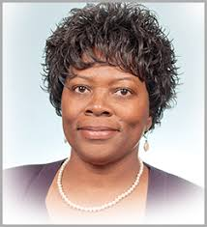
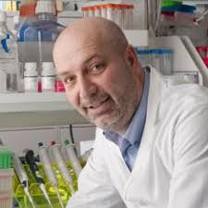
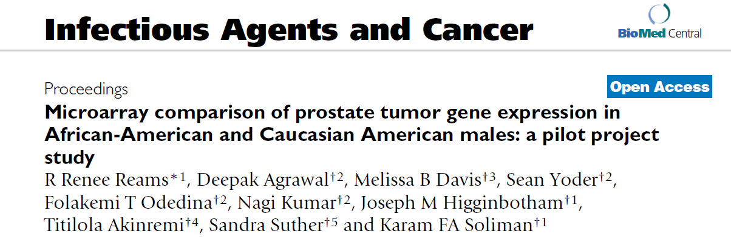
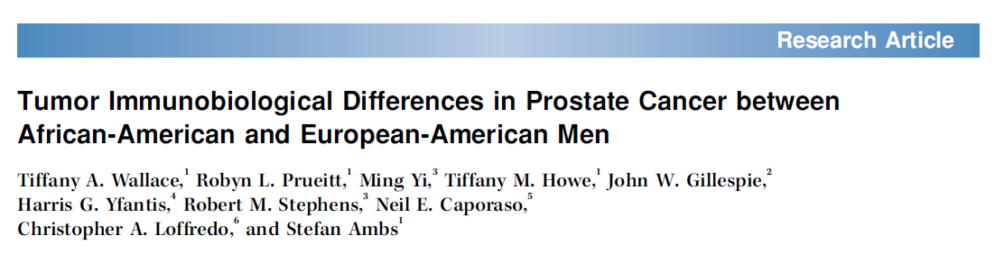
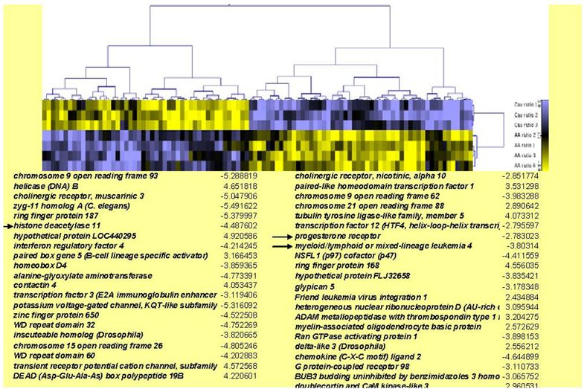
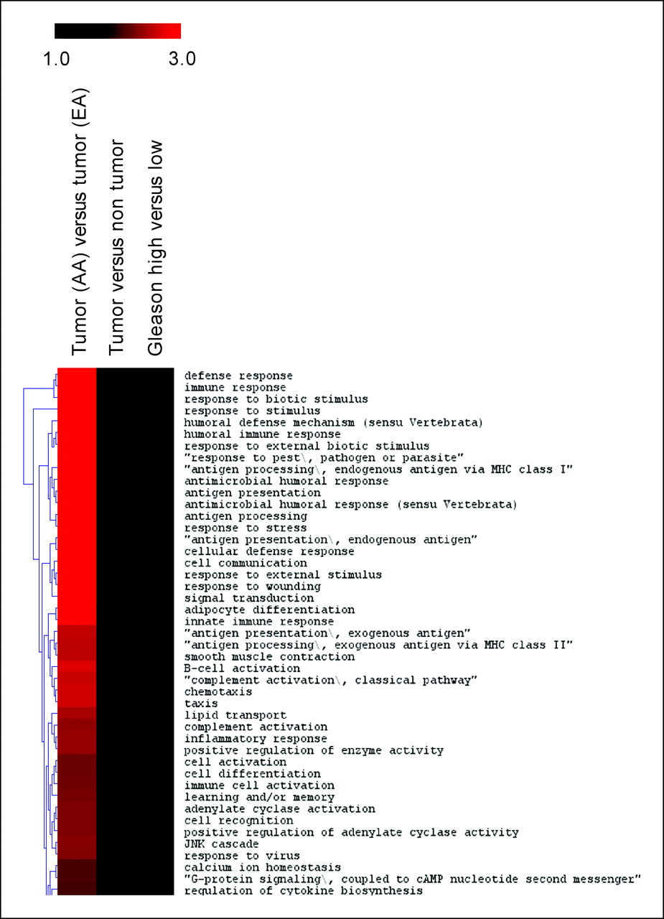
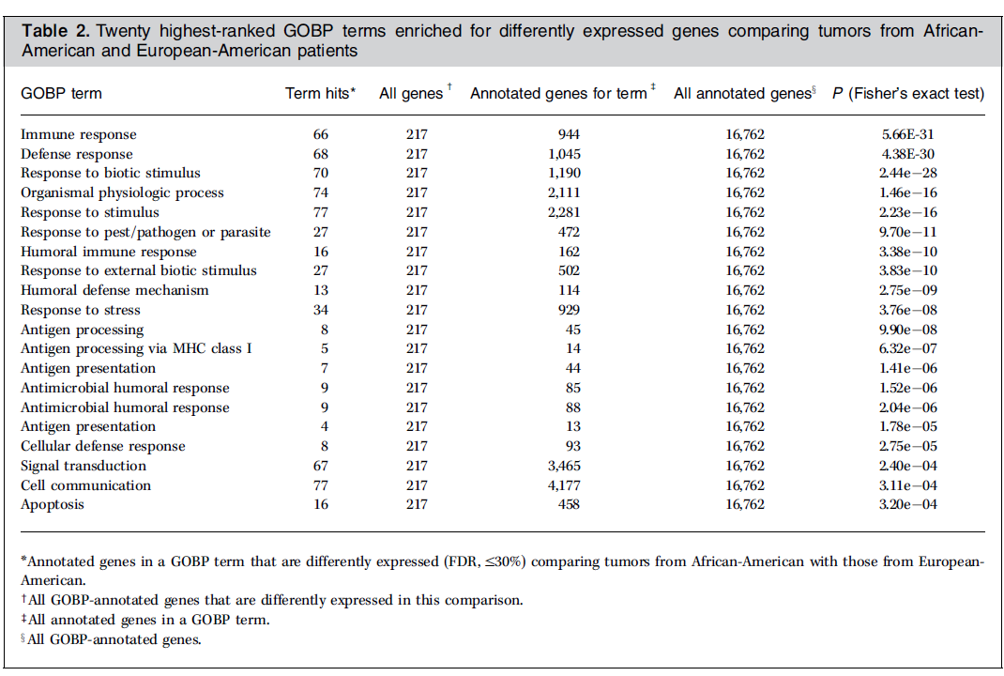
Renee Reams PhD
Florida A&M Univ.
Stefan Ambs PhD
NCI

Slide 10
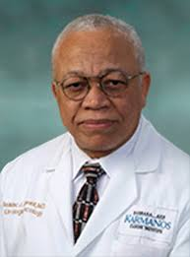
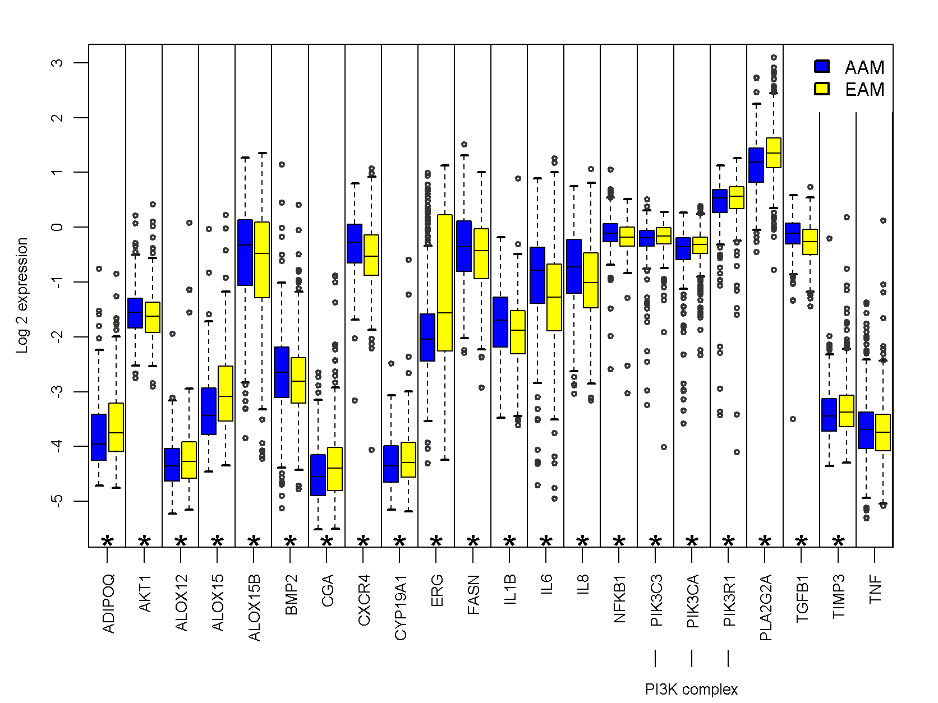
Are there Really genetic differences in PCa?
Isaac Powell, Greg Dyson, Sue Land, Julie Ruterbusch, Cathryn Bock, Steven Lenk, Mehsati Herawi, Richard Everson, Craig Giroux, Ann Schwartz, and Aliccia Bolig-Fischer
Wayne State University/Karmanos Cancer Institute
Figure 2. Boxplots of the log base 2 expression profile of the genes stratified by race from the network figure. The individual genes measured on the assay from the PI3K complexes are included in the graph. The stars at the bottom of the graph indicate statistically significant differences between races. As TNF is a central hub in the network, it is included in the graph even though it is not statistically significant.
Issac Powell MD
Wayne State Univ.
Archived tumor samples from radical prostatectomy (656 FFPE blocks) from Wayne State U pathology core
Focused 529 gene prostate cancer microarray
Cancer,Epid., Biomarker and Prevention, 2013

Slide 11

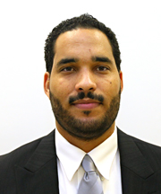
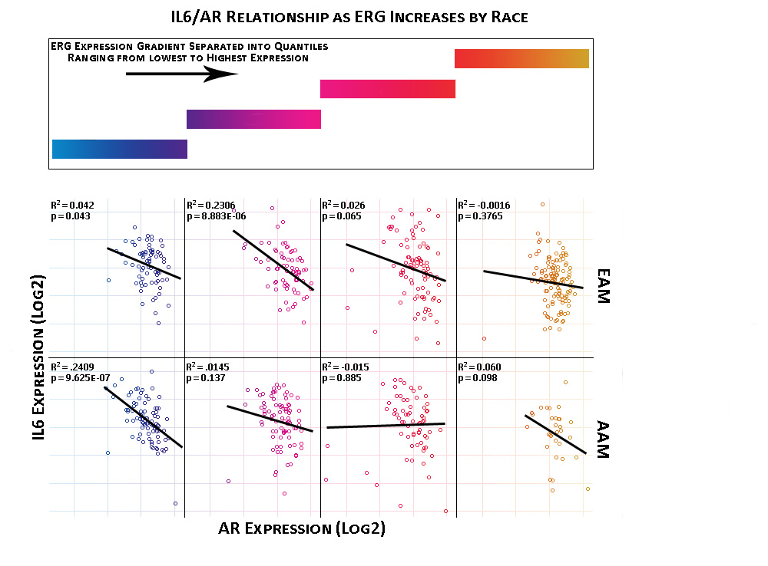
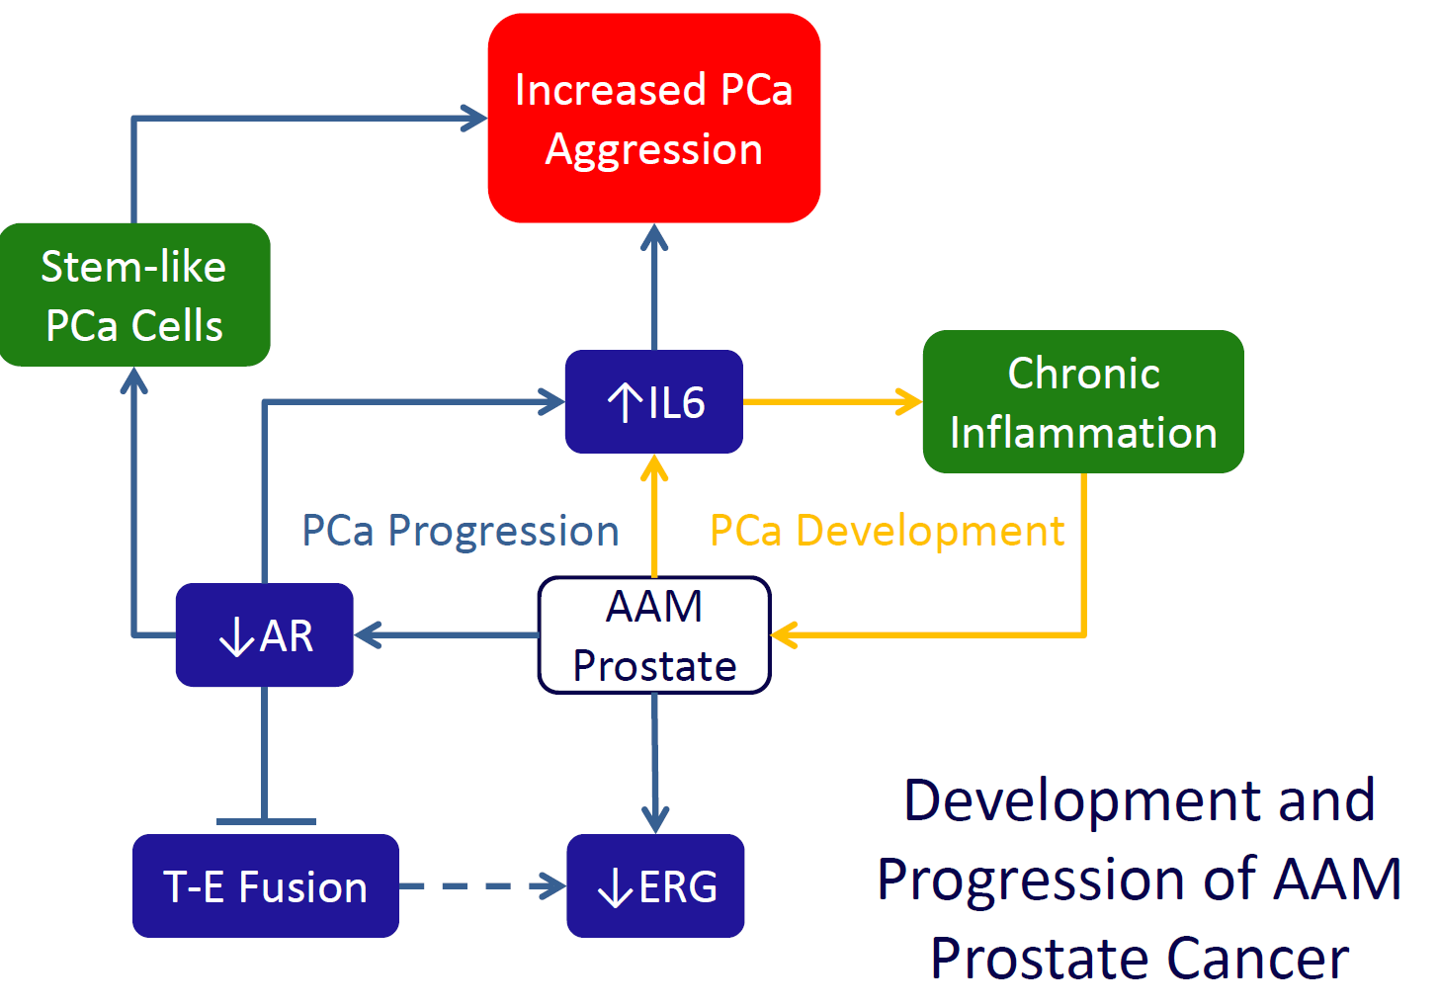
Fusion-Negative Prostate Tumors
Honghe Wang PhD
Jason White M.S
DO NOT POST
Unpublished data generated in Yates lab
Notes:
Conditioning plot showing the relationship between IL6 and AR across increasing ERG expression ranges – the IL6/AR relationships within the lower ERG expression ranges show statistical significance, with AAM patients showing the most significance in the lowest quantile of ERG expression.

Slide 12
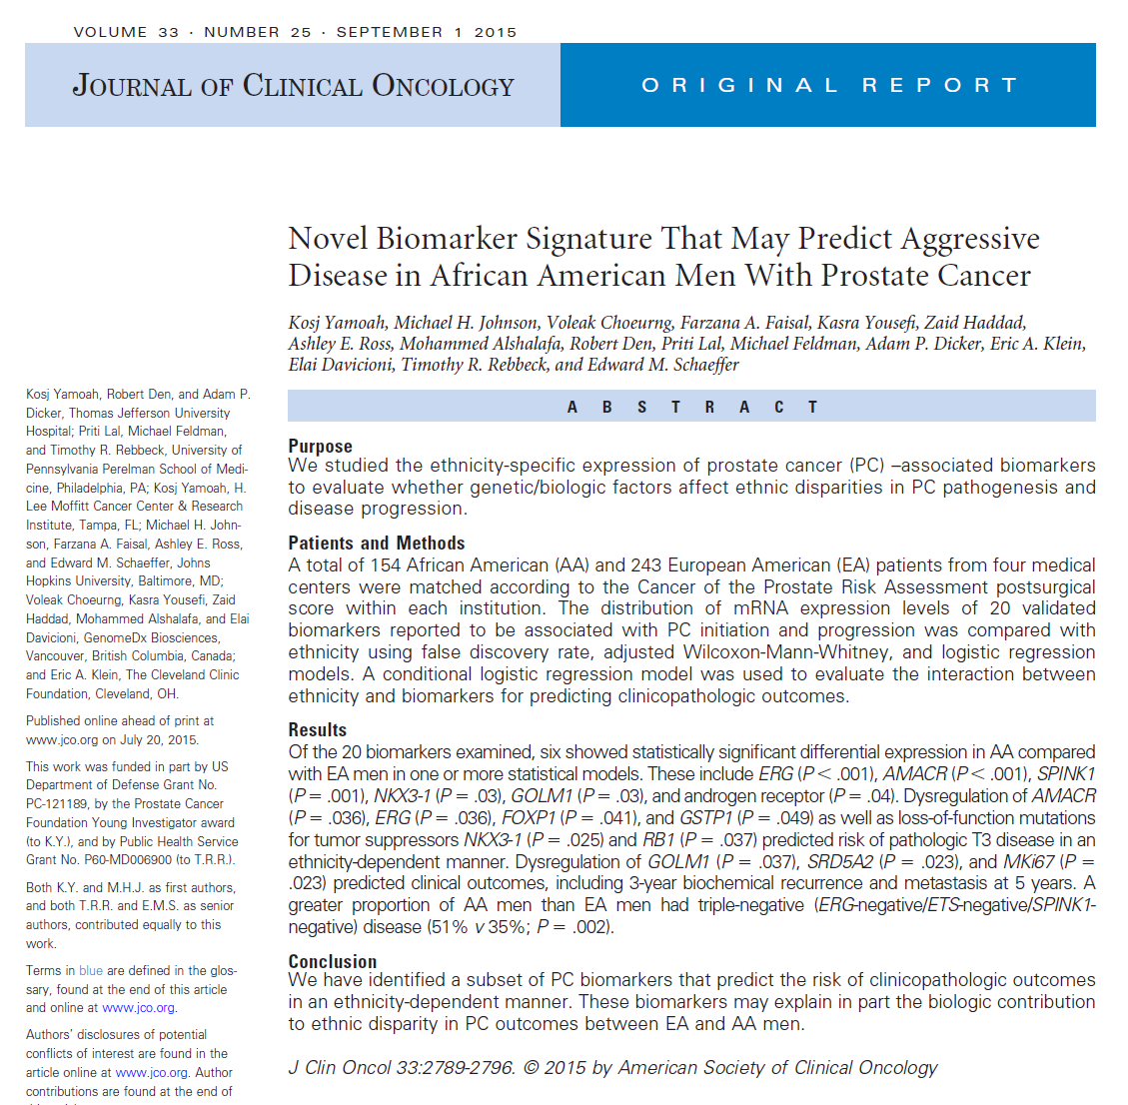
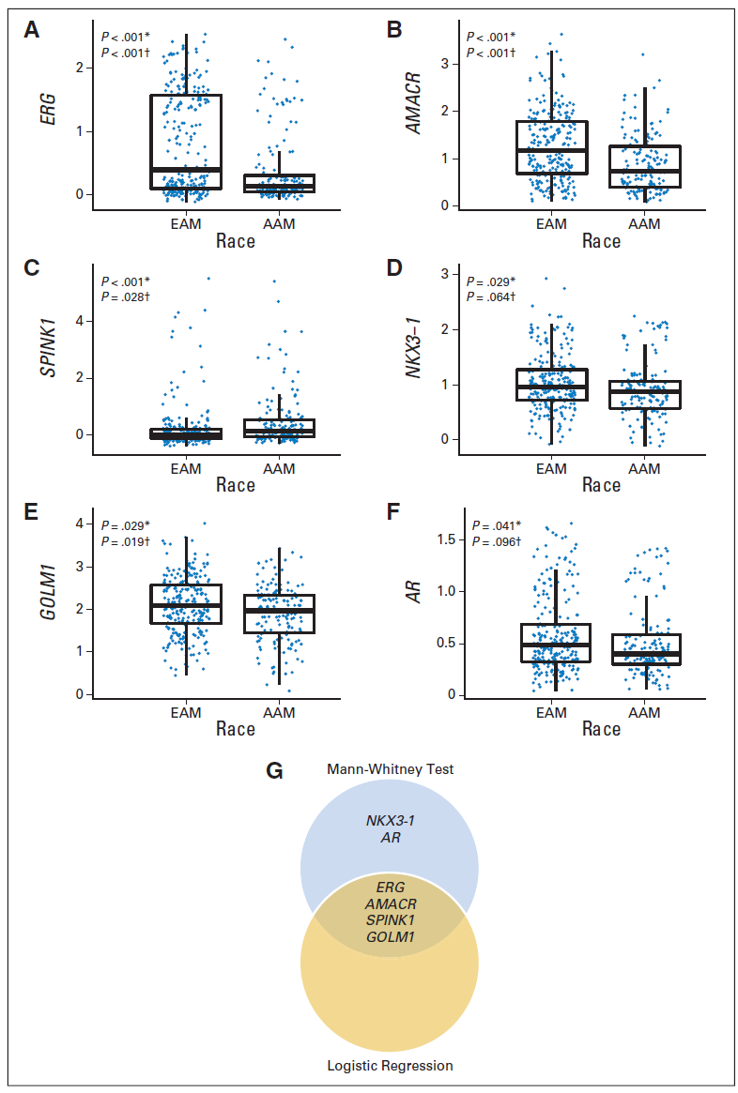
Validation of ERG expression in
AA PCa patients

Slide 13
An Inflammation and Interferon Signature in Prostate Tumors of African-American Men
Inflammation Signature reported by us: Wallace….Ambs, Cancer Res 2008, 68: 927– 36
“Viral Mimicry” Signature
Tang et al., Clin Cancer Res. 24, 5471-81, 2018
Courtesy of Stefan Ambs

Slide 14
IRDS is Associated with Early Disease Recurrence in the TCGA Prostate Cancer Cohort (n = 491)
Expression of 45 IRDS genes identifies prostate tumors with low (159), medium (270), and high (62) expression of this signature. TCGA cohort: mainly Caucasian men
High IRDS expression in prostate tumors is associated with decreased disease-free survival
Tang et al., Clin Cancer Res. 24, 5471-81, 2018
Courtesy of Stefan Ambs

Slide 15
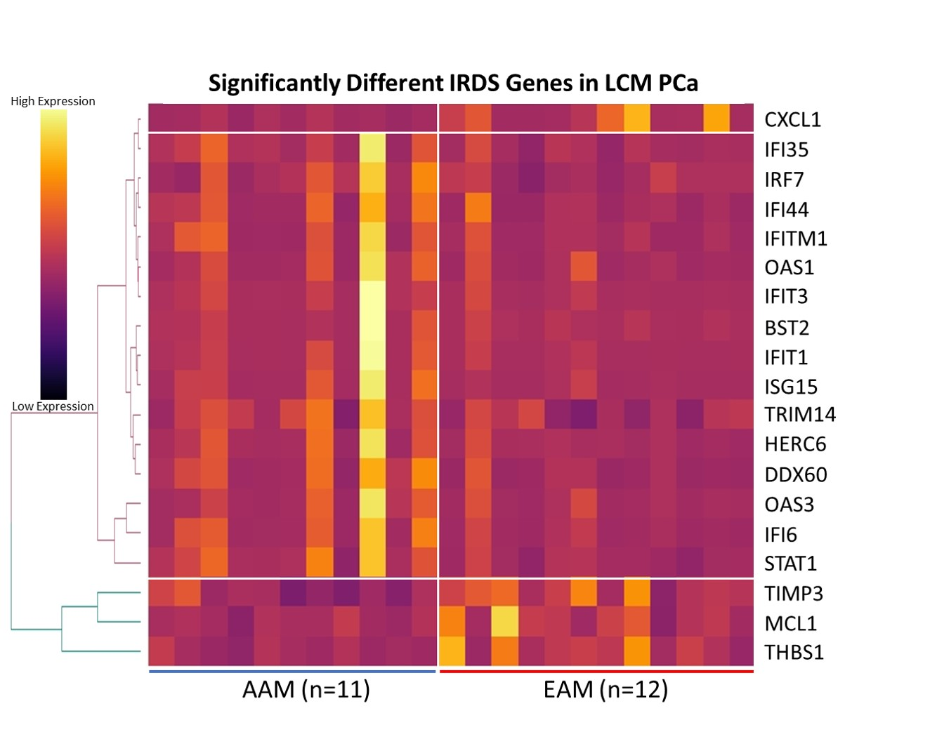
IRDS is Differentially Expressed in African American Prostate Tumors (n =25)
IRDS Genes | DeSeq2 p | DeSeq2 FC
ISG15 | 0.000940029 | 6.034184665
IFIT1 | 0.00100428 | 4.46019197
IFI6 | 0.004205191 | 4.047941765
IFIT3 | 0.005851447 | 3.042716698
BST2 | 0.01141968 | 2.781347555
IFITM1 | 0.012902893 | 2.4880496
HERC6 | 0.005293886 | 2.437905634
OAS1 | 0.043658746 | 2.369190495
OAS3 | 0.031867096 | 2.180944258
DDX60 | 0.00275988 | 2.172941725
IFI44L | 0.112764295 | 2.017033376
IFI44 | 0.036967059 | 1.99418857
STAT1 | 0.001258317 | 1.936523191
MX1 | 0.166720886 | 1.795229649
IFI35 | 0.010137064 | 1.793755047
LAMP3 | 0.171344399 | 1.620838163
USP18 | 0.110273377 | 1.53808785
CXCL10 | 0.151683957 | 1.522655748
IRF7 | 0.023841141 | 1.517336594
OASL | 0.375638271 | 1.333583873
TRIM14 | 0.031407036 | 1.322950288
PLSCR1 | 0.385590137 | 1.25003683
SH3YL1 | 0.271830719 | 1.163053617
ZNF273 | 0.752322256 | 1.049155155
MX2 | 0.895429581 | 1.045794252
LY6E | 0.850753536 | 1.043749734
DCN | 0.92280917 | 1.028784429
HSD17B1 | 0.986106449 | 1.002589777
NEAT1 | 0.941724426 | -1.012899276
LGALS3BP | 0.927415858 | -1.025947271
GALC | 0.515875359 | -1.155480195
RAP2C | 0.080112748 | -1.192463645
IGF2 | 0.59198238 | -1.252196117
CD59 | 0.06725397 | -1.25950305
ROBO1 | 0.261125665 | -1.262485868
RNA-Seq Macro Dissected PCa Tumors
DO NOT POST
Unpublished data generated in Yates lab

Slide 16


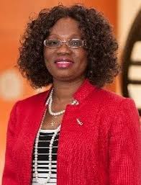

Prostate Cancer Transatlantic Consortium Program
Folakemi Odedina, PhD
Consortium PI & Director
Clayton Yates, PhD
Consortium co- PI & Director
Unique paradigm in understanding prostate cancer in people of African Ancestry

Slide 17
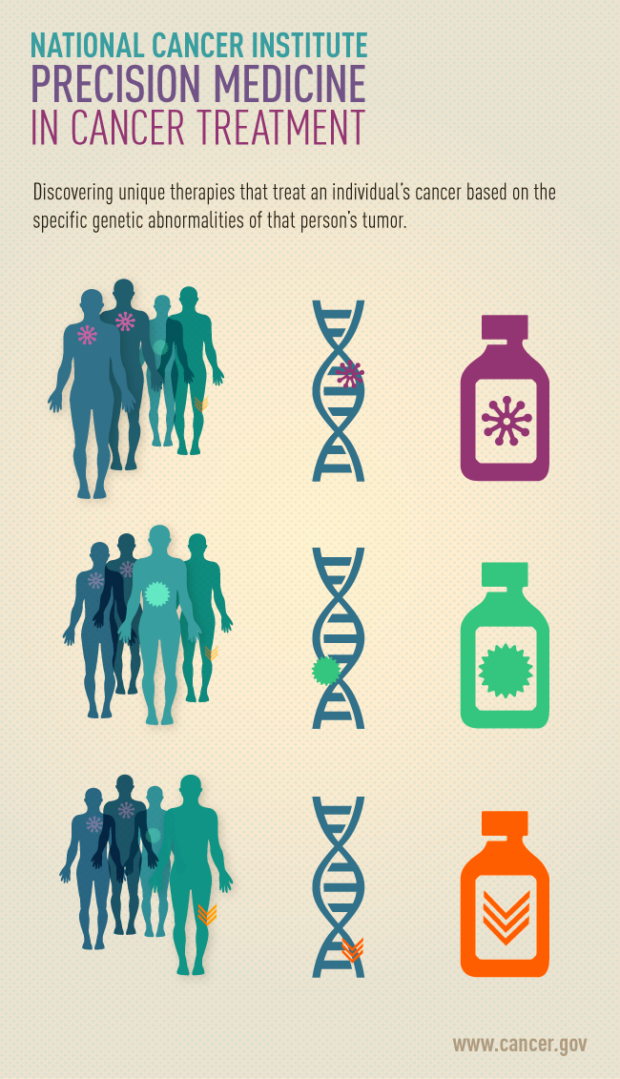
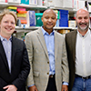
A Precision Medicine Study of How Inflammation May Underlie the Excessive Burden of Prostate Cancer in Men of African Ancestry
Department of Defense Congressionally Medical Directed Research Programs
IMPACT Award
What is Precision Medicine?
Overall Goal-Precision Medicine for Black Men
“Our objective is to find genes in Africans and African Americans so we can use the right drug to treat these men who suffer from prostate cancer the most”
Study Design: In collaboration with intramural scientist at the National Cancer Institute (NCI), we will study if there is a specific inflammation associated gene signature in over 3000 men of West African ancestry from US, Ghana, and Nigeria. We will perform Next Generation Sequencing 300 men to determine the gene profile of these patients and relate it US Black men with Prostate Cancer
Principle Investigator Team at NIH/NCI (Michael Cook and Stefan Ambs) and Tuskegee University (Clayton Yates)
Matching Drugs to a Person’s Genes

Slide 18
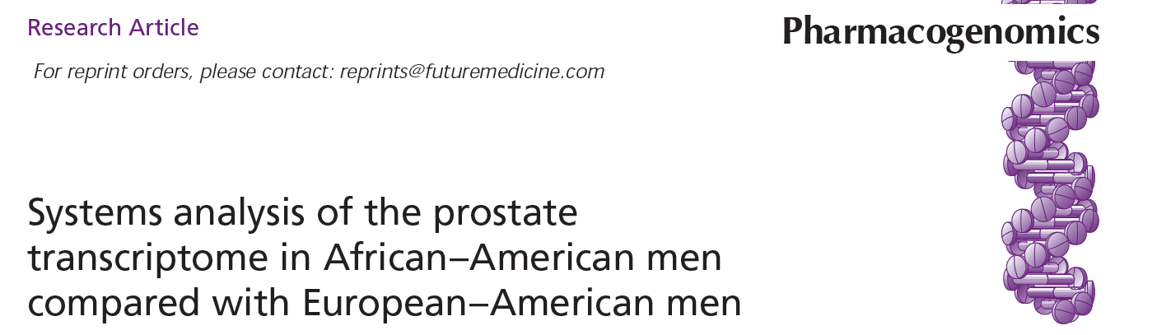
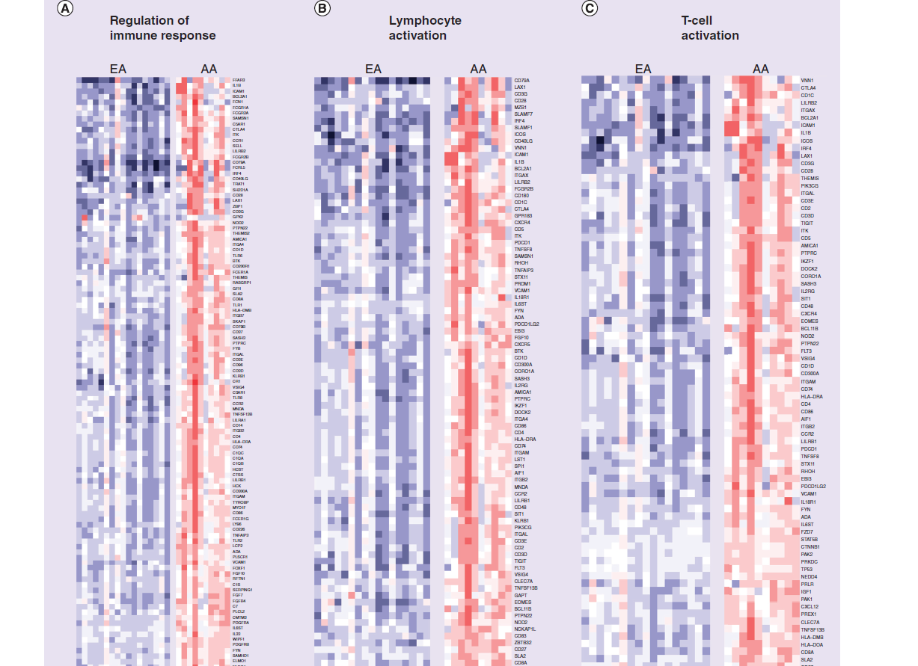
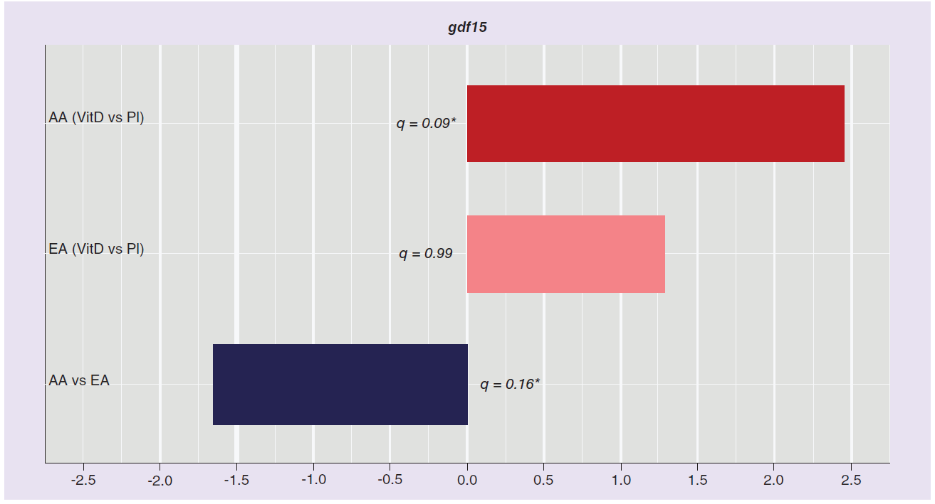
Vit-D reversed the immune signatures and aggressiveness in AA patients
AA Patients Receiving Vitamin D (VitD) prior to Surgery
AA = African American EA= European American
Hardman et al Pharmacogenomics. 2016 Jul;17(10):1129-1143.

Slide 19
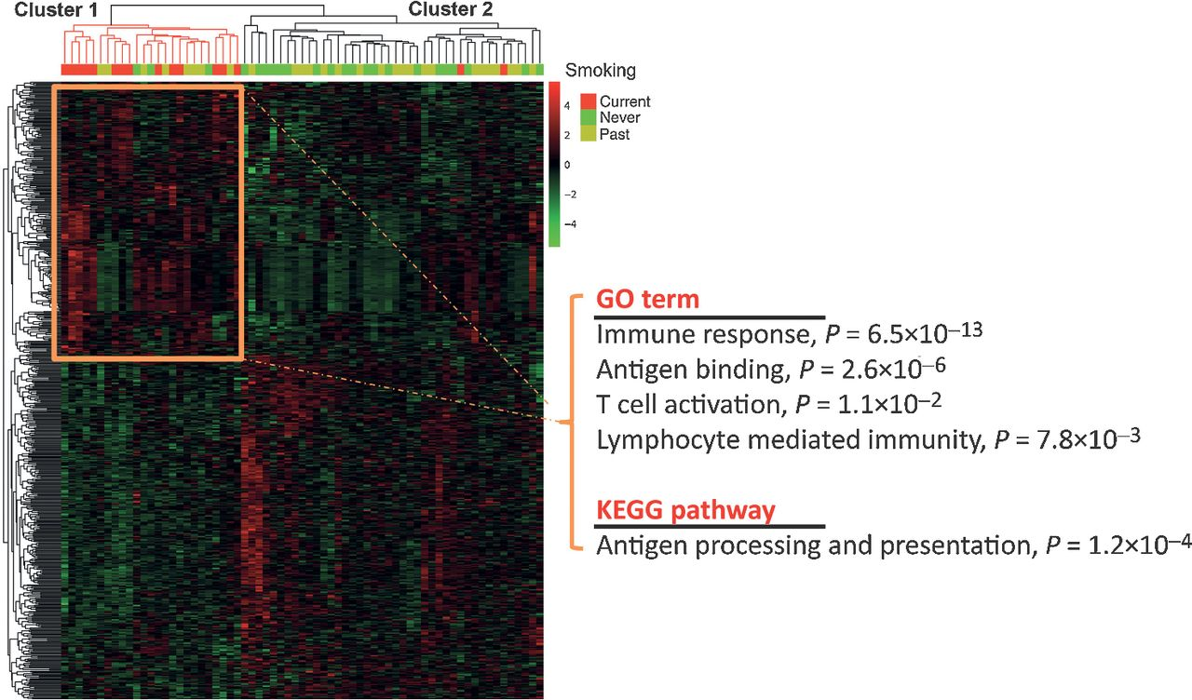
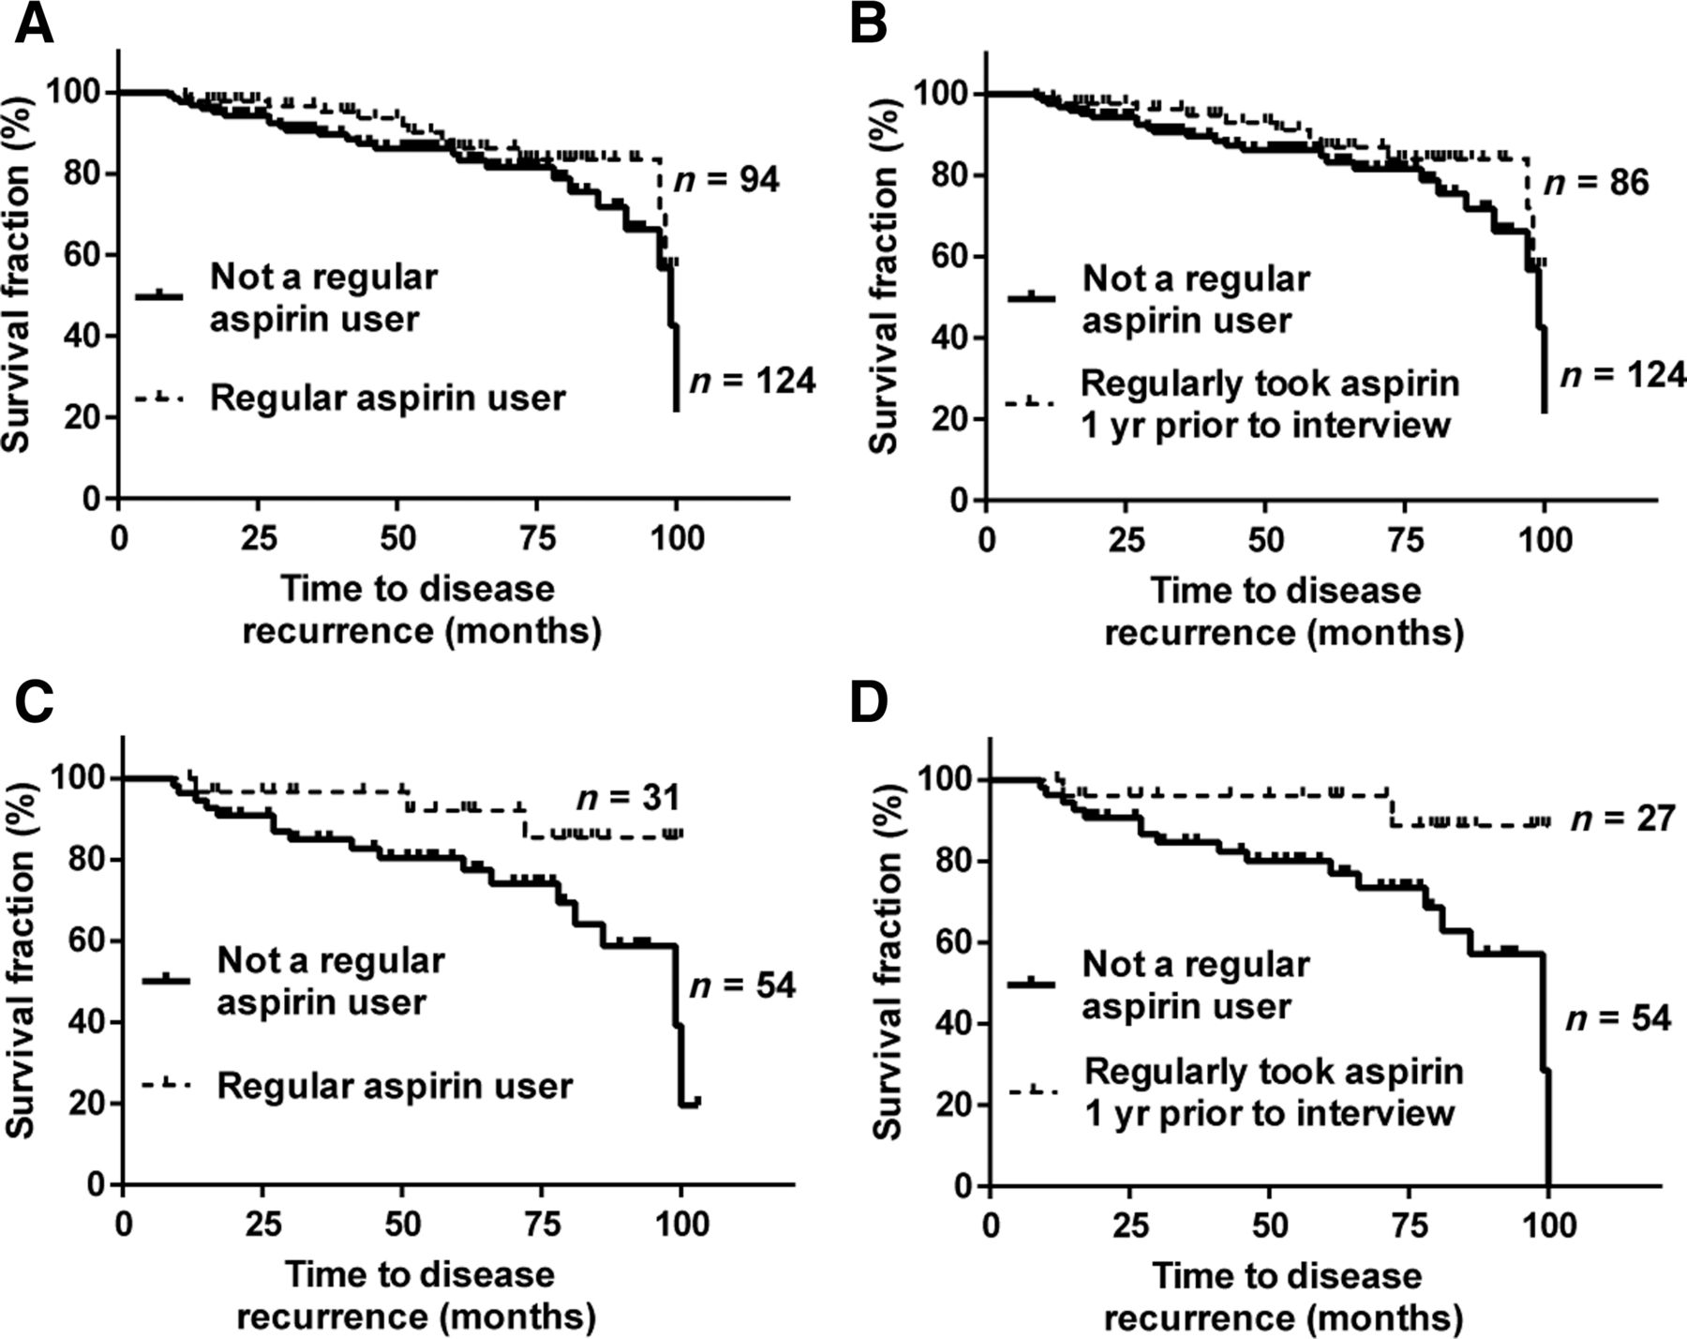
Regular aspirin use decreases diseases immune-related pathways in
AA men and smokers
African American Men with Prostate Cancer
Robyn L. Prueitt et al. Cancer Res 2016;76:1055-1065
Cheryl Jacobs Smith et al. Cancer Epidemiol Biomarkers Prev 2017;26:845-853
Notes:
Upregulation of genes in immune-related pathways is a characteristic of tumors from current smokers. Hierarchical cluster analysis with 601 probesets representing genes that were differentially expressed between current versus past and current versus past/never smokers. The expression pattern of these genes separates the 67 tumors (16 current, 28 past, and 23 never smokers) into two clusters. Cluster 1 represents tumors with upregulated expression of immune response–related genes as shown by the Gene Ontology (GO) term and Kyoto Encyclopedia of Genes and Genomes (KEGG) pathway association. This cluster is highly enriched for tumors from current smokers (P < 0.001). Overexpressed genes in cluster 2 did not have a significant pathway or GO term association.

Slide 20
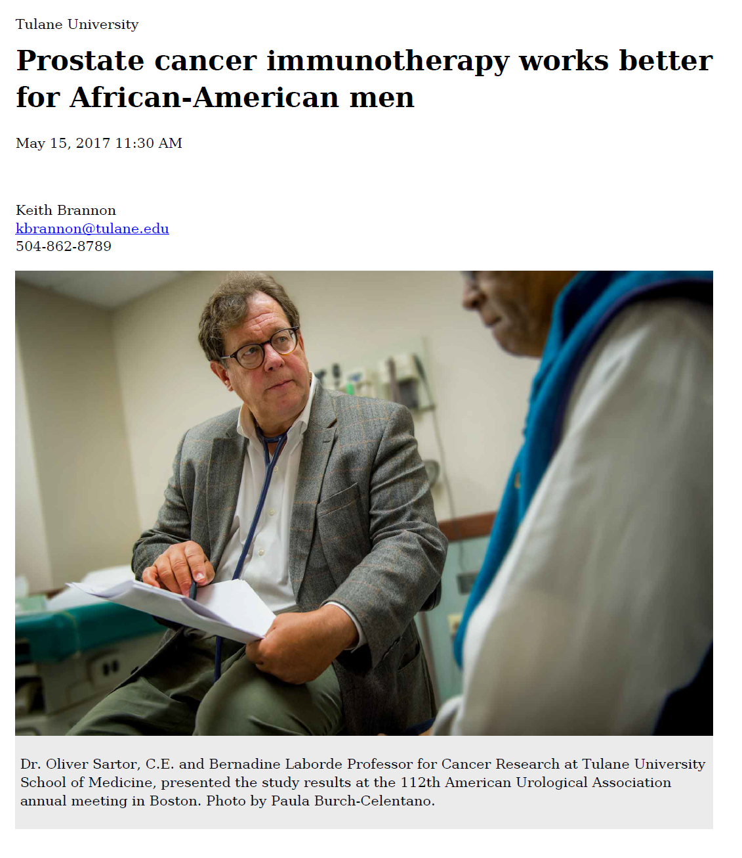
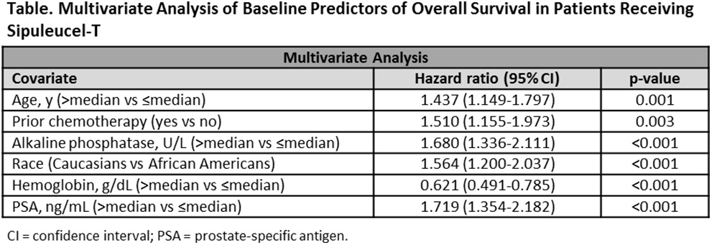
A Registry of Provenge Therapy in Men With Advanced Prostate Cancer (PROCEED)
"These new findings are very encouraging given that African-American men with prostate cancer have a mortality rate more than twice as high as Caucasian men.“ Dr. Oliver Sartor
The Journal of Urology 2017 197, e456-e457DOI: (10.1016/j.juro.2017.02.1089)

